Slide 1
Ethical Control of Unmanned Systems Mission Design, Semantic Web Exemplars and Data-Centric Security Considerations for Human Supervision of Lethal/Lifesaving Autonomy
Don Brutzman, Curt Blais and Bob McGhee
Naval Postgraduate School (NPS)
9 August 2022
Notes:
Distribution is unrestricted. See Open-Source License for Ethical Control for details controlling this work.

Slide 2
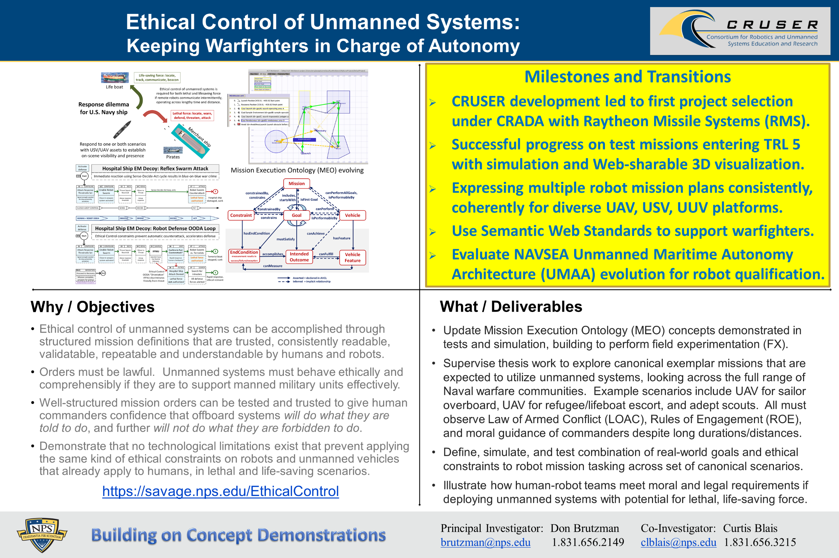
Ethical Control quad chart

Slide 3
Synopsis: Ethical Control of Unmanned Systems
Project Motivation: ethically constrained control of unmanned systems and robot missions by human supervisors and warfighters.
Precept: well-structured mission orders can be syntactically and semantically validated to give human commanders confidence that offboard systems
will do what they are told to do, and further
will not do what they are forbidden to do.
Project Goal: apply Semantic Web ontology to scenario goals and constraints for logical validation that human-approved mission orders for robots are semantically coherent, precise, unambiguous, and without internal contradictions.
Long-term Objective: demonstrate that no technological limitations exist that prevent applying the same kind of ethical constraints on robots and unmanned vehicles that already apply to human beings.
Paraphrase: can qualified robots correctly follow human orders?

Slide 4
Table of Contents
Flyer and Synopsis
Background History
Mission Representation using Autonomous Vehicle Command Language (AVCL)
Semantic Web and Mission Execution Ontology (MEO)
Ethical Control Mission Design
Exemplar Missions
Multiple Programming Languages
Simulation and Visualization
Data-Centric Security and Trust
Related Ethical Activities
Related Resources of Interest
Conclusions and Recommendations
Contact

Slide 5
Open-Source Licensing for Ethical Control
All NPS work is published as open source with no restrictions on use.
https://savage.nps.edu/EthicalControl/license.html (also .txt)
An excellent heuristic is to assume success – then what?
Ethical Control of unmanned systems is critically important worldwide.
Ethical Control must be unambiguously defined in order to be actionable by humans (military professionals) under all conditions facing U.S. military.
Ethical Control must be implementable across a totally diverse set of evolving unmanned and C2 systems (both open and closed) in order to be effective.
Ethical Control concepts, syntax definitions and semantic relationships for lethal/lifesaving force thus cannot be subject to proprietary restrictions.

Slide 6
Background History
Many years of work have composed multiple fields of study to provide techniques for maintaining human ethical control of unmanned systems.
In this work, ethical theory meets professional practice. Each step must work for human commanders and unmanned systems alike.

Slide 7
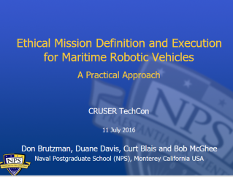
Key Insights regarding Human Ethical Control
Humans in military units are able to deal with moral challenges without ethical quandaries,
by using formally qualified experience, and by following mission orders that comply with Rules of Engagement (ROE) and Laws of Armed Conflict (LOAC).
Ethical behaviors don’t define the mission plan. Instead, ethical constraints inform the mission plan.
Naval forces can only command mission orders that are
Understandable by (legally culpable) humans, then
Reliably and safely executed by robots.
Reference: CRUSER TechCon Overview 2016
https://gitlab.nps.edu/Savage/EthicalControl/tree/master/documents/presentations
Notes:
Laws of Armed Conflict (LOAC) are also referred to as International Humanitarian Law (IHL).

Slide 8
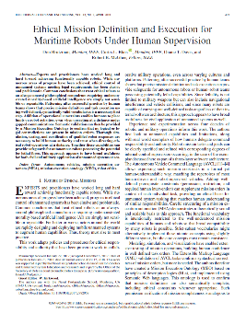
Ethical Mission Definition and Execution for Maritime Robots Under Human Supervision
Theoretical Basis
Don Brutzman, Curtis L. Blais, Duane T. Davis, Robert B. McGhee
IEEE Journal of Oceanic Engineering (JOE), Volume: 43 , Issue: 2 , April 2018
Abstract. Experts and practitioners have worked long and hard toward achieving functionally capable robots. While numerous areas of progress have been achieved, ethical control of unmanned systems meeting legal requirements has been elusive and problematic. Common conclusions that treat ethical robots as an always-amoral philosophical conundrum requiring undemonstrated morality-based artificial intelligence are simply not sensible or repeatable. Patterning after successful practice by human teams shows that precise mission definition and task execution using well-defined, syntactically valid vocabularies is a necessary first step. Addition of operational constraints enables humans to place limits on robot activities, even when operating at a distance under gapped communications. Semantic validation can then be provided by a Mission Execution Ontology to confirm that no logical or legal contradictions are present in mission orders. Thorough simulation, testing, and certification of qualified robot responses are necessary to build human authority and trust when directing ethical robot operations at a distance. Together these capabilities can provide safeguards for autonomous robots possessing the potential for lethal force. This approach appears to have broad usefulness for both civil and military application of unmanned systems at sea.
Notes:
https://ieeexplore.ieee.org/document/8265218

Slide 9
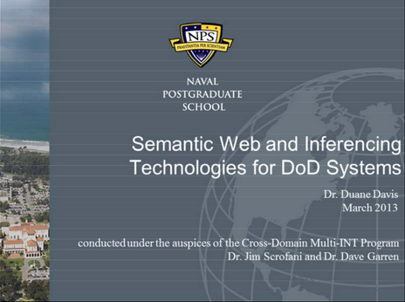
Semantic Web and inferencing technologies for Department of Defense systems
Duane Davis, NPS Technical Report NPS-CMIS-14-001, 2014
Available via https://calhoun.nps.edu/handle/10945/43723 (report) (slideset)
Abstract. Operational commanders and intelligence professionals are provided with a continually-increasing volume of data from numerous sources. Effective utilization of this data can be hampered by difficulties in fusing different data streams for presentation, correlating related data from various sources and developing reliable summary and predictive products. An opportunity presently exists to improve this situation through the incorporation of Semantic Web technologies into Department of Defense (DOD) systems. This report provides a didactic overview of Description Logics (DL) and their implementation in Semantic Web languages and technologies to include the mathematical properties supporting robust knowledge representation. Subsequently, the algorithms for automated reasoning and inferencing with DLs are discussed. Included in this discussion is a comparison of available Semantic Web applications for ontology development and realization or DL reasoning capabilities with real-world knowledge bases. Finally, mechanisms for applying artificial intelligence techniques to ontological DL information are presented.

Slide 10
Description Logic (DL) Rules provide basis for Mission Execution Ontology (MEO)
Rules | Description Logic Equations | Plain-language description
M = Mission Rules
M1 | Mission ⊑ ∀startsWith.Goal ⊓ =1startsWith.Goal | A Mission can only start with a Goal and must start with exactly one Goal
M2 | Mission ⊑ ∀includes.Goal ⊓ ≥1includes.Goal | A Mission can only include Goals and must include one of more Goals
M3 | Mission ⊑ ∀hasConstraint.Constraint | A Mission can only be constrained by Constraints
M4 | startsWith ⊑ includes | A Mission must include the Goal that it starts with
M5 | Mission ⊑ ∀performableBy.Vehicle | A Mission can only be performed by a Vehicle
M6 | Cannot be expressed in DL | A Mission cannot be performable by a Vehicle unless that Vehicle has the ability to identify all Constraints associated with that mission
M7 | Cannot be expressed in DL | A Mission cannot be performable by a Vehicle unless that Vehicle has the capability to accomplish all Goals included in that Mission
Excerpted from full
Mission Execution Ontology Decision Logic Tables
Original author:
Duane Davis

Slide 11
NPS contributions toward achieving run-time ethical constraints in mission execution by autonomous robots and human/robot teams 1
History
1. NPS began research on autonomous underwater vehicles (AUV) in the early 1990's. The first vehicle, tested at sea in the mid-1990's, was "Phoenix". This vehicle length was around 6 ft., weight approximately 600 lb. At that time, the onboard control system was called RBM for "Rational Behavior Model". RBM was modeled on standard naval practice for deployment and operation of manned submarines at the time.
2. The top level of the three layer RBM software architecture assumed that AI was required to replace the function of a submarine commander. Specifically, we believed that first order logic (predicate calculus) would be needed for mathematical modeling and programming of a commander's function. Therefore a separate "SPARC" workstation running "Prolog" language was included in Phoenix. RBM functioned well in Phoenix at sea testing.
3. In early 2000's, Phoenix was replaced by a larger vehicle called "Aries", that contained a more advanced on board sensor suite, larger batteries, and more powerful main propulsion thrusters. Aries was about 1000 lb. in weight and 8 feet long, and capable of longer duration and more complex missions than its predecessor. Experience with Phoenix led us to full practical realization that mission control based on human style reasoning (predicate logic) cannot, (in general) be proved correct for a given mission. Fortunately, we also came to realize that "finite state" logic is adequate for any mission control tasks we actually anticipated carrying out by autonomous vehicles. In contrast to our experience with Phoenix, for Aries we were able to prove by exhaustion of all possible outcomes that its missions were correctly programmed (that is, that they accomplished what we intended). Aries was a success, and was retired after completion of all planned mission tasks. All results were published.

Slide 12
NPS contributions toward achieving run-time ethical constraints in mission execution by autonomous robots and human/robot teams 2
History
4. Early in the current decade, we began to realize that responsible experimentation with larger and more powerful robots (AUVs or others) would require that some run-time ethical constraints be incorporated into their mission control software. This was not done for Phoenix or Aries. As we addressed this requirement, it become apparent to us that inclusion of such constraints requires a possible "exception" outcome of execution of a mission phase goal (command) in addition to the "success" and "failure" outcomes we had previously considered. This understanding was summarized in our 2018 JOE paper that was based on such "tri-state" logic.
5. Since publication of our 2018 paper, we have been concerned with implementation details for tri-state mission logic for autonomous robots and human/robot teams. To date, we have demonstrated, in human interactive form, execution of a simulated 8-state "sailor overboard" mission by a human/robot team, using either Prolog or Common Lisp as a programming language. We expect soon to complete an XML implementation.
6. A key aspect of tri-state logic, including possible violation of an ethical constraint, either pending or actual, is the need for constant situational awareness by mission control software. We believe that mandating this type of software for mission control could possibly have prevented loss of human life in recent passenger aircraft and self-driving car accidents. We urge further research on this issue ASAP.
-- Robert McGhee, NPS, December 2019

Slide 13
Mission Representation using Autonomous Vehicle Command Language (AVCL)
Structured vocabulary to define unmanned-system missions, understandable by human commanders, useful in multiple programming languages plus Semantic Web logical queries.

Slide 14
Autonomous Vehicle Command Language (AVCL)
AVCL is a command and control language for humans supervising autonomous unmanned vehicles.
Clarity arises from close correspondence to human naval terminology.
Structured vocabulary defining terms and relationships for mission planning, execution, conduct, recording and replay across diverse robot types.
Common-ground XML representations for
Mission agenda plans, mission scripts, and post-mission recorded telemetry results.
Future work: defining unit tests and expected results for verification and validation.
Operators have single archivable, validatable format for robot tasking, results
directly convertible to and from a wide variety of different robot command languages.
Mission Tasking
https://savage.nps.edu/Savage/AuvWorkbench/AVCL/AVCL.html

Slide 15
Example AVCL mission agenda, as pseudo-code XML
<?xml version="1.0" encoding="UTF-8"?>
<UUVMission>
<GoalSet>
<Goal area=”A” id=”goal1”>
<Search nextOnSuccess=”goal2” nextOnFailure=”goal3”/>
</Goal>
<Goal area=”A” id=”goal2”>
<SampleEnvironment nextOnSuccess=”goal3”
nextOnFailure=”recover”/>
</Goal>
<Goal area=”B” id=”goal3”>
<Search nextOnSuccess=”goal4” nextOnFailure=”goal4”/>
</Goal>
<Goal area=”C” id=”goal4”>
<Rendezvous nextOnSuccess=”recover” nextOnFailure=”recover”/>
</Goal>
<Goal area=”recoveryPosition” id=”recover”>
<Transit nextOnSuccess=”missionComplete” nextOnFailure=”missionAbort”/>
</Goal>
</GoalSet>
</UUVMission>
AVCL is readable by human or robot,
captures logic of mission tasking
XML ensures syntactically correct, well-defined, numerically valid
Needed: semantic representation
to check ethical, logical consistency

Slide 16
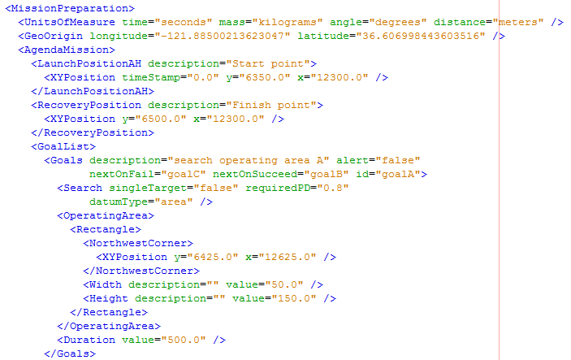
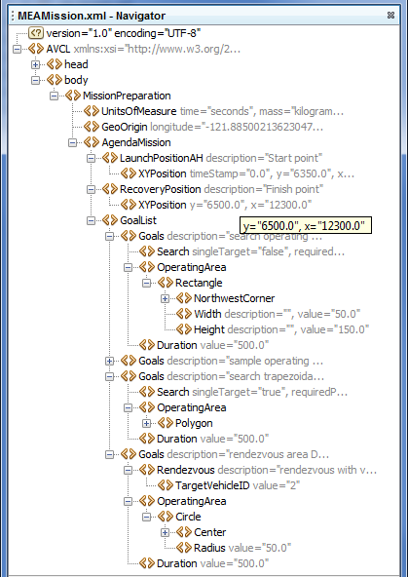
Corresponding example: MEAMission.xml using AVCL document

Slide 17

NPS Dissertation: AVCL mission vocabulary
Design, implementation and testing of a common data model
supporting autonomous vehicle compatibility and interoperability
Duane T. Davis, Naval Postgraduate School (NPS), September 2006
Abstract. Current autonomous vehicle interoperability is limited by vehicle-specific data formats and support systems. Until a standardized approach to autonomous vehicle command and control is adopted, true interoperability will remain elusive. This work explores the applicability of a data model supporting arbitrary vehicles using the Extensible Markup Language (XML). An exemplar, the Autonomous Vehicle Command Language (AVCL), encapsulates behavior-scripted mission definition, goalbased mission definition, inter-vehicle communication, and mission results. Broad applicability is obtained through the development of a behavior set capturing arbitrary vehicle activities, and automated conversion of AVCL to and from vehicle-specific formats. The former uses task-level behaviors suitable for mission scripting and goal decomposition. Translations use the Extensible Stylesheet Language for Transformation, XML data binding, context-free language parsing, and artificial intelligence machine learning and search techniques. Translation capability is demonstrated through mappings of AVCL to and from multiple vehicle-specific formats. A final demonstration of the power of a common autonomous vehicle data model is provided by the implementation of a hybrid control architecture. The model's vehicle-independence and the ability to generate vehicle-specific data are leveraged in the design of an architecture that provides increased autonomy by augmenting a vehicle's existing controller. The utility of this architecture is demonstrated through implementation on the Naval Postgraduate School's ARIES Unmanned Underwater Vehicle.
Semantic Web Deep Dive

Slide 18
AVCL mission goals vocabulary (Davis 2015)
AVCL mission goals | Define | Used | Definition
Attack | partial | √ | To conduct a type of offensive action characterized by employment of firepower and maneuver to close with and destroy an enemy.
Decontaminate | √ |  | To provide purification making an area safe by absorbing, destroying, neutralizing, making harmless, or removing chemical, biological, or nuclear contamination.
Demolish | √ |  | To destroy structures, facilities, or material by any available means.
IlluminateArea | √ |  | To provide locale lighting by searchlight or pyrotechnics.
Jam | √ |  | To deliberately radiate, re-radiate or reflect electromagnetic energy with the object of impairing the use of electronic devices or systems.
MarkTarget | √ | √ | To make visible (by the use of light, infrared, laser, smoke, etc.) of an object in order to allow its identification by another object.
MonitorTransmissions | √ | √ | To conduct electronic warfare support operations with a view to searching, locating, recording and analyzing radiated electromagnetic energy.
Patrol | √ | √ | To gather information or carry out a security mission.
Rendezvous | √ | Partial | Achieve a meeting at a specified time and place.
Reposition | √ | √ | To change position from one location to another.
SampleEnvironment | Partial | √ | Collect environmental samples for testing for chemical compounds, biological creatures, or nuclear hazards.
Search | √ | √ | To look for lost or unlocated objects or persons.
More
Goal Types Foreseen

Slide 19
Semantic Web and Mission Execution Ontology (MEO)
Apply well-developed Semantic Web standards to integrate queries and reasoning to AVCL for logical consistency checks.

Slide 20
Background: Improving Semantic Representation
Knowledge Representation (KR) is an area of artificial intelligence (AI) research and practice focused on encoding meaning into data.
Academia and industry now have a detailed path toward higher levels of machine understanding corresponding to human understanding.
Refer to the Ontology Spectrum on the next slide (source: Obrst, Leo, and Mills Davis. 2006. SICoP White Paper Series Module 2: Semantic Wave 2006 - Executive Guide to the Business Value of Semantic Technologies, Project 10X, May 2015).
Acronyms: Database (DB) ; Extensible Markup Language (XML); Resource Description Language / Schema (RDF/S); Unified Modeling Language (UML); Web Ontology Language (OWL)

Slide 21
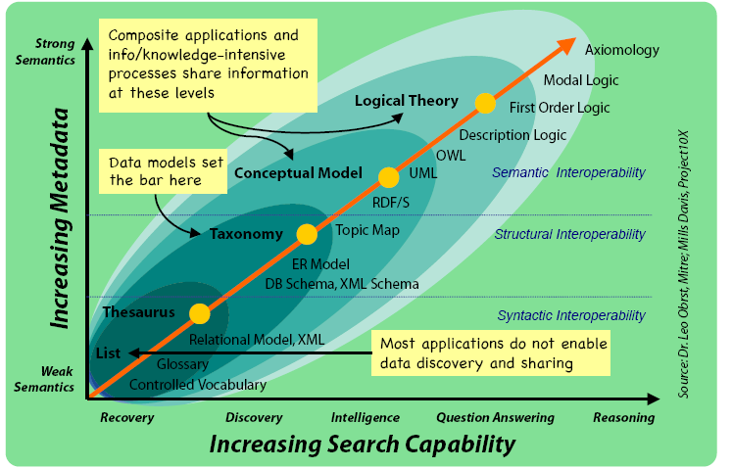
Ontology Spectrum
Improving Semantic Representation

Slide 22
Background: Improving Interoperability
Interoperability: “the capability of a system to automatically, without human intervention, provide services to and accept services from other systems, and to use the services so exchanged to enable the systems to work together to achieve a desired outcome” (Blais and Lacy 2004).
Academia and industry have laid out a path toward higher levels of interoperability: refer to the Levels of Conceptual Interoperability Model (LCIM) on the next slide (source: Tolk, Andreas, Saikou Y. Diallo, Charles D. Turnitsa, and Leslie S. Winters. 2006. “Composable M&S Web Services for Net-centric Applications.” Journal for Defense Modeling & Simulation (JDMS), 3:1:27-44. January.).
Objective is to achieve conceptual and pragmatic interoperability.

Slide 23
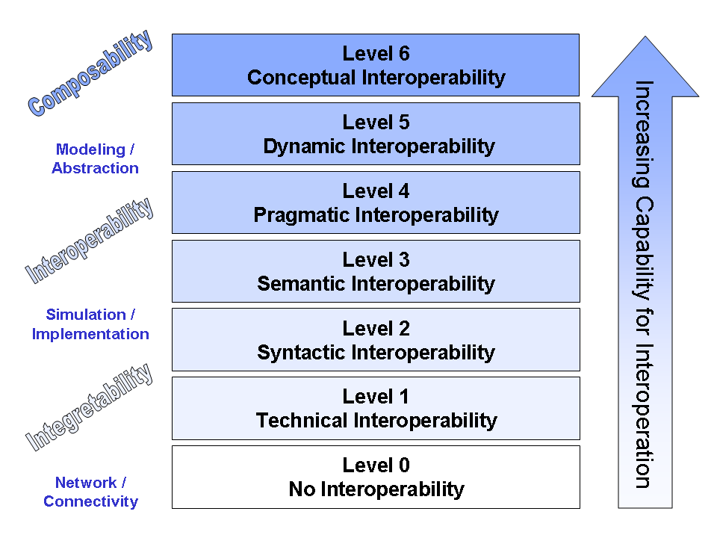
Levels of Conceptual Interoperability
Improving Interoperability: Levels of Conceptual Interoperability Model
Integratability

Slide 24
Background: Semantic Web
Architects of the World Wide Web have laid out a layered set of standards to achieve the Semantic Web vision: “not a separate Web but an extension of the current one, in which information is given well-defined meaning, better enabling computers and people to work in cooperation” (Berners-Lee et al. 2001)
Ultimate goal: achieve a scalable trusted information infrastructure where humans and software interact meaningfully, in a repeatable environment where expectations of quality and integrity are met.
Scalable approach indicates that single (ship + robot) solutions have potential to grow and encompass many simultaneous systems, thus improved data sharing, mission deconfliction, coordinated operations

Slide 25
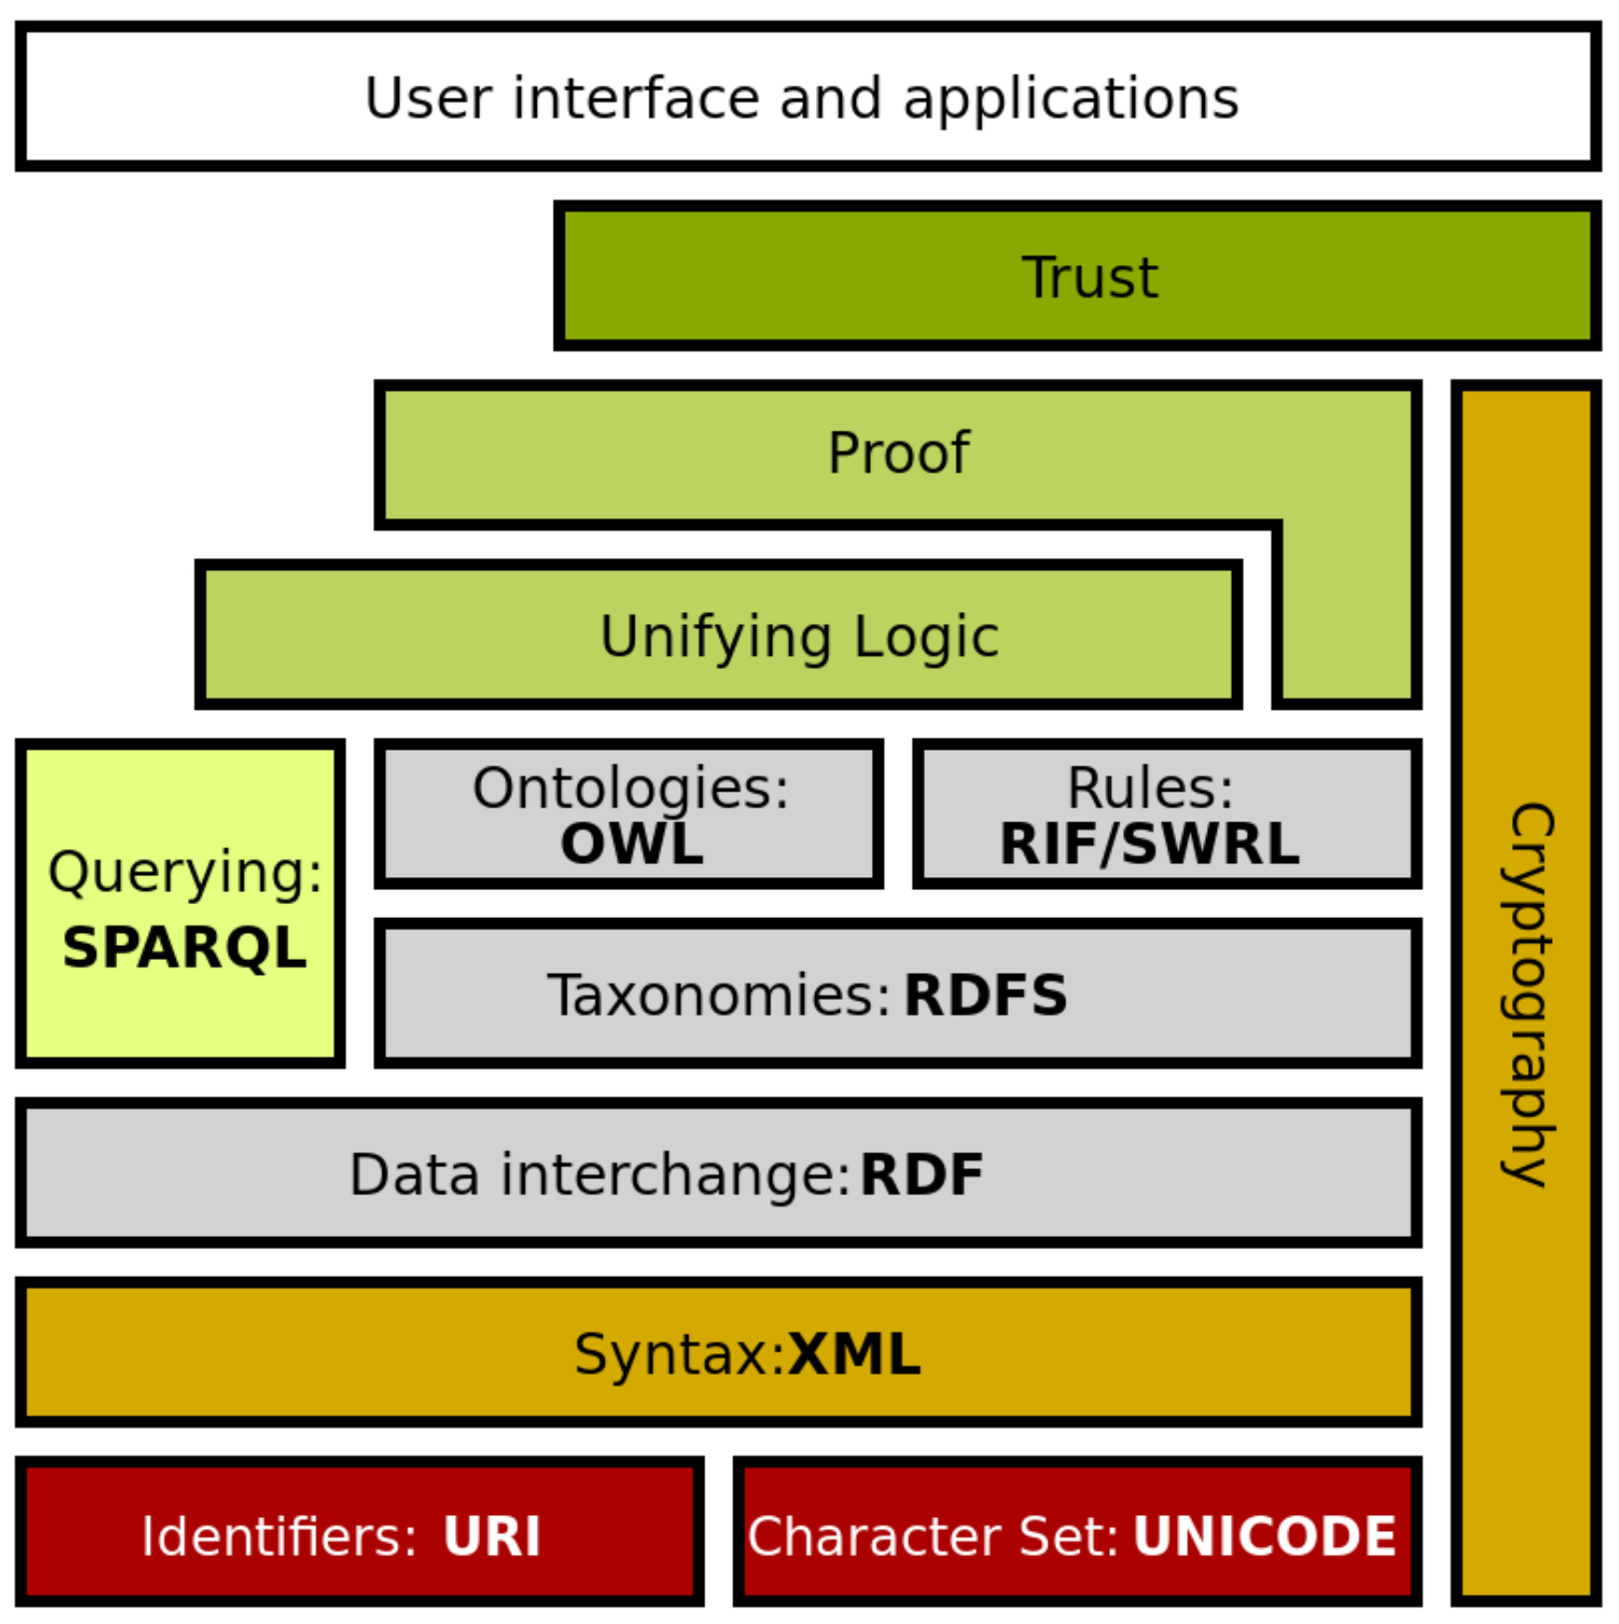
Semantic Web Stack
Extends larger Web architecture
All of these data languages are approved W3C standards
Proof and unifying logic are mathematically well defined
Trusting derived (composed) statements arises from
Encryption + digital signature confirms trusted data sources
Formal logic is basis for deriving new information
Wikipedia: Semantic Web Stack
Of note: this project is exercising every layer of Semantic Web stack.

Slide 26
Motivating insights: converting data into logic
"The answer to your question is the response to the query."
Jim Hendler and Dean Allemang
Meaningfulness of an answer matches the precise meaning of a question.
"Trying to use the Semantic Web without SPARQL is like trying to use a relational database without SQL.“
Tim Berners-Lee
Language representations are needed for query as well as for information.
"The proof of the pudding is in the eating."
Wiktionary
Confidence in results requires testing.
Notes:
X3D Ontology for Semantic Web, https://www.web3d.org/x3d/content/semantics/semantics.html

Slide 27
Mission Execution Ontology (MEO) Development
Define MEO from concepts, properties, relationships using Protégé tool.
Create full set of canonical missions in AVCL (XML).
Determine exemplar mappings for AVCL primitives to Turtle for RDF/OWL.
Write conversion stylesheet AvclToMEO.xslt for full expressiveness.
Convert all AVCL missions to corresponding triples.
Confirm AVCL MEO, missions validate satisfactorily using Protégé, ARQ.
Automate build process as suite of repeatable unit-test queries (log).
Write SPARQL metaqueries to test, document MEO ontology relationships.
In progress: SPARQL queries to test AVCL mission representations in Turtle.

Slide 28
Specific developer build.xml capabilities using Apache Ant
Test and validation utility tasks, release results checked in (build.all.log.txt)
AVCL mission conversion to MEO triples: convertAvclToMeoTurtle.examples.all
AVCL mission conversion to other programming languages: convertAvclToLisp.examples.all, convertAvclToProlog.examples.all
View gitlab.nps.edu site, locally created owldoc, etc.
Perform SPARQL.query.tests (results)
Create downloadable .zip of fully documented archive
Run, test example missions in Lisp, Prolog programming languages
Deploy, publish development site as https://savage.nps.edu/EthicalControl

Slide 29
Mission Execution Ontology (MEO) for Ethical Control of Unmanned Systems in Surrogate Scenarios
Summary of relationships
Autonomous Vehicle Command Language (AVCL) for Missions.
Declarative XML, years of NPS research.
Multiple Mission Representations.
Imperative commands (orders/waypoints/etc.).
Declarative commands (mission goals).
Mission results (order log, telemetry etc.).
Mission metadata for parameters, settings.
Lisp and Prolog examples (Bob McGhee, NPS).
Autonomous Unmanned Vehicle (AUV) Workbench Simulation and Visualization Support
Recently restored, debug testing commenced.
AVCL 2.1 is prior published version, centered on syntactic validation, solo robot operations.
AVCL 3.0 is new working version for testing range of multi-participant missions.
Mission Execution Ontology (MEO) for Semantic Validation
Semantic Web framework of rules, relationships for ethical validation.
Initial examples in IEEE JOE paper.
Retested using current Protégé, Jena tools.
Sailor Overboard and Other Missions
Hand-crafted triples using Turtle syntax.
Beginning to build unit testing framework.
Confirming correlation of AVCL information model to existing MEO ontology.
Automatic conversion of AVCL missions to match, thus accelerating multiple-mission testing on diverse systems.
Visualization, reporting via AUV Workbench can aid understanding, mission planning and further progress.

Slide 30
Unmanned Vehicle Mission Execution Ontology (MEO)
Concepts
Roles
Mission
Dashes indicate roles or concepts defined in terms of other roles or concepts
has_constraint
applies_to
can_perform
performable_by
starts_with
includes
is_next
Constraint
applies_to
Goal
has_capability
Vehicle
end_state
follows
can_identify
has_feature
End_ Condition
requires
meets_requirement
Goal_ Requirement
can_fulfill
Vehicle_ Feature
can_test
Original design
15 October 2014

Slide 31
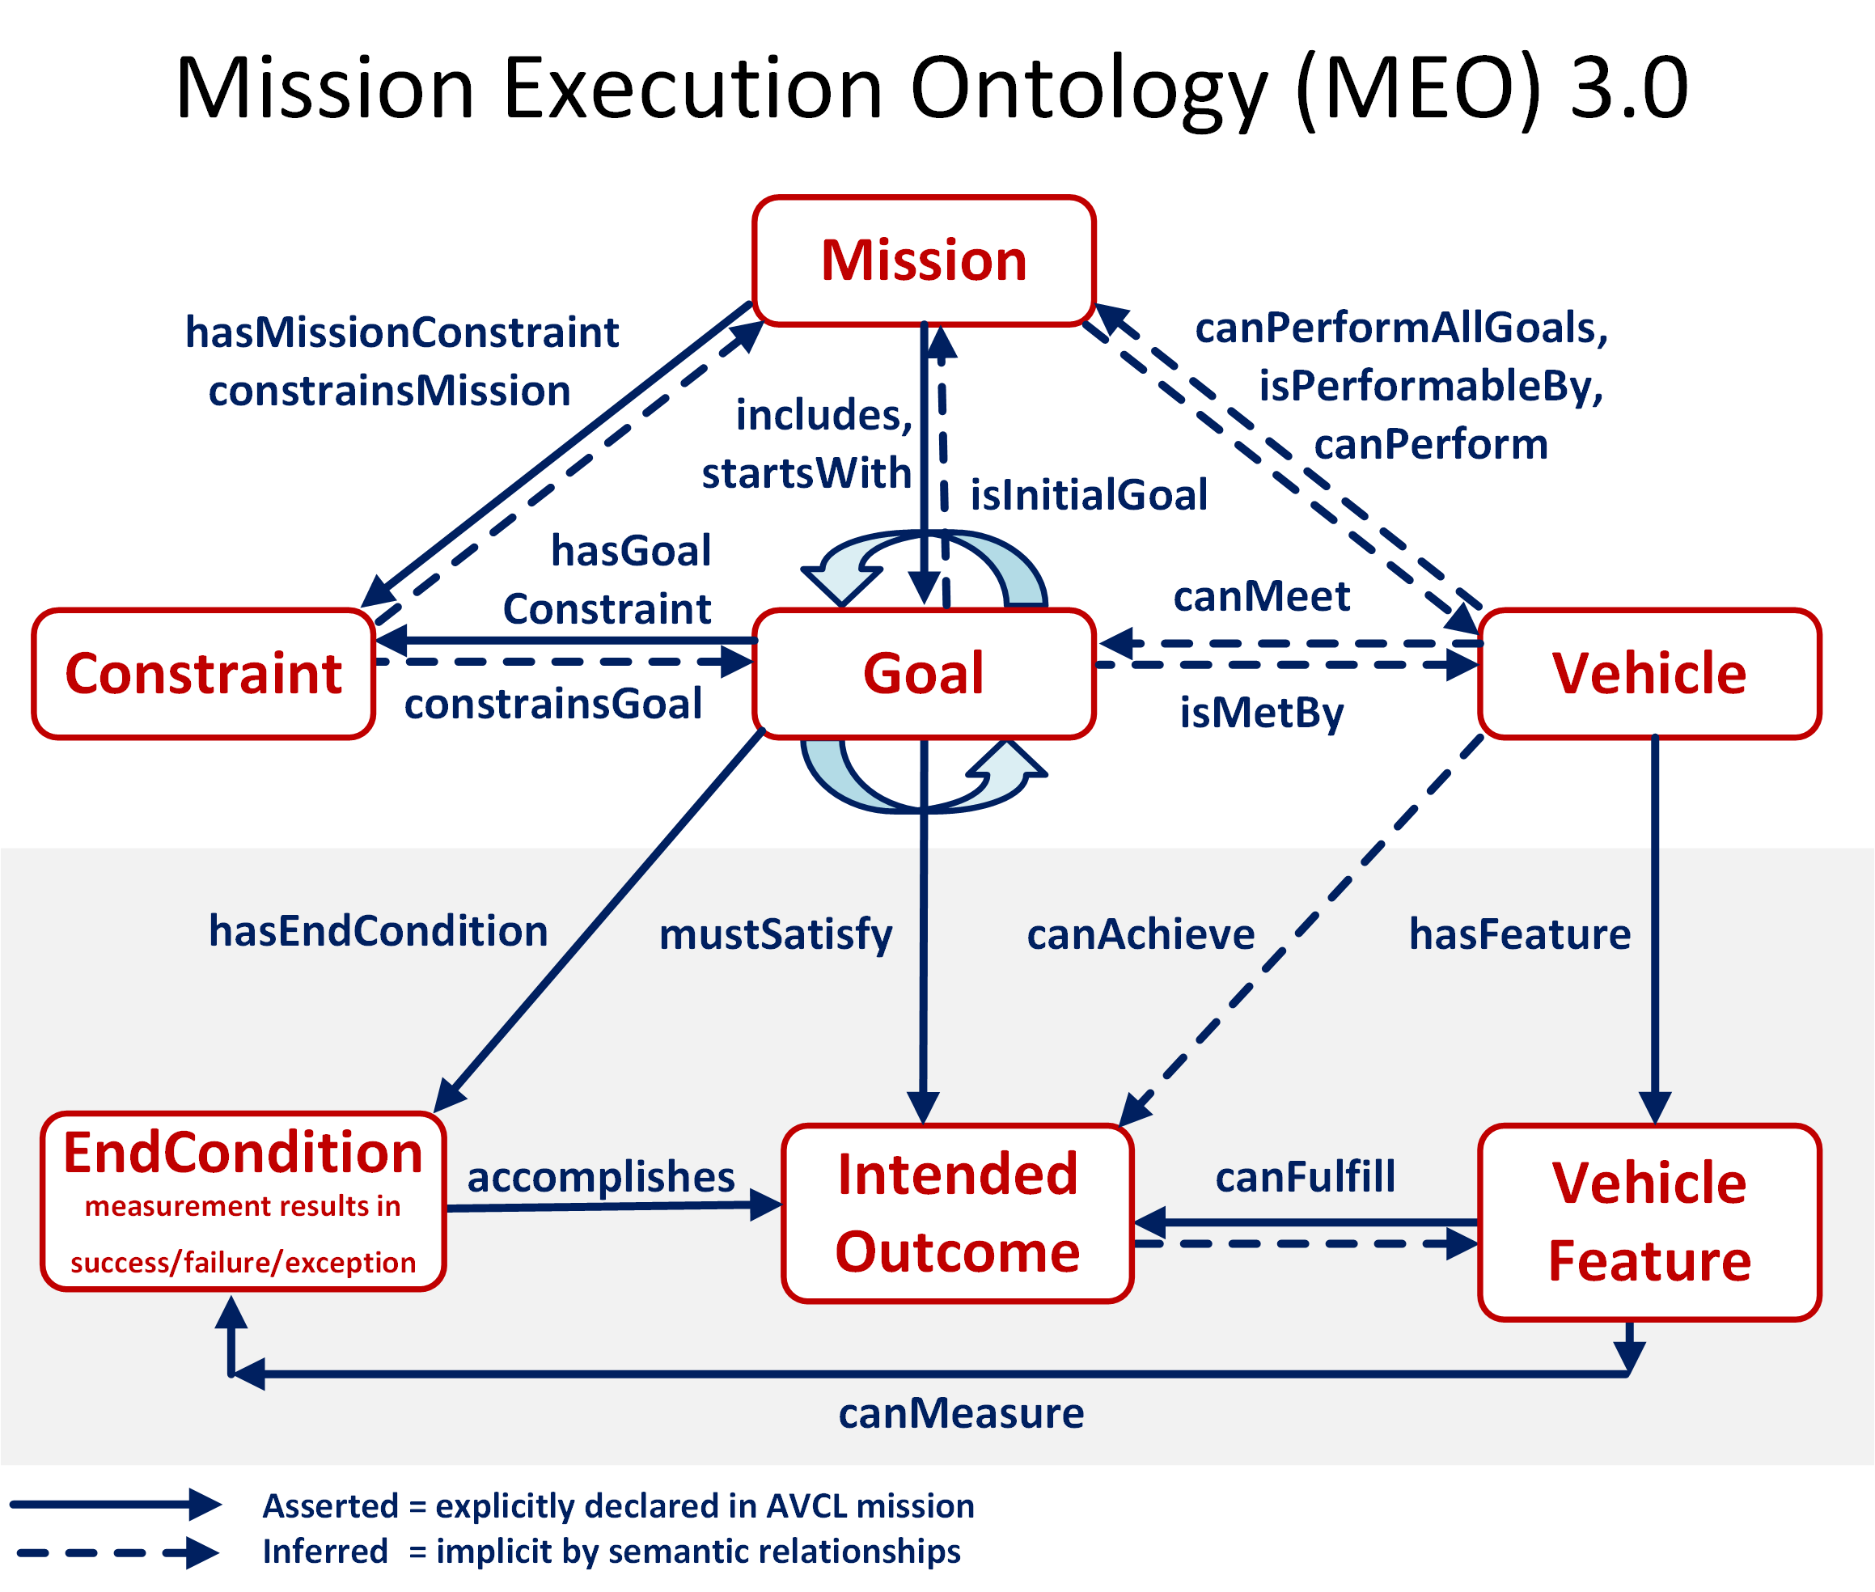

Slide 32
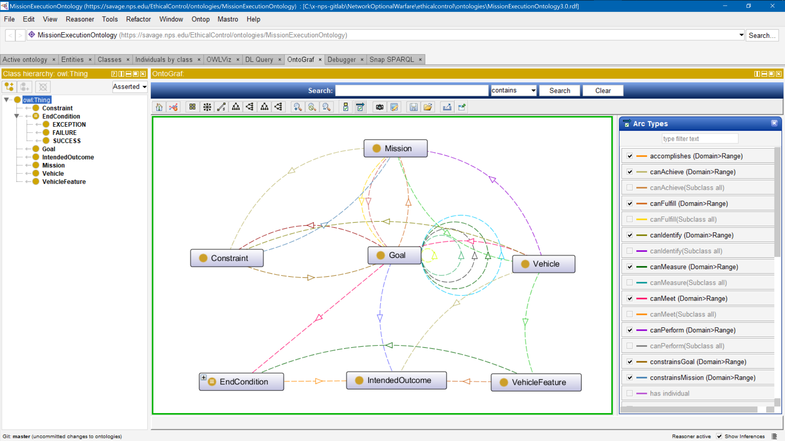
Mission Execution Ontology (MEO) source implemented, tested using Protégé tool

Slide 33
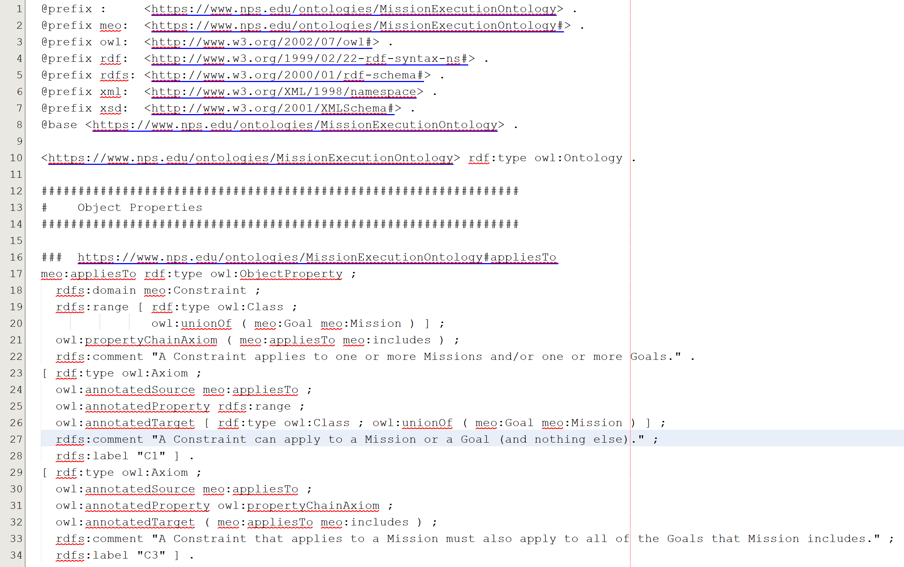
Mission Execution Ontology (MEO) source implemented, tested using Protégé tool
Turtle (.ttl) syntax

Slide 34
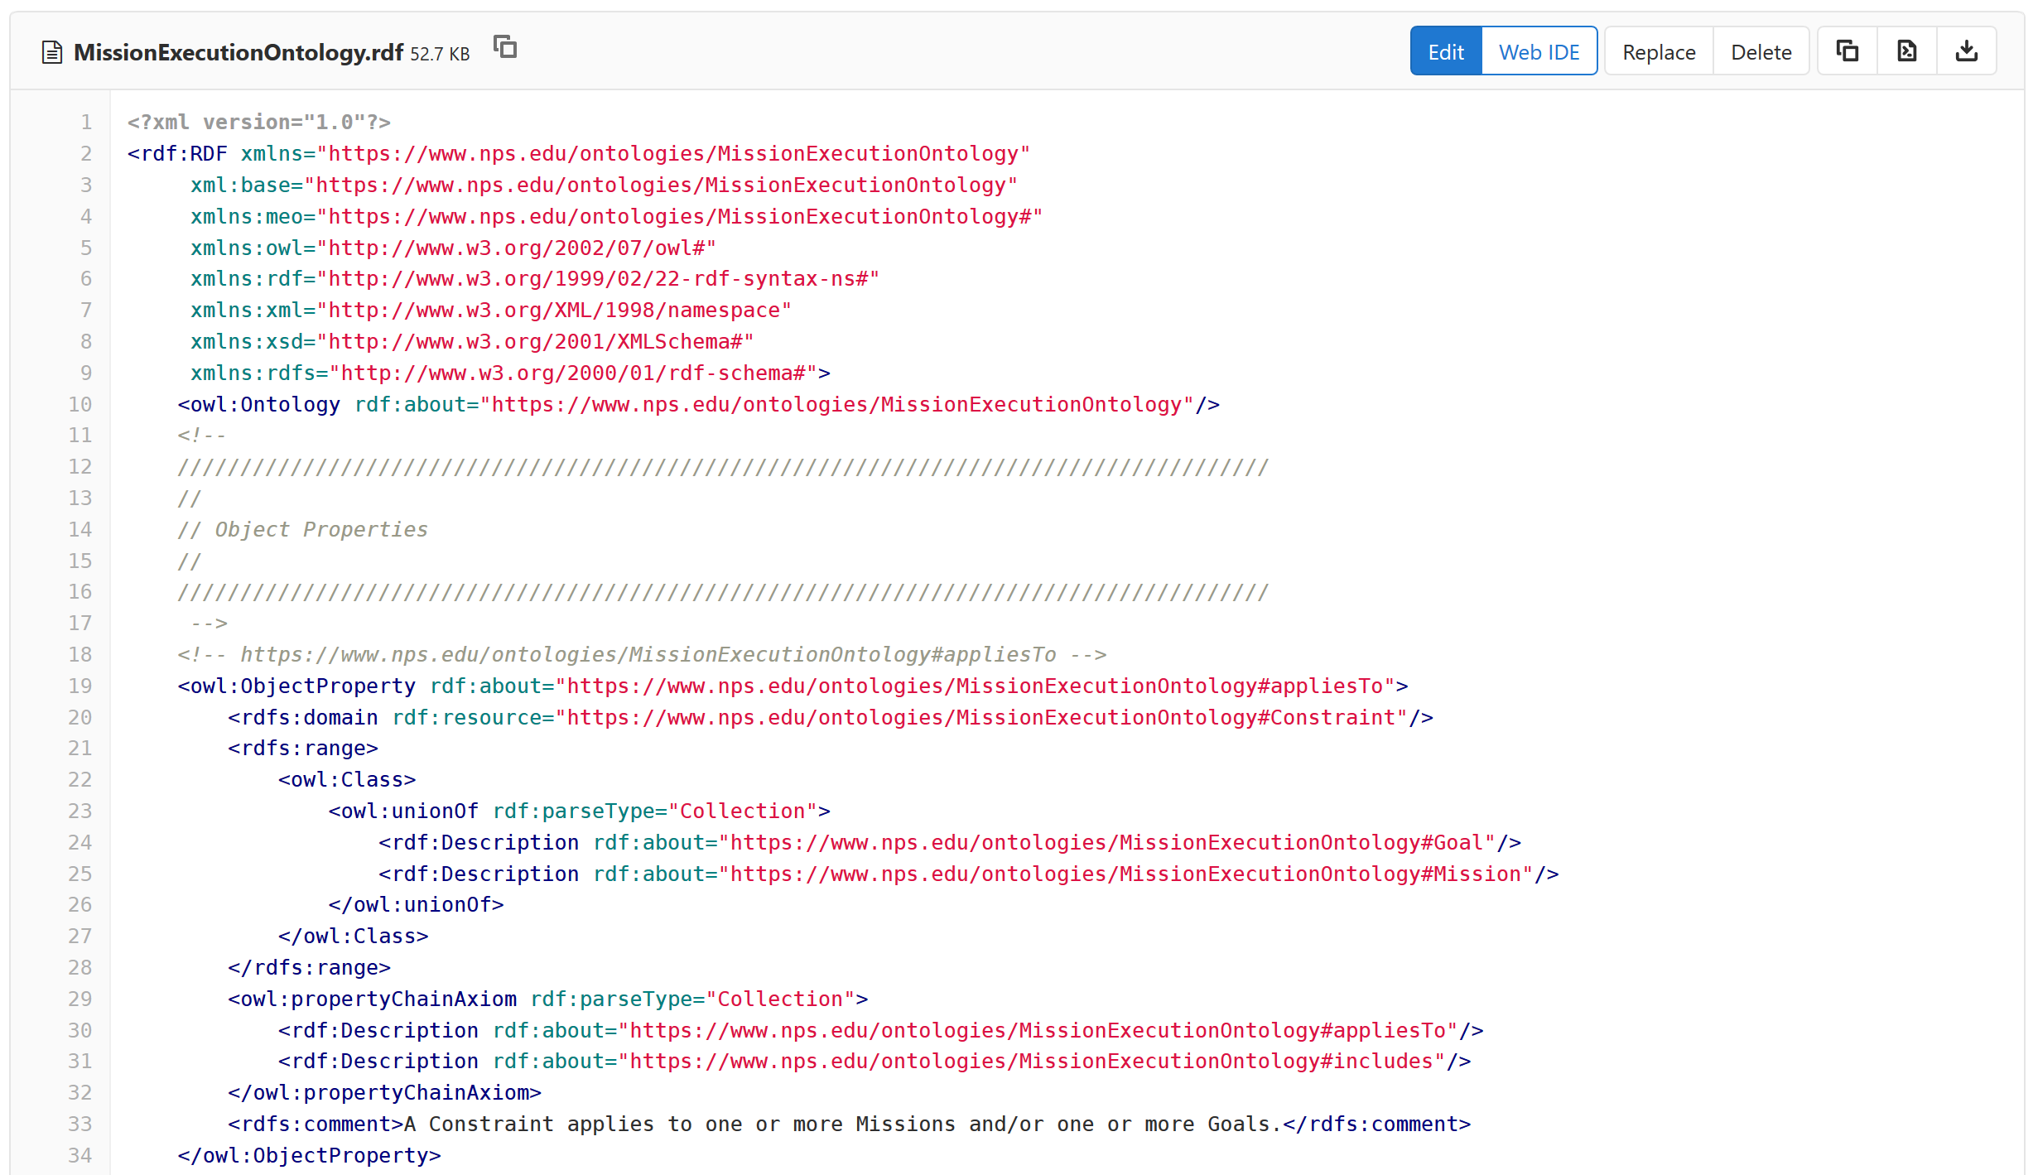
Mission Execution Ontology (MEO) source implemented, tested using Protégé tool
RDF (XML) syntax

Slide 35
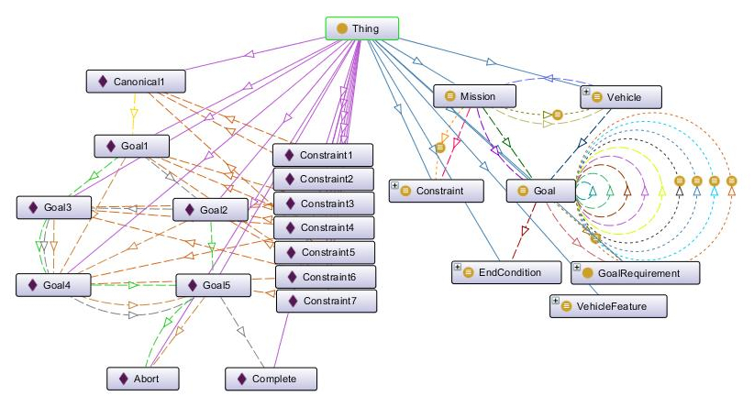
Example Mission Validation using Protégé Tool

Slide 36
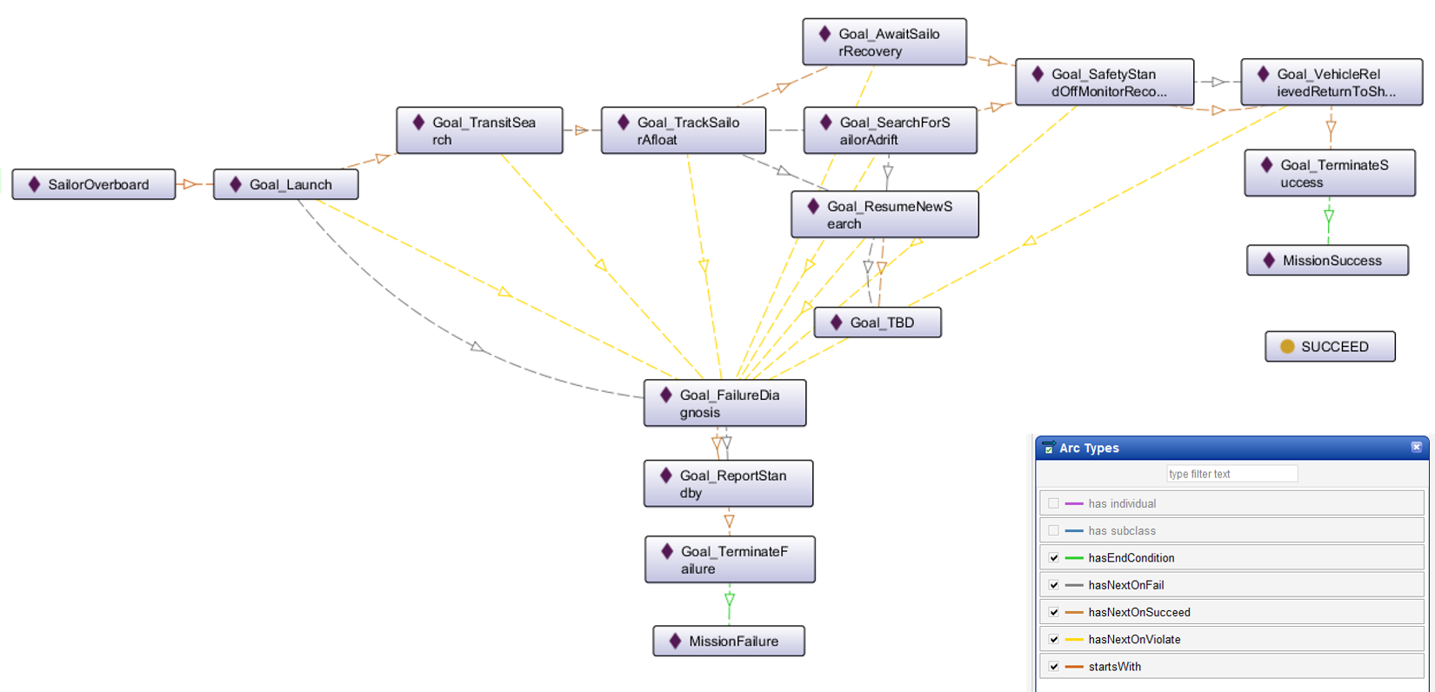
Ethical Control of Unmanned Systems in a Surrogate Scenario: Sailor Overboard Mission defined using the MEO Ontology
Current work is designing,
building and testing a set
of exemplar missions

Slide 37
Ontology for Ethical Control of Unmanned Systems in a Surrogate Scenario: Example Relationship Definitions
Mission Definition Expressed in Subject-Predicate-Object Triples Using Semantic Web Standards
Excerpt of Sailor Overboard Mission, expressed in Turtle Syntax:
### https://www.nps.edu/ontologies/MissionExecutionOntology/missions#Goal_Launch
:Goal_Launch rdf:type owl:NamedIndividual ;
meo:hasNextOnFail :Goal_FailureDiagnosis ;
meo:hasNextOnSucceed :Goal_TransitSearch ;
meo:hasNextOnViolate :Goal_FailureDiagnosis .
### https://www.nps.edu/ontologies/MissionExecutionOntology/missions#Goal_TransitSearch
:Goal_TransitSearch rdf:type owl:NamedIndividual ;
meo:hasNextOnFail :Goal_SearchForSailorAdrift ;
meo:hasNextOnSucceed :Goal_TrackSailorAfloat ;
meo:hasNextOnViolate :Goal_FailureDiagnosis .

Slide 38
SPARQL Protocol and RDF Query Language
“SPARQL is an RDF query language — that is, a semantic query language for databases — able to retrieve and manipulate data stored in Resource Description Framework (RDF) format.” -- Wikipedia
Standardized as World Wide Web (W3C) Recommendation
Open-source implementations that we use include Apache ARQ and Protégé tool.
We use SPARQL to express queries against AVCL missions in RDF/OWL (Turtle syntax) together with Mission Execution Ontology (MEO).
Results reveal interesting properties about missions that are otherwise difficult to determine. Inferences can also be combined and correlated.
Goal is to express in-depth mission-related queries that determine
Whether all logical mission prerequisites and constraints are satisfied, and
Whether tactical policies and Rules of Engagement (ROE) are met.

Slide 39
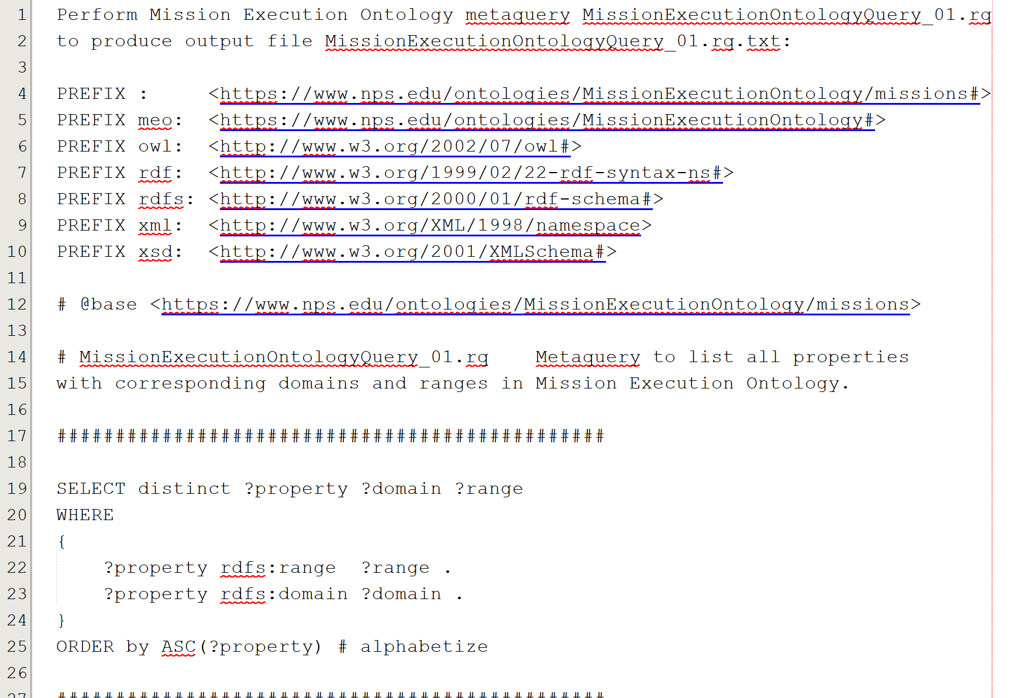
Confirm MEO via self-centered SPARQL metaquery MissionExecutionOntologyQuery_01.rq

Slide 40
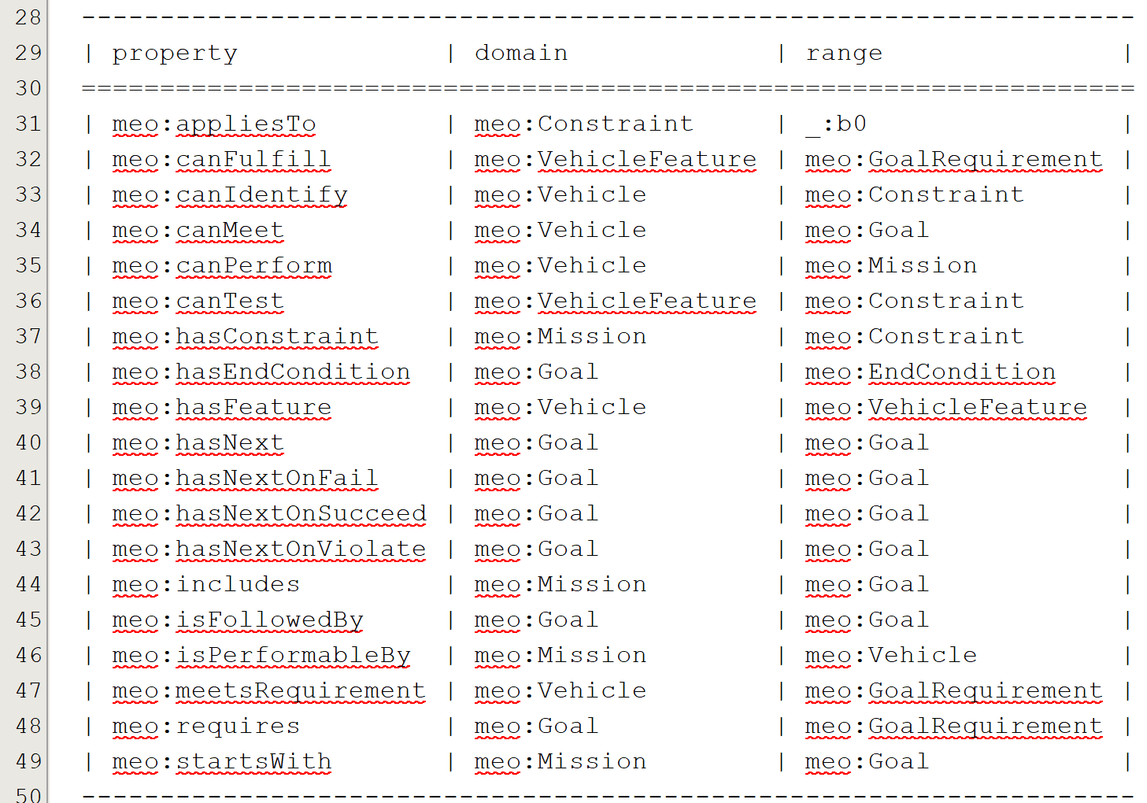
Confirm MEO via self-centered SPARQL metaquery response MissionExecutionOntologyQuery_01.rq.txt

Slide 41
Ethical Control Mission Design
Life-saving missions and missions with lethal force are complementary. Human-robot activity can result in lethal or life-saving outcomes.
Continuing refinement and clarity are opening the path to repeatability. OODA Loop compatibility ensures harmonization with human operations.

Slide 42
Core Considerations for Artificial Intelligence (AI)
Effective AI turns data into information for use by humans.
AI systems do not have capacity for rational thought or morality.
Unmanned systems require sophisticated control across time, space.
A large and involved body of internationally accepted law comprises Law of Armed Conflict (LOAC), bounding Rules of Engagement (ROE).
Only professional warfighters have moral capacity, legal culpability, and societal authority to direct actions applying lethal force.
Humans must be able to trust that systems under their direction will do what they are told to do, and not do what they are forbidden to do.
Successful Ethical Control of unmanned systems must be testable.

Slide 43
Not suitable for brute-force numerical computation
AI algorithms for Machine Learning (ML) and Data Mining are often based on statistically training against large datasets to find patterns for filters.
For example, convolutional neural networks, genetic algorithms, reinforcement learning, etc.
Often requires identifying right/wrong matches within large search spaces.
Such predictive analytics are useful for classification models using detailed and noisy sensor data. Given the central importance of IFFNU and some conditional communications to ethical control, ML filters can be helpful if carefully applied.
Nevertheless such approaches are not appropriate for carefully following Rules of Engagement (ROEs), Laws of Armed Conflict (LOAC) or other ethical prerequisites, especially when human expertise and judgement is essential for robot teams.
(Similarly, massive computation or Quantum Computing approaches might be useful in some problems, but are not of practical use for Ethical Control mission orders given by human commanders judiciously guiding remote mobile robots)
Naval history has long shown that sound human judgement is crucial for assessing best strategies and courses of action in ill-structured contexts. Semantic Web approaches are preferable and actionable for Ethical Control.

Slide 44
Conceptual Chunking: definition
“In cognitive psychology, chunking is a process by which individual pieces of an information set are broken down and then grouped together.
“A chunk is a collection of basic familiar units that have been grouped together and stored in a person's memory. These chunks are able to be retrieved more easily due to their coherent familiarity.
“It is believed that individuals create higher order cognitive representations of the items within the chunk. The items are more easily remembered as a group than as the individual items themselves.
“These chunks can be highly subjective because they rely on an individuals perceptions and past experiences, that are able to be linked to the information set. The size of the chunks generally range anywhere from two to six items, but often differ based on language and culture.” -- Wikipedia

Slide 45
Conceptual Chunking for mission design
Command clarity is paramount when giving or receiving mission orders.
Especially important for humans providing clear directions to teams.
Must avoid danger of ambiguity or anthropomorphizing robots as human-like.
Multiple AVCL mission design aspects support chunking for clarity:
Well-defined structured vocabulary describing hierarchy of distinct familiar goals.
Orders that are readable by both humans and unmanned systems.
Validatable as syntactically correct, no typos or gaps, avoids GIGO.
Validatable as semantically correct, no prerequisite omissions or contradictions.
Shown in this project: can group goal tasks within specific phase definitions.
Future work: demonstrate best practices for common mission phases.
Establish testable design patterns as reusable templates, aiding operator clarity.
45

Slide 46
Mission clarity for humans – and robots
Simplicity of success, failure, and (rare) exception outcomes encourages well-defined tasks and unambiguous, measurable criteria for continuation.
Confirmable beforehand: can a tactical officer (or commanding officer) review such a mission and then confidently say
“yes I understand and approve this human-robot mission” or, equivalently,
“yes I understand this mission and my team can carry it out themselves.”
Converse:
if an officer can’t fully review/understand/approve such a mission, then likely it is ill-defined and needs further clarification anyway.
Added benefit: missions that are clearly readable/runnable by humans and robots can be further composed and checked by C2 planning tools to test for group operational-space management, avoiding mutual interference, etc.

Slide 47
Wrong question, right question
Wrong question to ask first when planning a tactical operation:
“What are my robots doing out there?”
Right question to ask first when planning a tactical operation:
“What is my human-robot team doing out there?”
Human-robot team mission has to be understood first!
Robots complement humans, who must remain in charge throughout.
If you don’t have an OODA loop, you don’t have a competent plan.

Slide 48
Observe Orient Decide Act (OODA) Loop
“The OODA loop is the cycle observe–orient–decide–act, developed by military strategist and USAF Colonel John Boyd. Boyd applied the concept to the combat operations process, often at the operational level during military campaigns. It is now also often applied to understand commercial operations and learning processes. The approach explains how agility can overcome raw power in dealing with human opponents.” – Wikipedia
All effective purposeful military activity can be conceived in terms of OODA loop feedback process, especially at tactical/operational levels.
Aligning Ethical Control mission design with OODA loop ensures that unmanned systems understandably partner within human-run teams.

Slide 49
OODA Significance for Ethical Control
Classical robotic Sense-Decide-Act cycle for closed-loop control is insufficient for proper delegation of lethal (or lifesaving) force to unmanned systems.
Observe-Orient-Decide-Act (OODA) Loop is essential for coherent operations.
Observe includes direct sensing and communication inputs.
Orientation includes thorough Rules of Engagement (ROE) constraints and identification friend/foe/neutral/unknown (IFFNU) of all relevant contacts.
Decision logic of unmanned system tactics, techniques, procedures (TTP) includes authorization and confirmation by human supervisors, either in real-time or in advance, for critical steps leading to lethal force.
Actions in tandem with direct or intermittent human supervisory command enables effective Ethical Control of remote systems.
Feedback loops are essential, generally leading to… more effective operations.

Slide 50
OODA Clarity for Mission Definitions
Robot activity must complement, not contradict, human OODA loop.
Application of ROE and LOAC requirements can be confirmed present as part of mission definition, typically as
Goal success/failure criteria, preset authorities or time-outs for delegation, and
Constraints on conduct (safe zones, permission periods/requirements, etc.)
When human leaders confirm correct inclusion of ROE requirements in mission orders, they essentially perform an audit of doctrine and TTPs.
Similar audit confirmation can be applied to well-structured orders:
Autonomous Vehicle Command Language (AVCL) expresses well-defined goals,
Mission Execution Ontology (MEO) defines relationships and requirements,
SPARQL queries can be written to perform such logical-confirmation checks.
Resulting mission orders are thus coherent from OODA perspective.

Slide 51
Loop management: principles
Proper algorithms always includes one or more termination conditions.
Sequence of operations proceeds through a finite number of steps, otherwise the system is performing an infinite loop without end.
Infinite-loop sequencing or recursion is a common computational failure mode and must be protected against for reliable operations.
Nevertheless a frequent characteristic of at-sea operations is to perform repeated tasks in an interactive fashion until complete…
Either via task success, or a terminating condition that forces halting.
The presence of termination conditions can be verified in mission logic and also tested in simulation.

Slide 52
Loop management: practice
Example terminating conditions, some fixed/adaptive and some iterative/exceptional:
Reach maximum number of iterations.
Point of diminishing returns (e.g. unchanging search effectiveness).
Time-out deadline reached, or else no longer feasible to continue.
Insufficient power remains, conduct graceful shutdown for recovery.
Equipment damage or unexpected software failure; log and shutdown.
Interfering operational conditions (e.g. potential hazard to friendlies).
Human direction asserts higher priority and overrides decision logic.
Future work: expressing all these constraints precisely in AVCL missions.

Slide 53
Canonical Ethical Mission Development 1
Progressive sophistication to test and evaluate Ethical Control design.
Sailor Overboard for life-saving force under close coordination,
Lifeboat Tracking for life-saving force under remote conditions,
Pirate Boats Seizing Merchant for steady escalation to lethal force,
Robot Swarm Attacks Hospital Ship to prevent hostile provocation of sense-decide-act vulnerabilities through Ethical Control safeguards. Two variants show fundamental importance of ethical constraints.
Demonstrating a range of functionality tests majority of Ethical Control capabilities that are currently envisioned. These canonical capabilities also “set the stage” for further work on advanced problems of interest.

Slide 54
OODA Loops for Ethical Control Canonical Missions
Ethical Control OODA Loops | Observe | Orient | Decide | Act
Sailor Overboard | Find Sailor | Report status | Avoid interference | Track sailor until rescued or relieved
Lifeboat Rescue | Find Lifeboat | Report status | Two-way communication | Track life raft until relieved
Pirate Seizure of Merchant Ship | Find merchant ship, pirate small boats | Identity Friend Foe Neutral Unknown (IFFNU) Issue warnings | Human commander authorization to use lethal force | Attack to defend ship if provoked, stay with merchant
Hospital Ship Swarm Attack | EM threat signals detected | (no orientation step in Sense Decide Act) | Reflex-response weapons attack | Mistaken attack on friendly = war crime
Hospital Ship Defense detects spoofing anti-pattern | EM threat signals detected | IFFNU including correlation | Human requirement for lethal force unmet, attack avoided | Report threat alert, commence search for hostile actors

Slide 55
Canonical Ethical Mission Development 2
Next steps: completing this initial set of missions is expected to
Demonstrate both logical soundness and human comprehensibility of Ethical Control methodology, for both life-saving and lethal force.
“Tune up” AVCL vocabulary for mission orders, revealing good practices and repeatable design patterns for common activities in diverse missions.
Translation of AVCL missions into corresponding MEO representations to allow deeper semantic validation of correctness of ethical constraints.
Performing AVCL missions in AUV Workbench tool is expected to show mission execution working in simulation, or else reveal hidden flaws.
Future work: prepare for comprehensive testing of unmanned systems across range of requirements necessary for afloat operational qualification.

Slide 56
Tactical span of control for ship with many robots
Span of control is number of subordinates reporting to a supervisor.
Classic definition from business management, also applies to leadership.
In effect, multiple offboard unmanned systems supervised by a ship comprise its span of control across the tactical battlespace.
Greater tactical presence across distances of time and space means ship commanders have greater ability to influence their local theater.
Clear mission guidance on human-checkpoint requirements reduces dependency on communication links (i.e. Network Optional Warfare).
Next diagram illustrates how such increased ability to project power enables ship to maintain chosen standoff location while nevertheless focusing direct attention and actions in multiple locations at once.

Slide 57
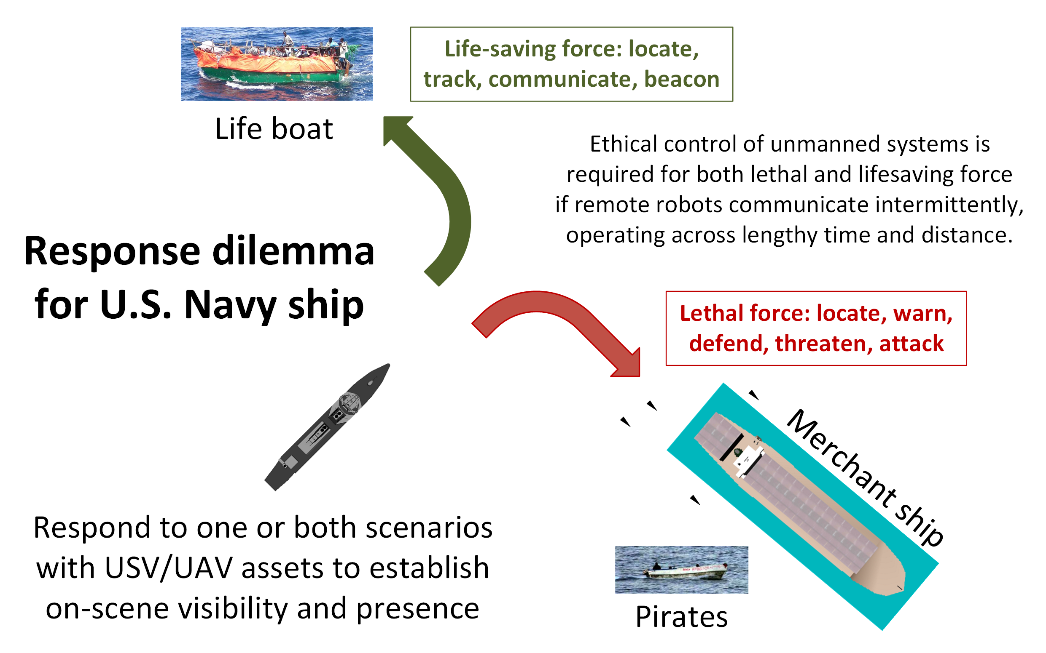
Ship response dilemma

Slide 58
Exemplar Missions
Unmanned systems working in tandem with human forces, authorized by commander for life-saving or lethal force, can handle progressive challenges in distance and time.
Notes:
The following missions carefully define and test such capabilities.

Slide 59
Catalog of Exemplar Missions
Structure for each section
Design and Description
Mission decision-flow diagram
AVCL implementation source: version control, XML Spy table
Semantic Web Mission MEO .ttl Turtle representation
SPARQL semantic queries
Lisp and Prolog autocode
AUVW simulation
Sailor Overboard
Lifeboat Tracking
Pirates Seizing Merchant Ship
Hospital Ship EM Decoy Scenario compares Sense-Decide-Act vs. Observe-Orient-Decide-Act (OODA)

Slide 60
Sailor Overboard Mission: Design
Motivations
Explore how life-saving force is complementary to lethal force, with many similar considerations for remote supervision.
First demonstrate human-system teaming in close proximity to ship, where direct override of robot control by human operator is possible.
No temporal delays, all actions and reactions must be immediate.
Show that mission design can complement shipboard procedures.
Lessons learned
Good design patterns to visually represent AVCL mission satisfactorily.
Temporal flow (left to right, e.g. Gantt chart) best suited for diagram.

Slide 61
Sailor Overboard Mission: Description
Purpose
Life saving: single unmanned air/surface vehicle actions to complement human responses when performing “SAILOR OVERBOARD” operations.
Carried out in direct concert with formal shipboard emergency procedures.
Multiple UAVs/USVs might be employed in parallel with ships and aircraft, avoid mutual interference by each following deconflicted mission orders.
Phases
Deploy/Launch, Rendezvous, Track Sailor until Safe, Return/Recovery.
Human Supervisory Role
Order standoff if interfering, manual control is possible due to proximity, can communicate to sailor via loudspeaker or beacon light.

Slide 62
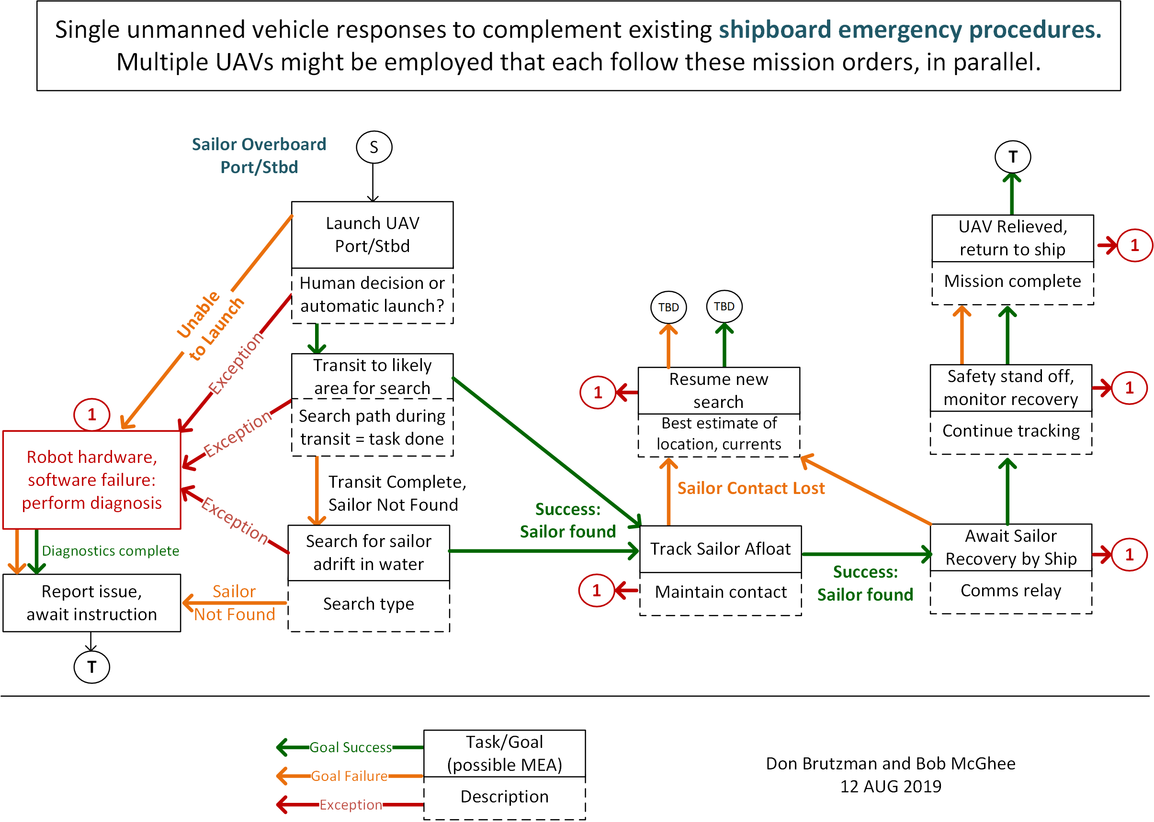
Sailor overboard, original diagram
Original Version

Slide 63
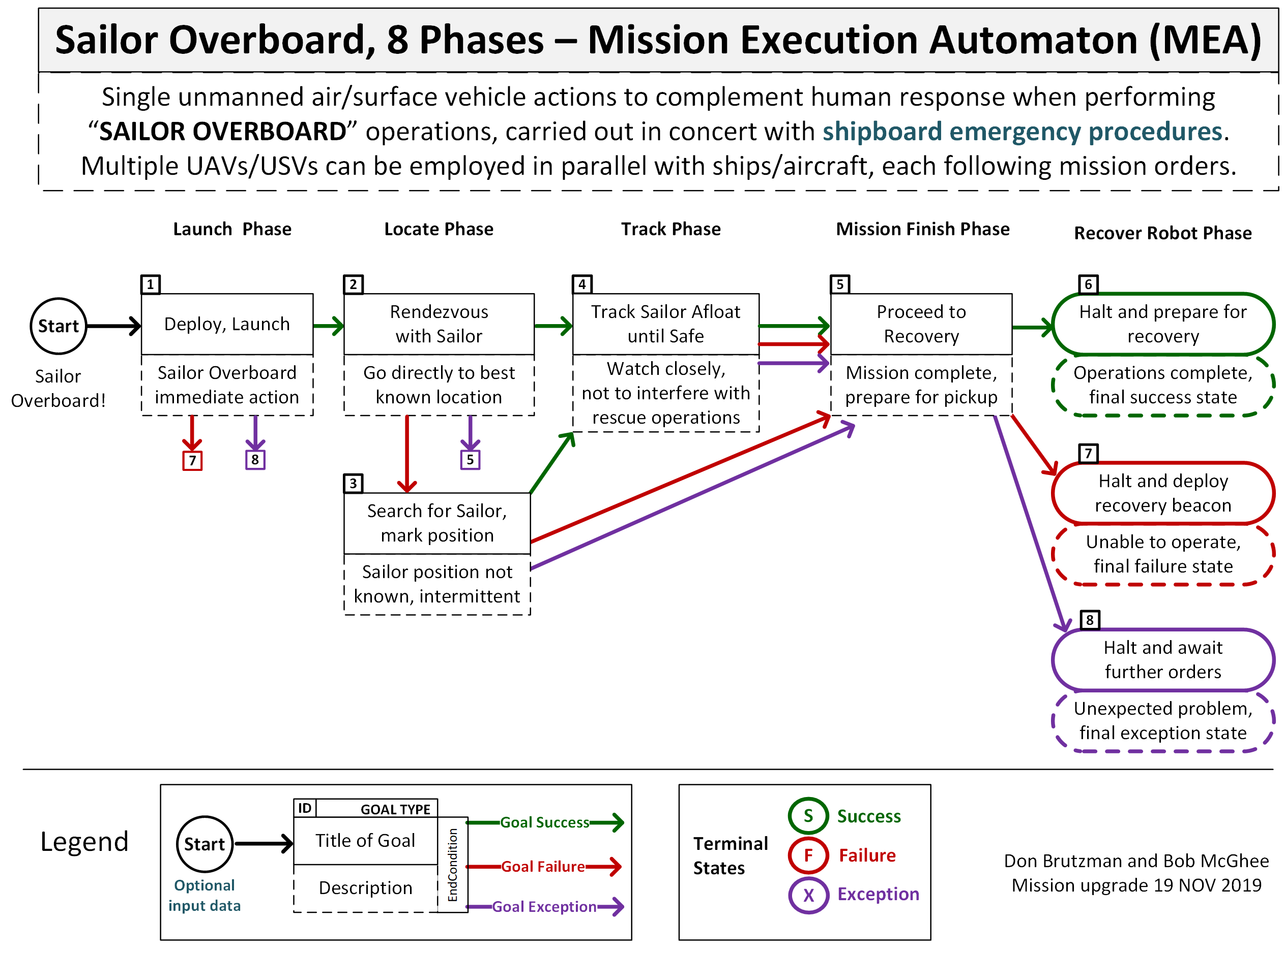
Sailor overboard mission diagram

Slide 64
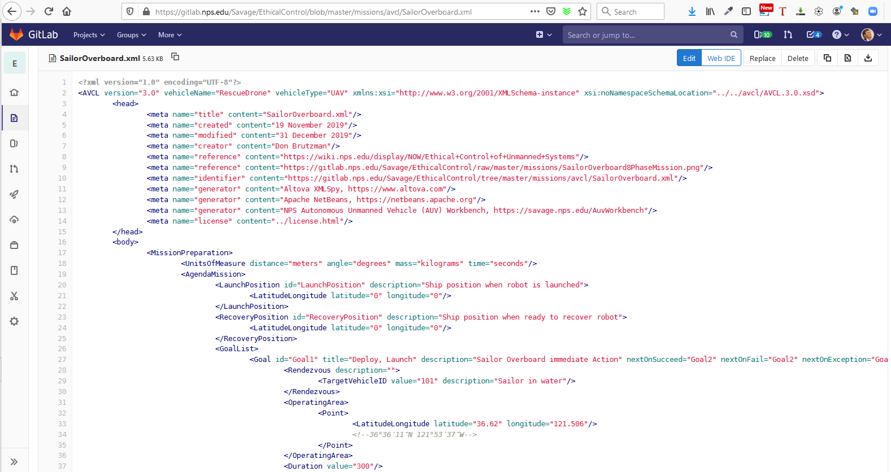
SailorOverboard.xml in gitlab.nps.edu version control

Slide 65
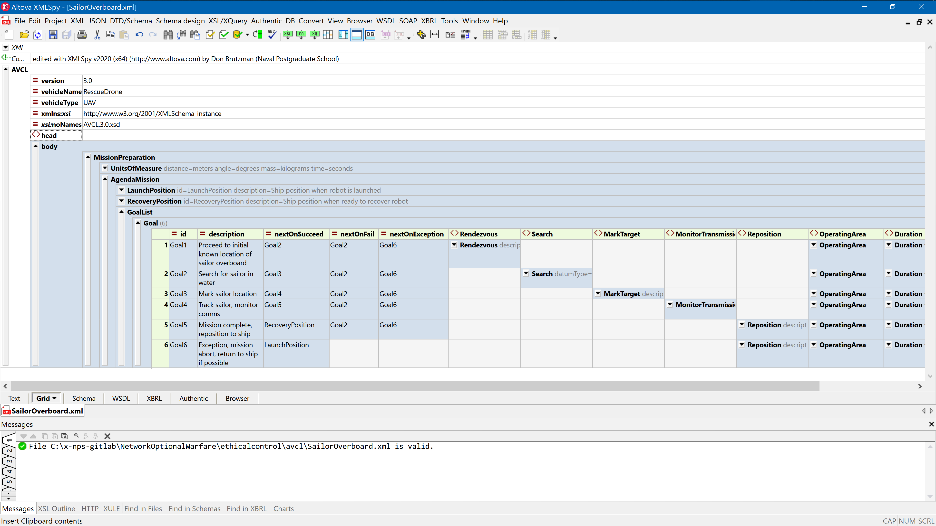
Sailor overboard mission orders AVCL

Slide 66
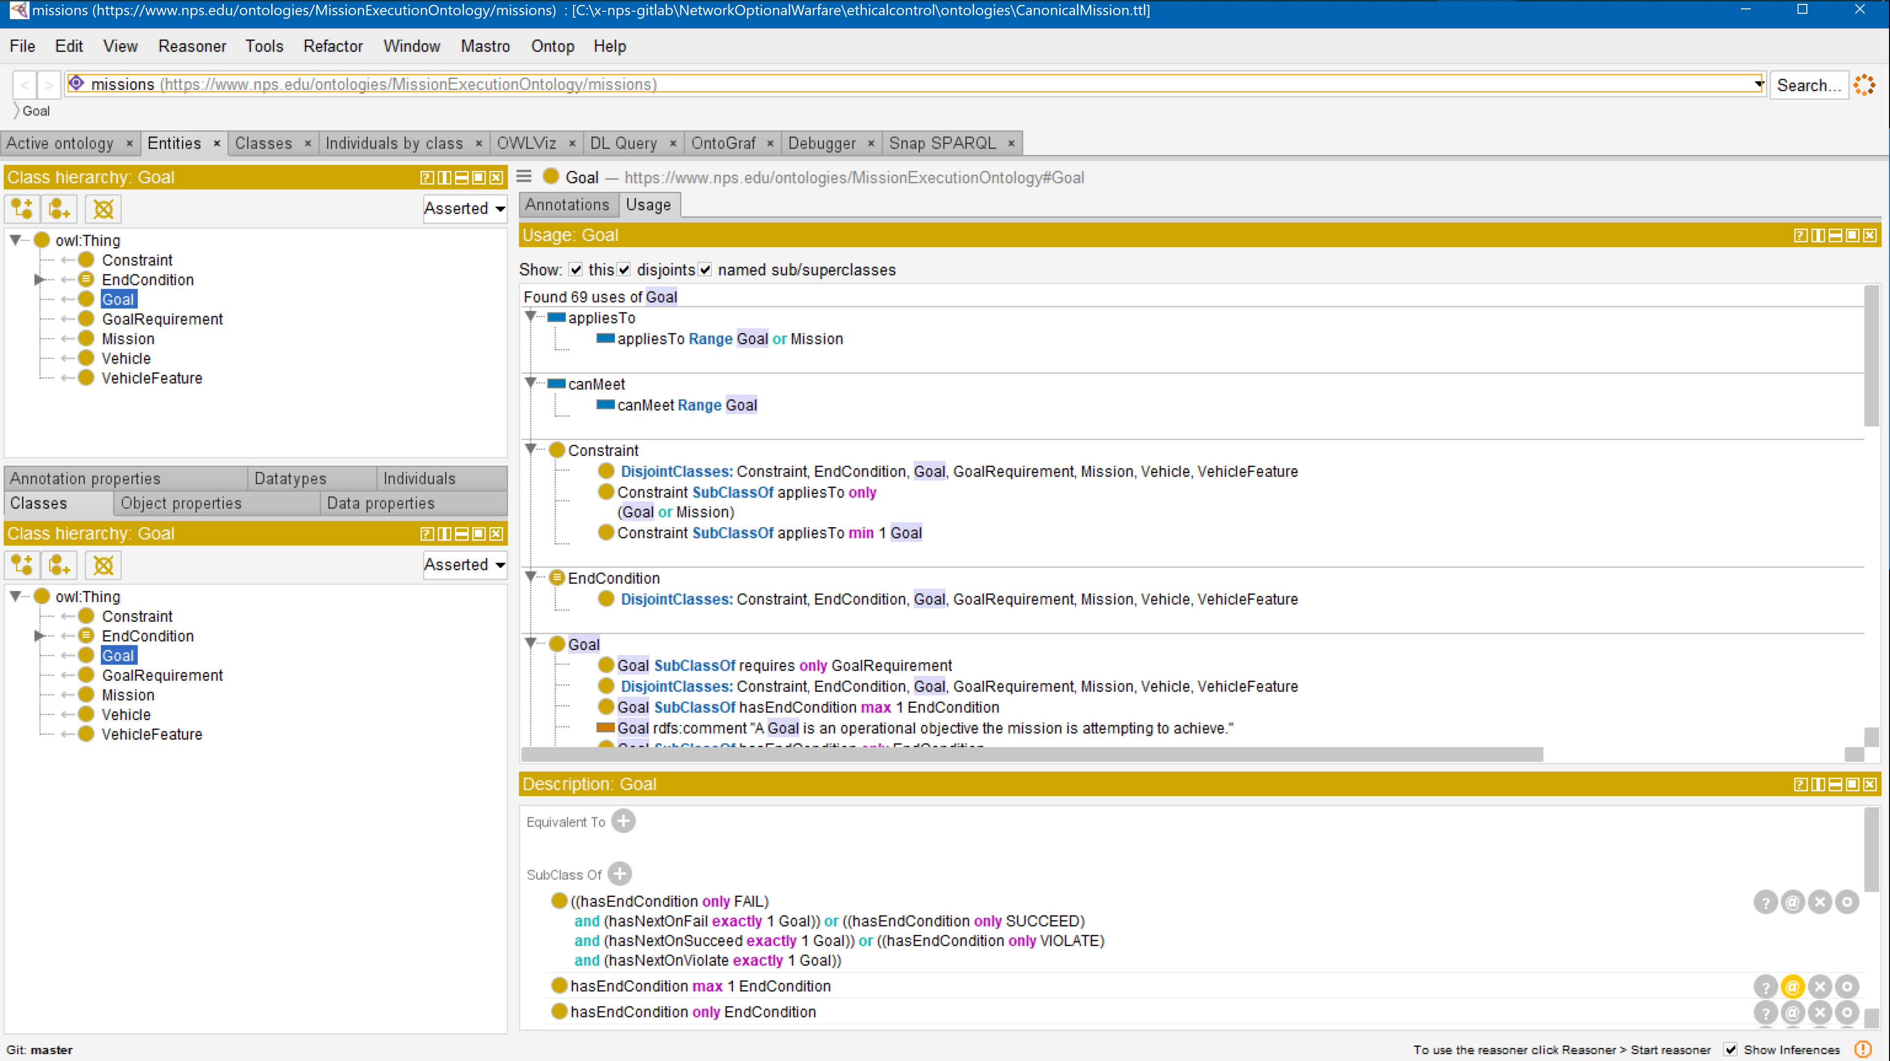
Sailor overboard mission .ttl Turtle

Slide 67
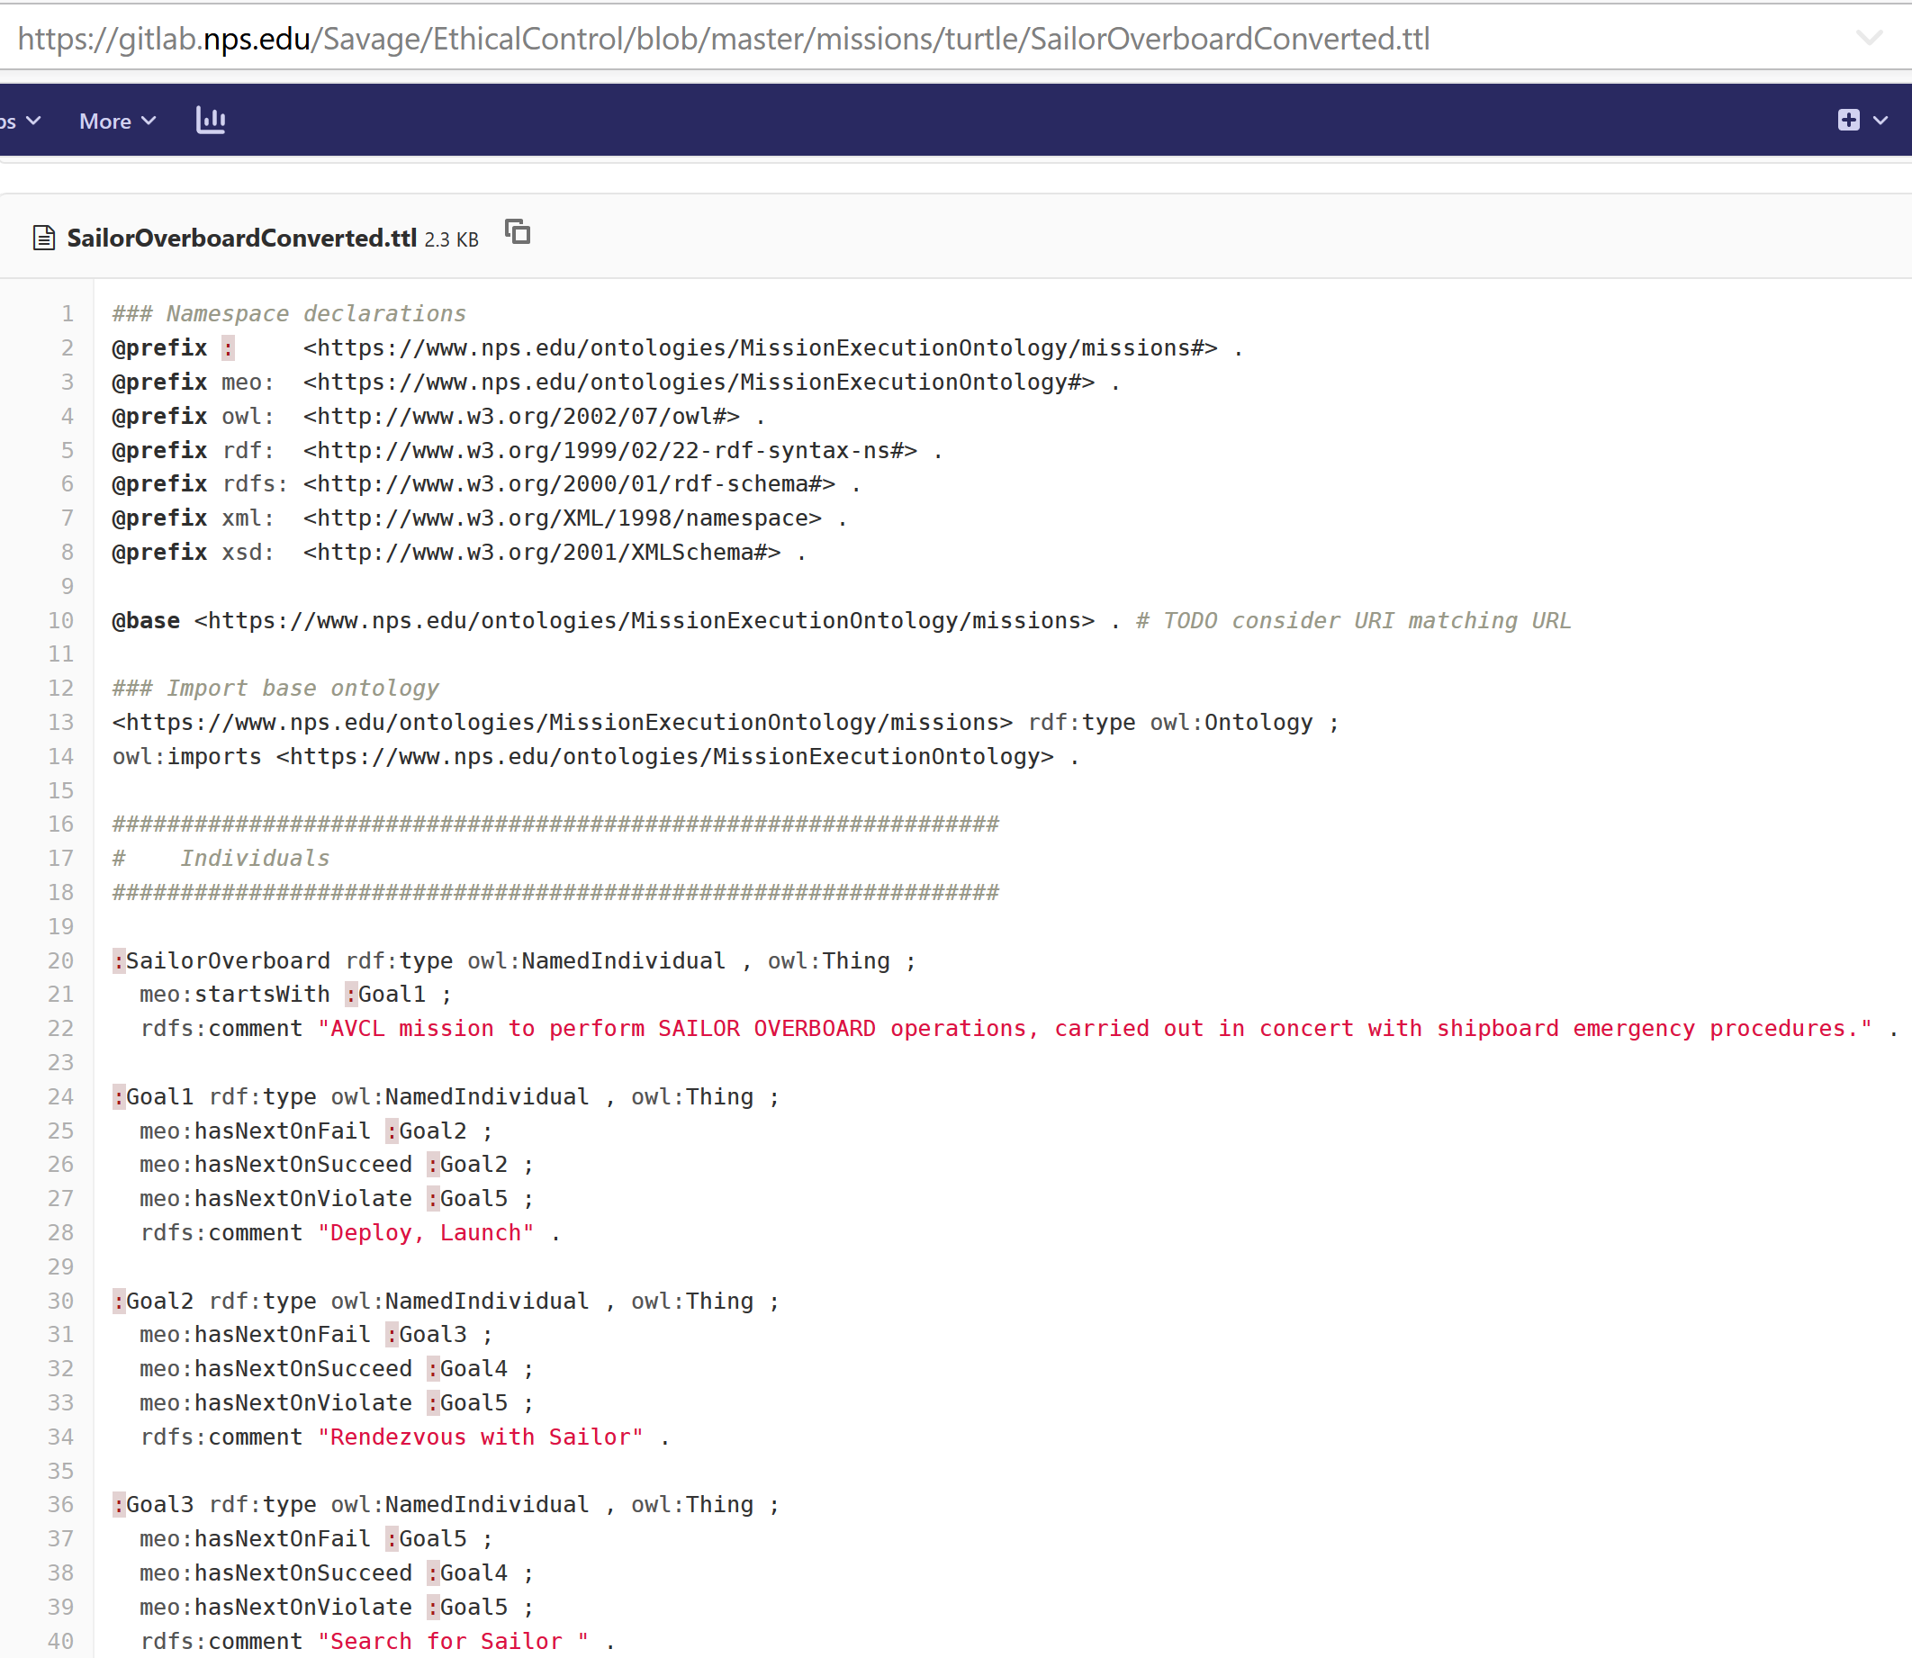
SailorOverboardConverted.ttl Turtle excerpt autogenerated in gitlab.nps.edu version control

Slide 68
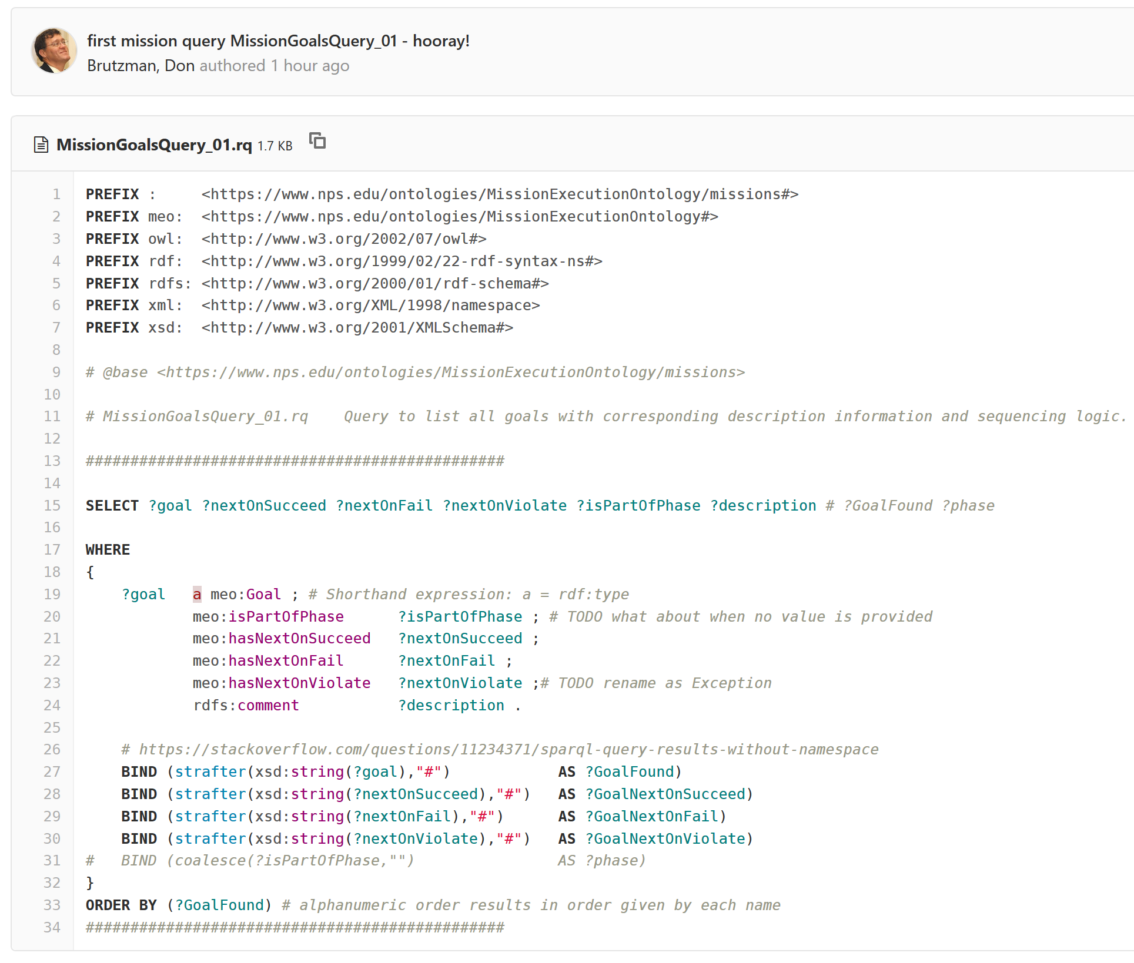
SPARQL mission query MissionQuery_01_GoalBranches.rq

Slide 69
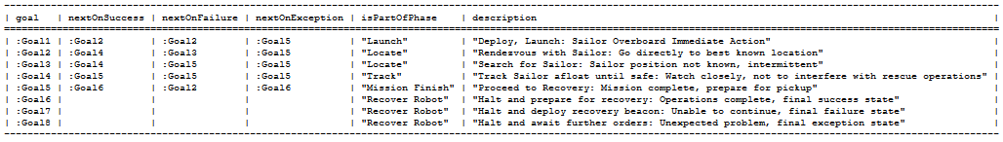
SPARQL query response SailorOverboardConverted. MissionQuery_01_GoalBranches.rq.txt
SPARQL query response
SailorOverboardConverted. MissionQuery_02_InitialGoal.rq.txt

Slide 70
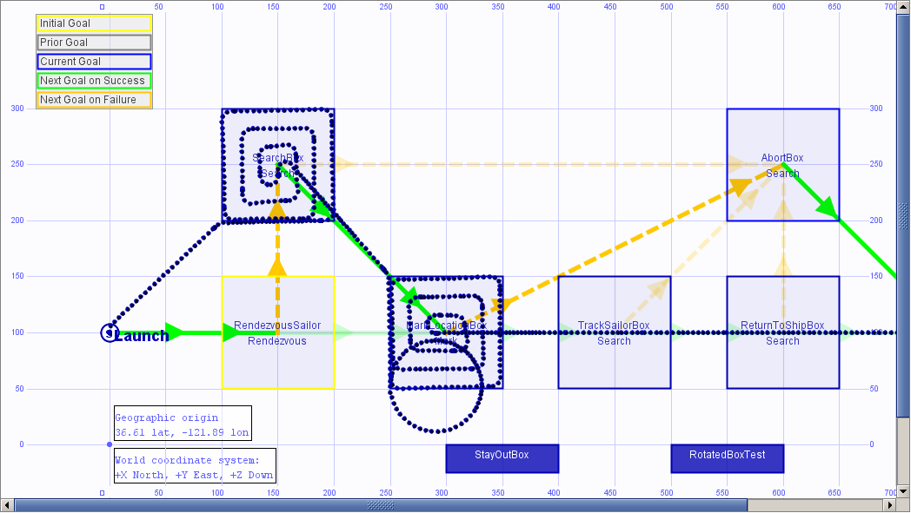
Sailor overboard simulation AUVW
UPDATE IN
PROGRESS

Slide 71
Lifeboat Tracking Mission: Design
Motivations
Similar to Sailor Overboard in demonstrating use of life-saving force.
Far greater distances, over the horizon, increases ship span of control.
Potential for intermittent or lost communications in real time, requires advance guidance for default behaviors desired by human controller.
Consider possible transfer of supervisory control mid-mission to another cooperating vessel – appears feasible.
Lessons learned
Vertical grouping of related subtasks helps in structuring goal sets, without requiring change to ternary logic of AVCL mission goals.
Coexistence of multiple constraints is possible, requires careful thought.

Slide 72
Lifeboat Tracking Mission: Description
Purpose
Provide remote presence for locating, tracking, communications and beaconing.
Phases
Deploy/Launch, Rendezvous, Track Lifeboat, Beacon/Communicate, Return/Recovery.
Human Supervisory Role and Constraints
Monitor, communicate, respond or coordinate rescue effort.
Low fuel condition and graceful-degradation response.

Slide 73
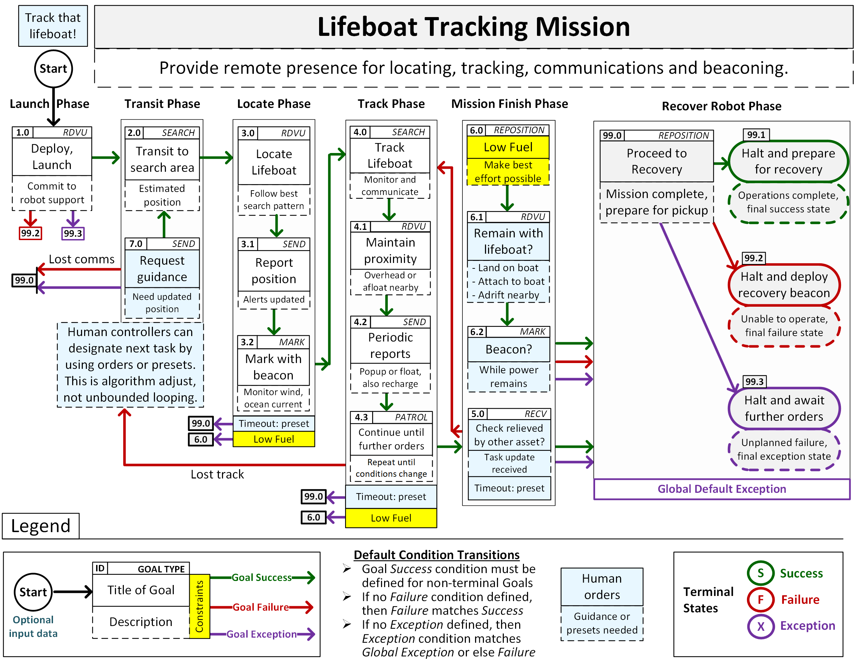
Lifeboat tracking mission

Slide 74
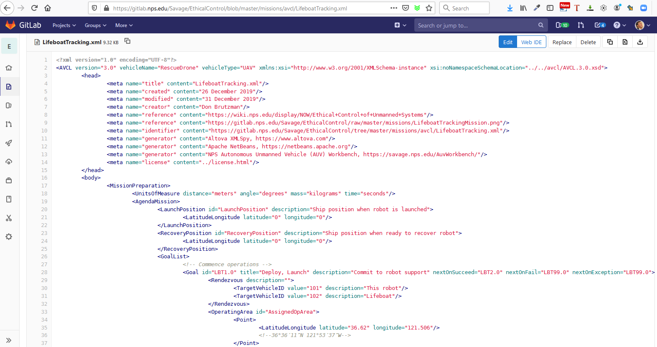
LifeboatTracking.xml in gitlab.nps.edu version control

Slide 75
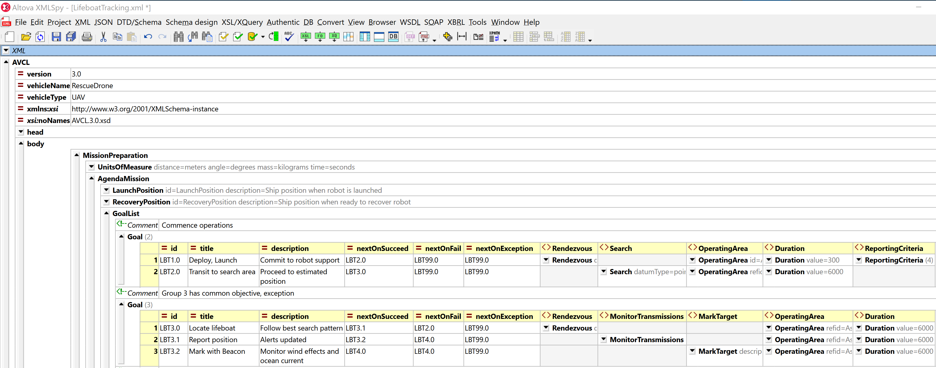
Lifeboat Tracking Mission in AVCL, goals 1..3

Slide 76
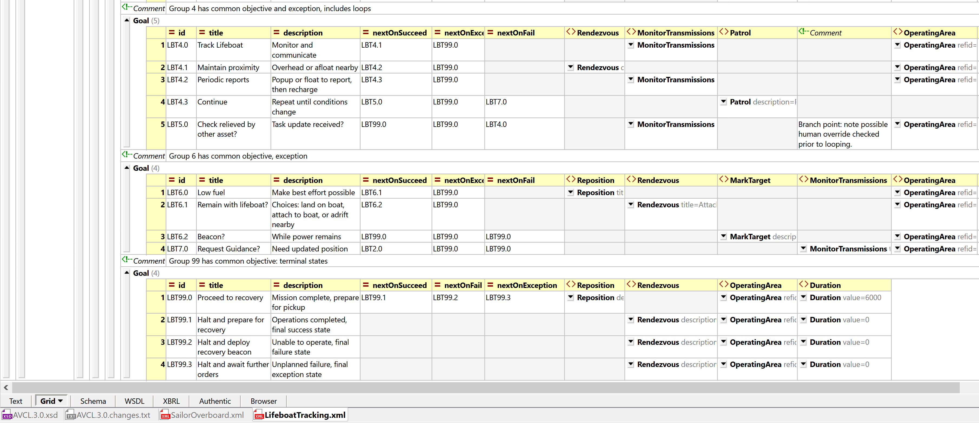
Lifeboat Tracking Mission in AVCL, goals 4..end

Slide 77
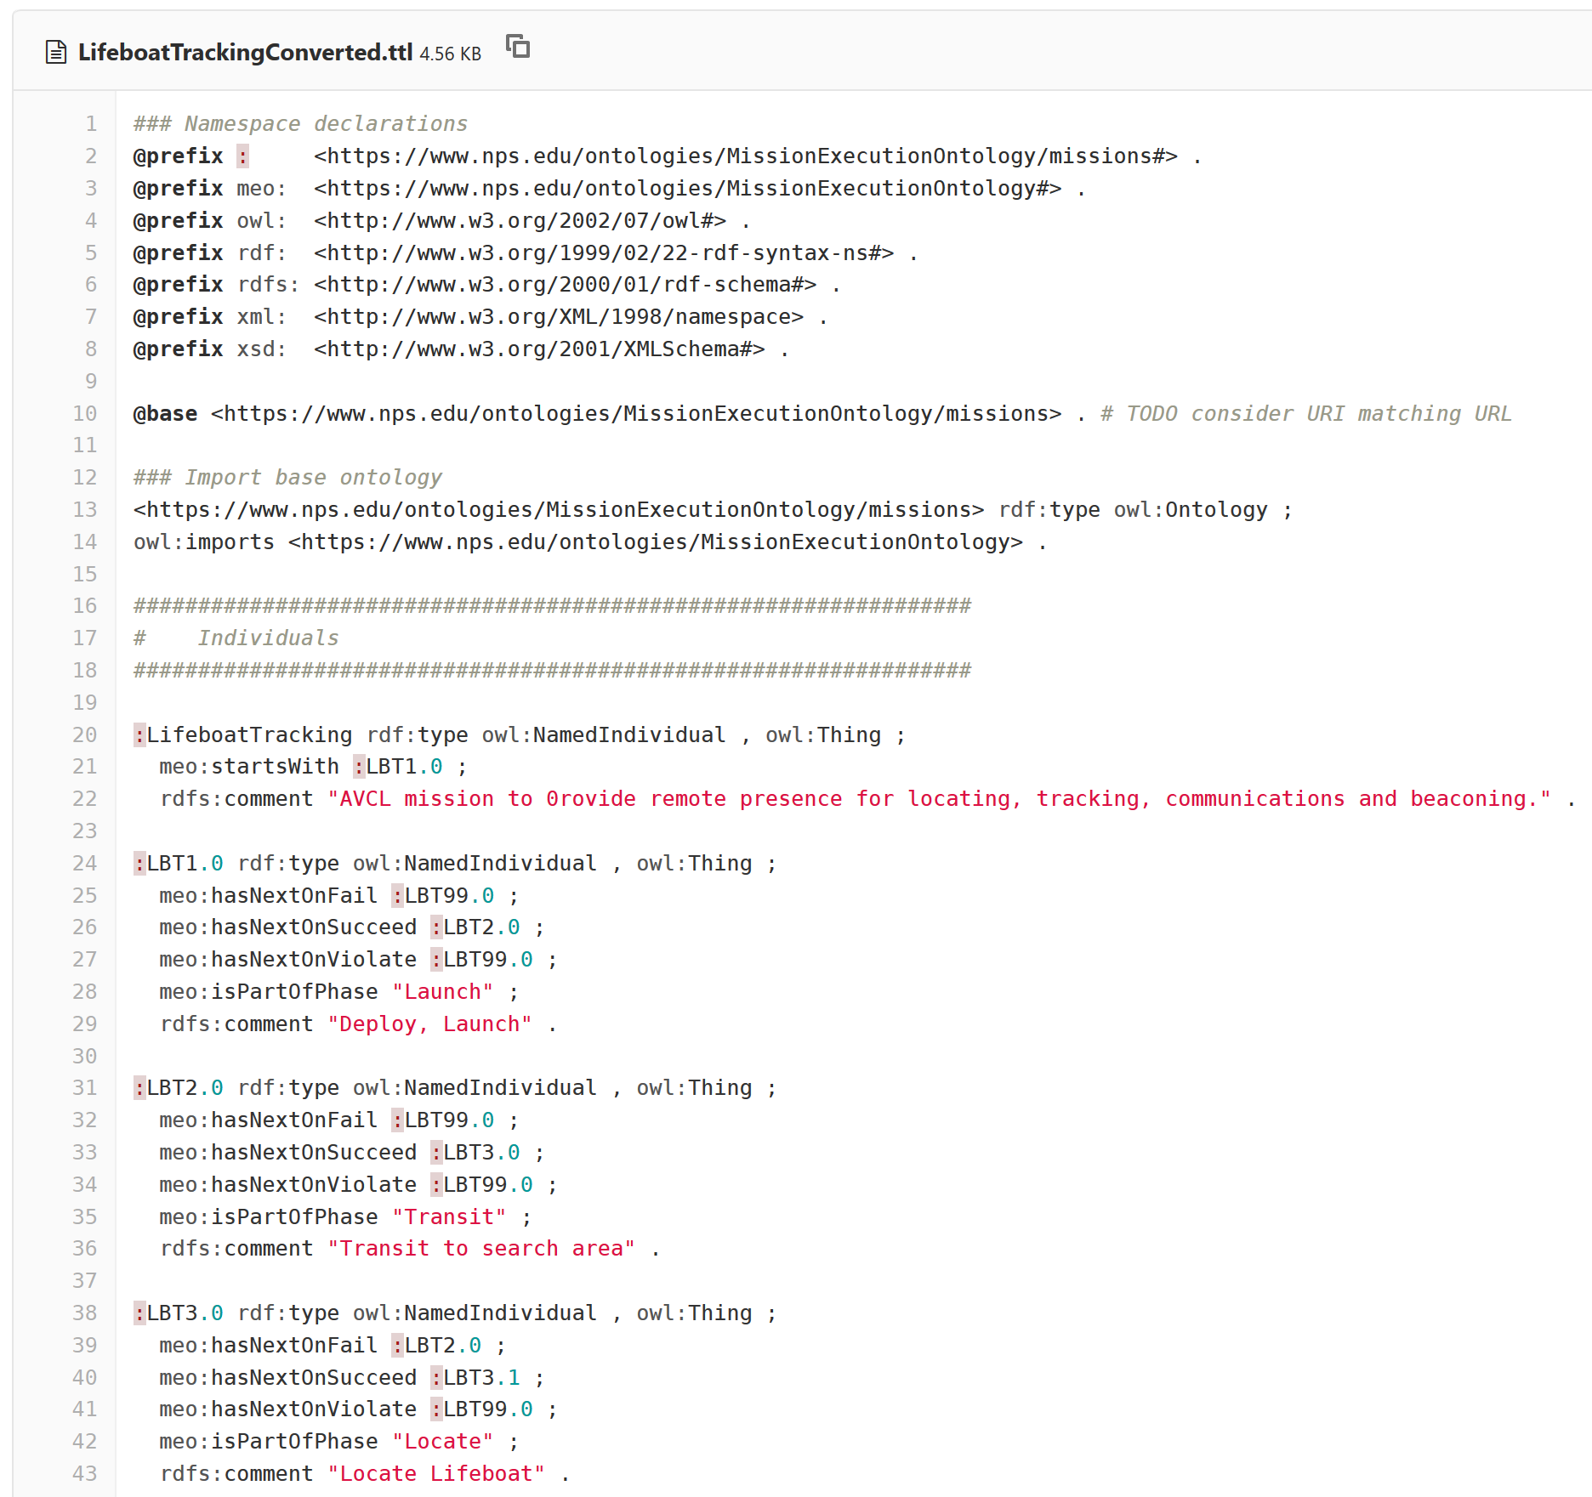
LifeboatTrackingConverted.ttl Turtle excerpt autogenerated in gitlab.nps.edu version control

Slide 78
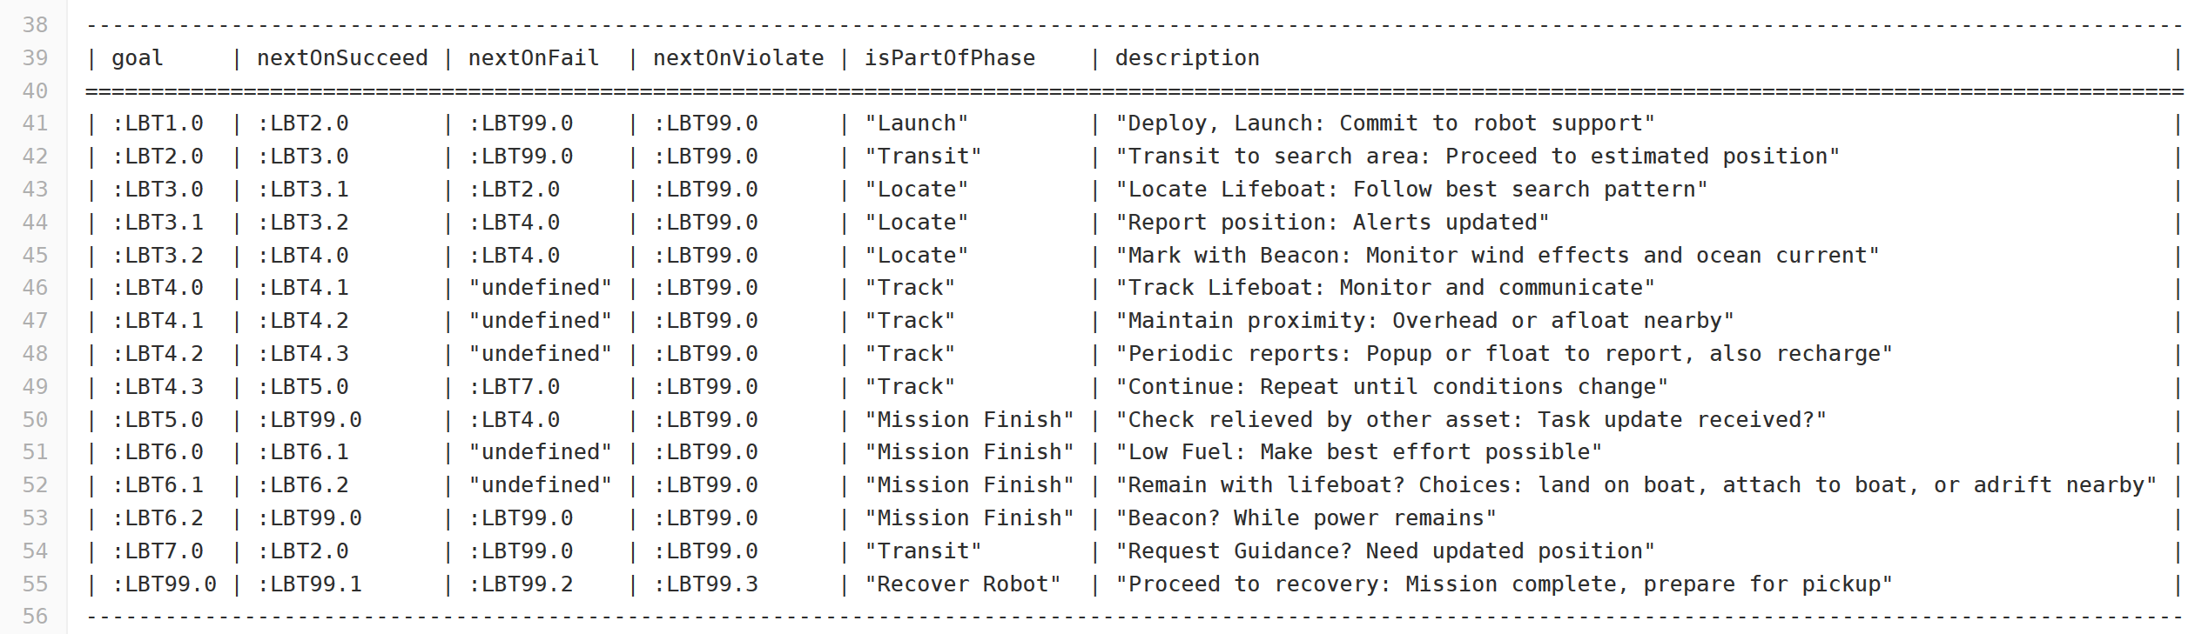
SPARQL query response LifeboatTrackingConverted.MissionGoalsQuery_01_GoalBranches.rq.txt

Slide 79
Pirates Seizing Merchant Mission: Design
Motivations
Necessity to apply lethal force against pirates distant from own ship, corresponding life-saving force potential for hostage merchant crew.
Must operate over long time period, emphasize restraint throughout.
Provide soft and strict supervisory checkpoints for human control.
Lessons learned
Concept of phases helped organize overall mission structure sensibly (approach, warning, attack, recovery).
Looping is necessary, human control checkpoints help avoid deadlock.

Slide 80
Pirates Seizing Merchant Mission: Description
Purpose
Overtake pirate small-boat gang attempting to capture threatened evading merchant ship.
Phases
Deploy/Launch, Search, Approach and Track, Warning, Attack.
Human Supervisory Role and Constraints
Control pace of engagement, careful deliberate escalation.
Confirm IFFNU classification, must order lethal force prior to use.
Low fuel condition and graceful-degradation response.
Low ammunition condition: fight to finish, or stand in reserve?

Slide 81
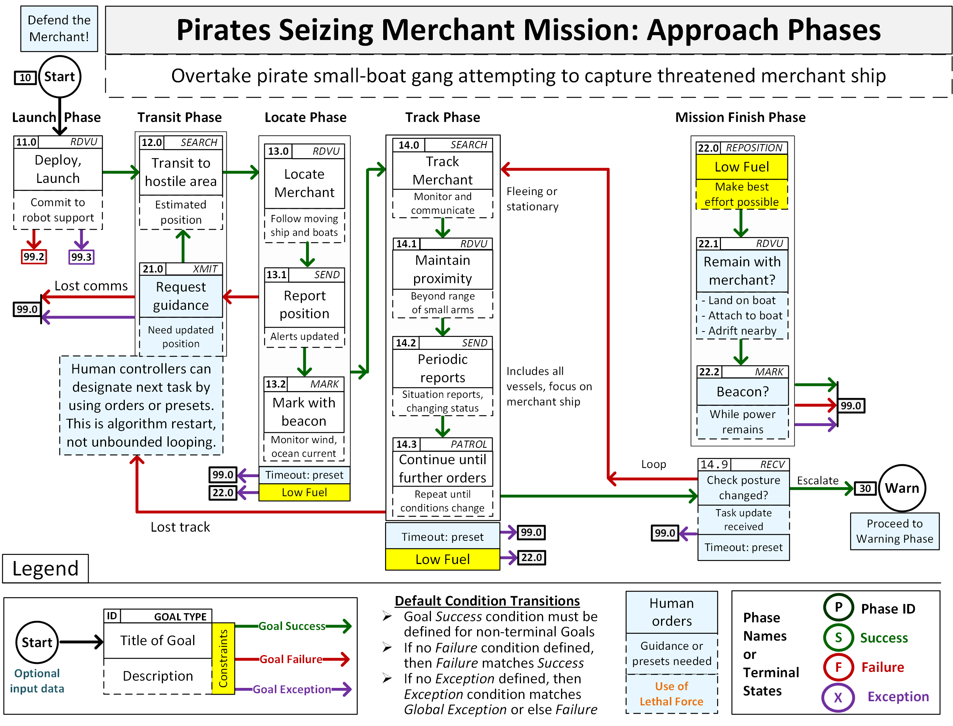
Pirates attack merchant ship 1

Slide 82
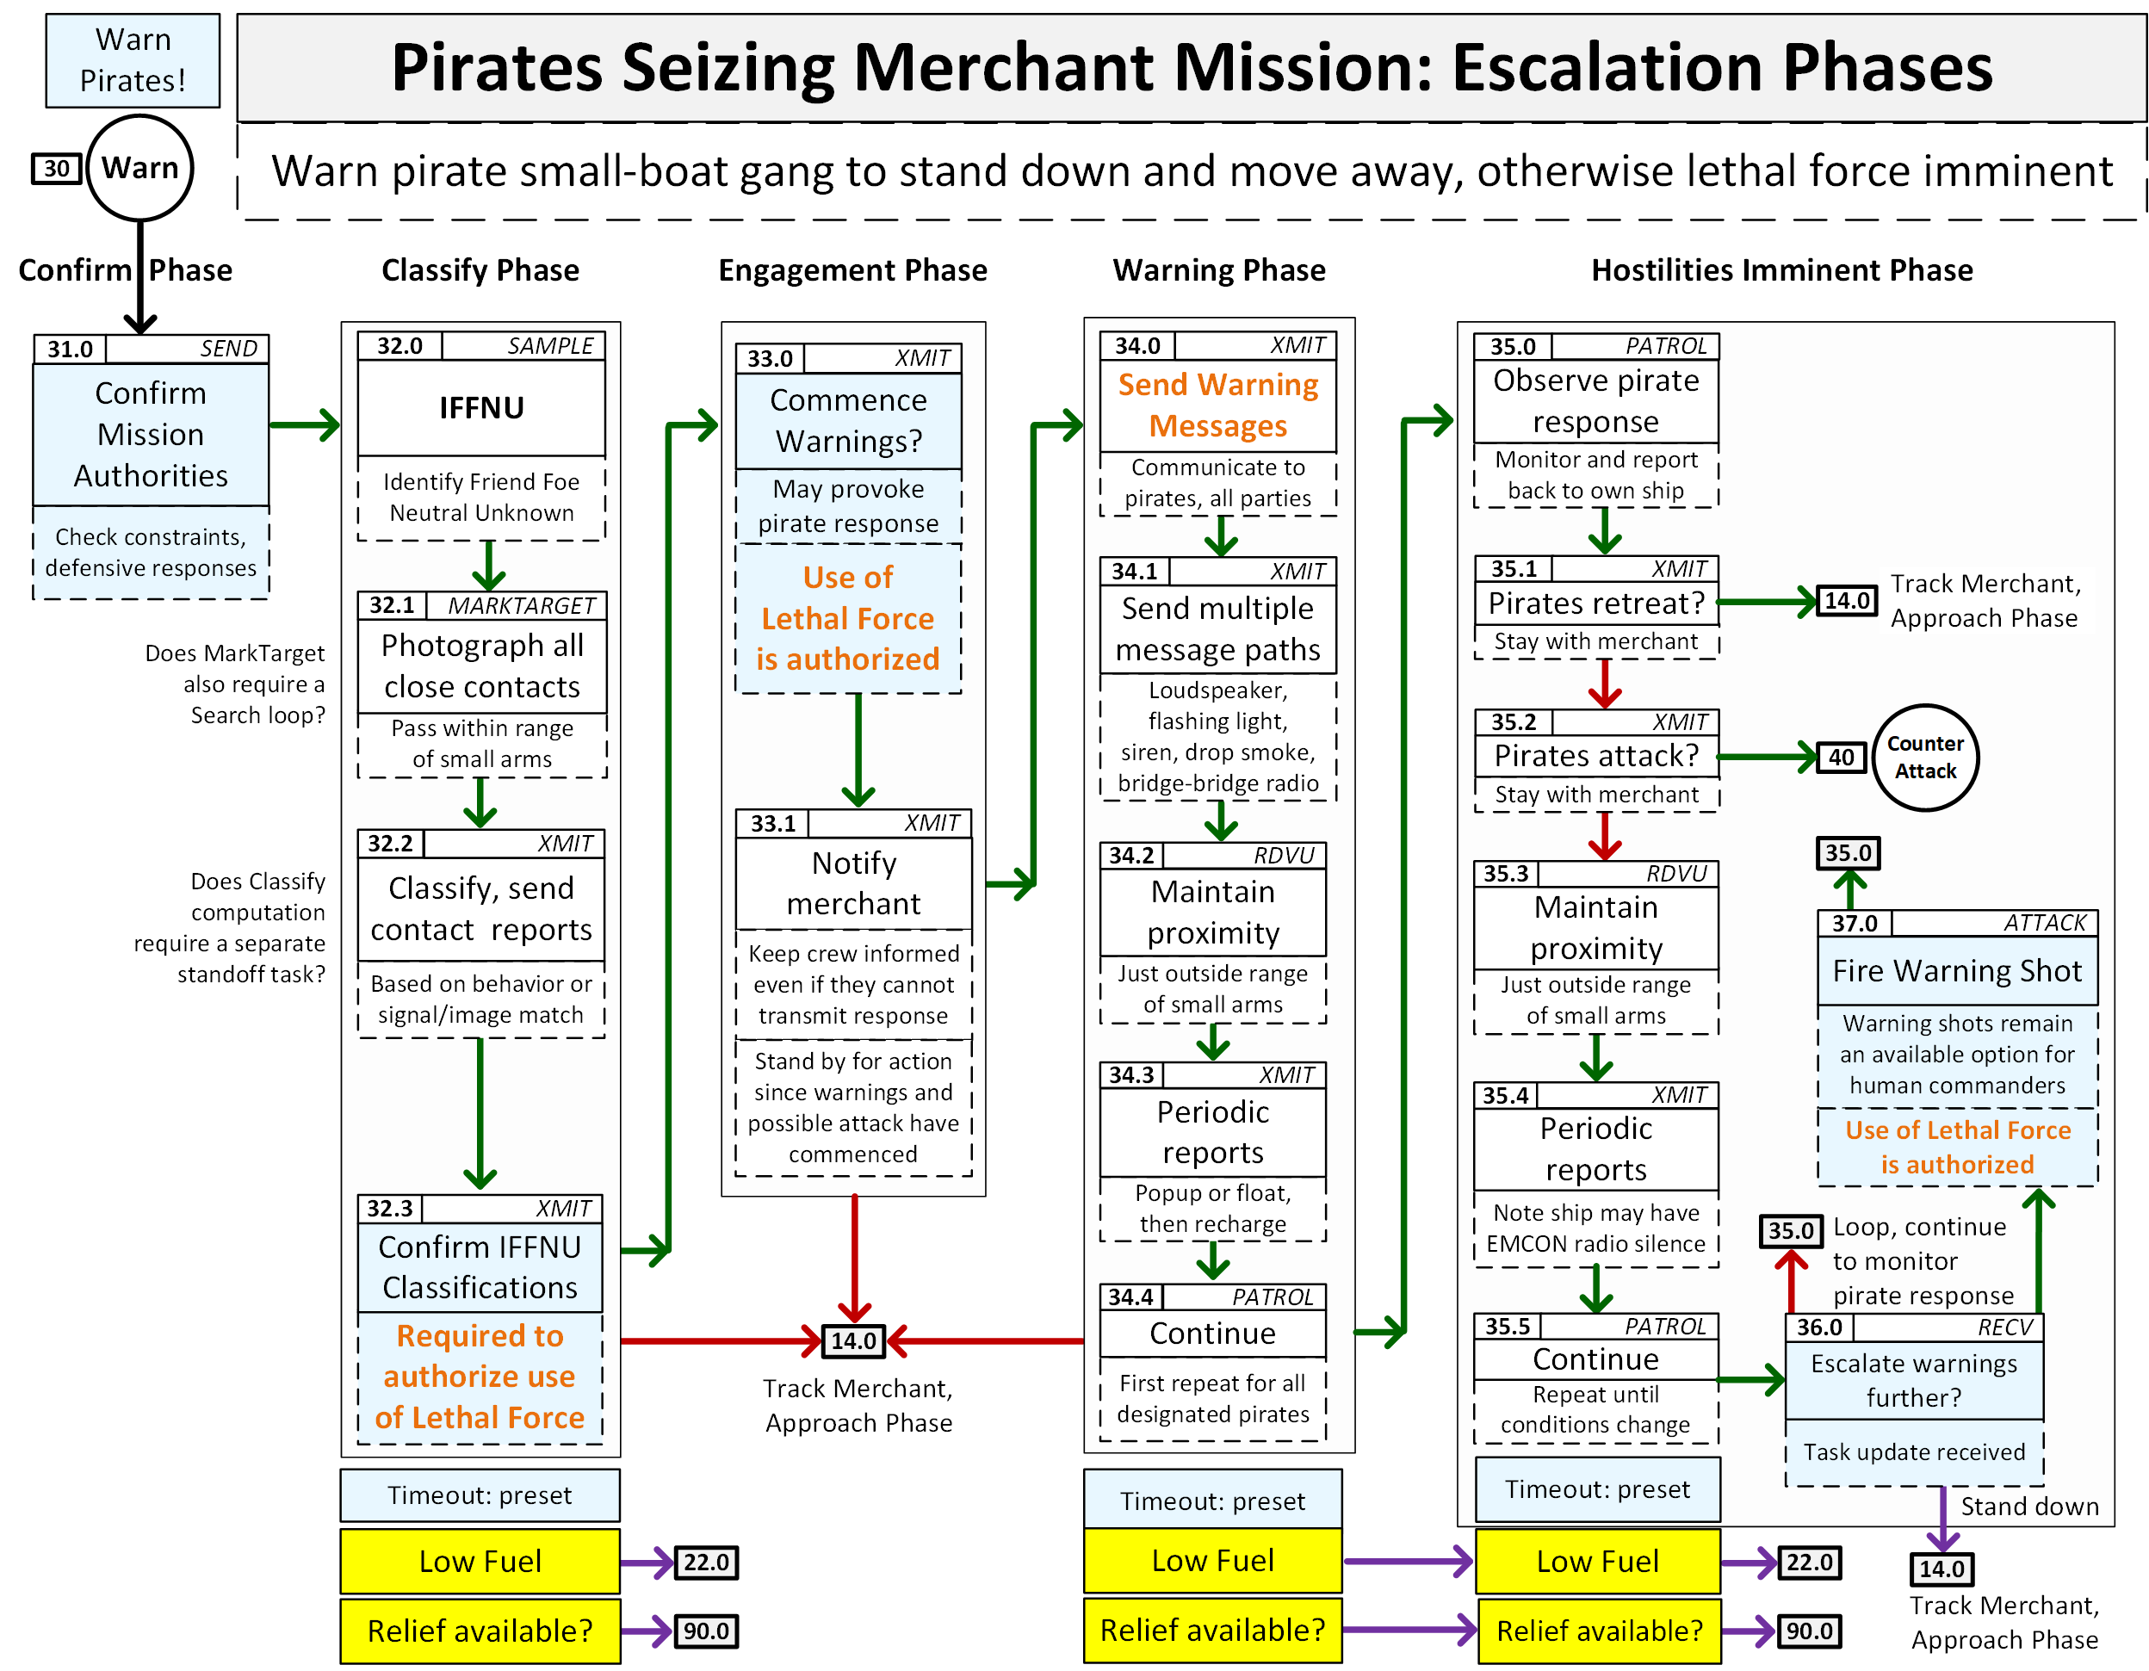
Pirates attack merchant ship 2

Slide 83
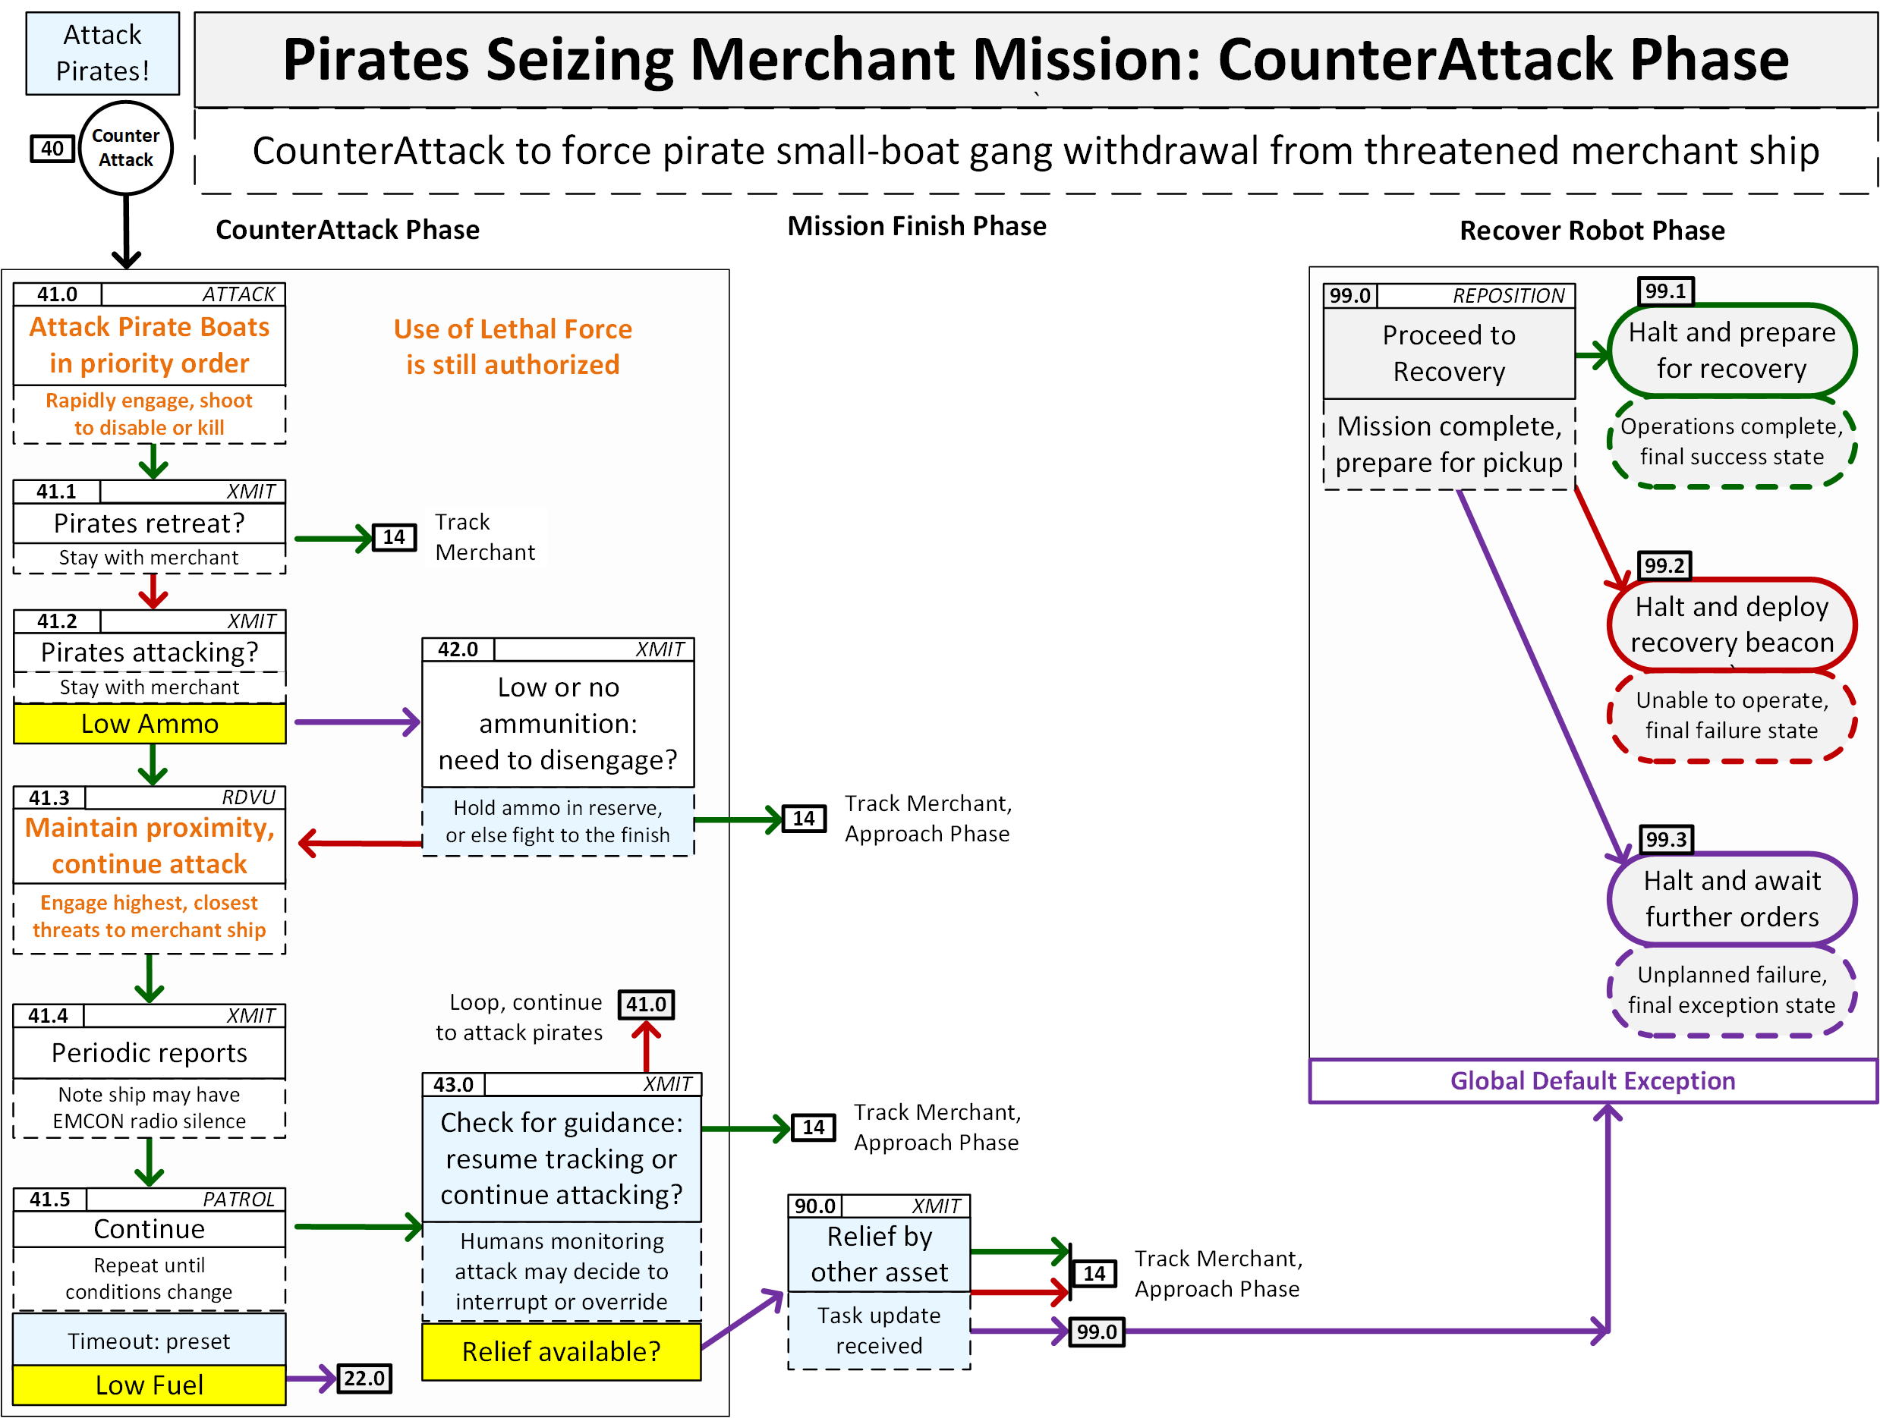
Pirates attack merchant ship 3

Slide 84
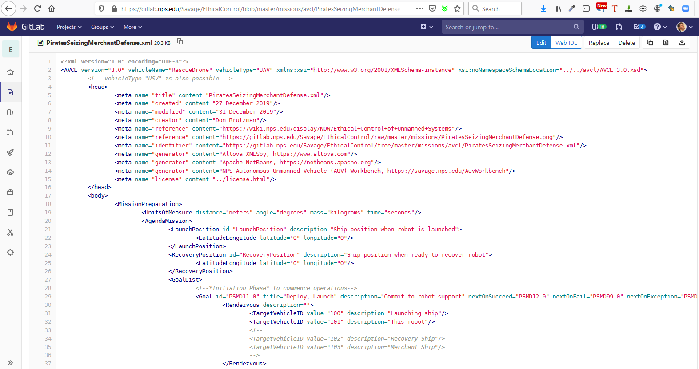
PiratesSeizingMerchantDefense.xml in gitlab.nps.edu version control

Slide 85
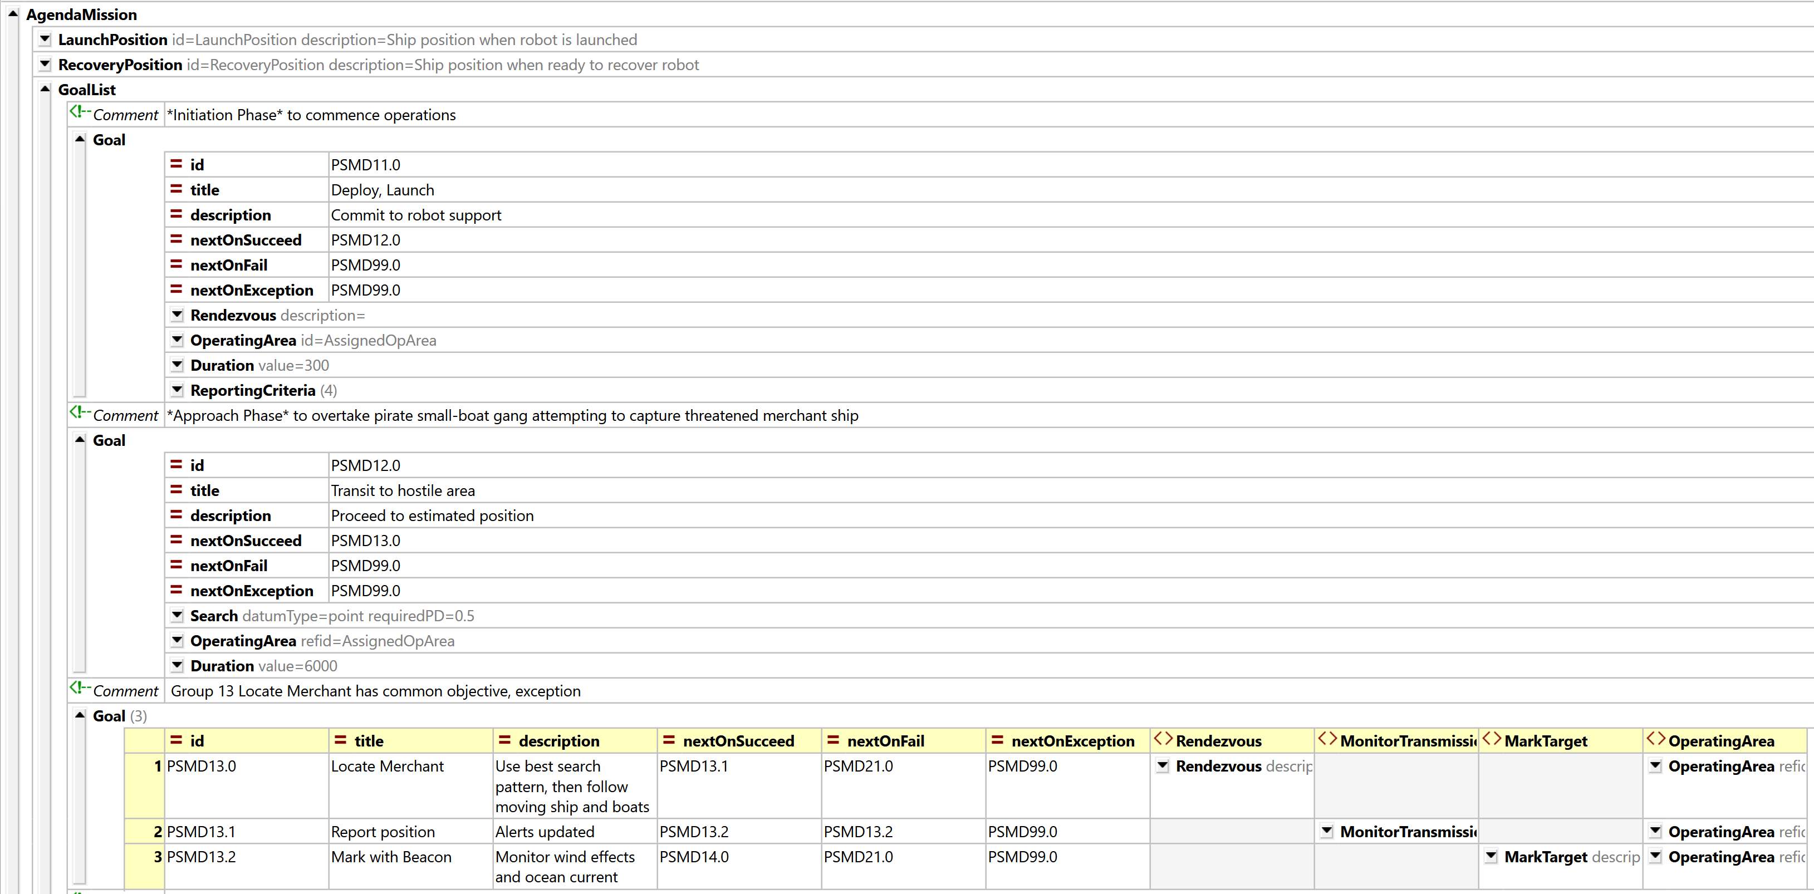
PiratesSeizingMerchantDefense.xml AVCL 1

Slide 86
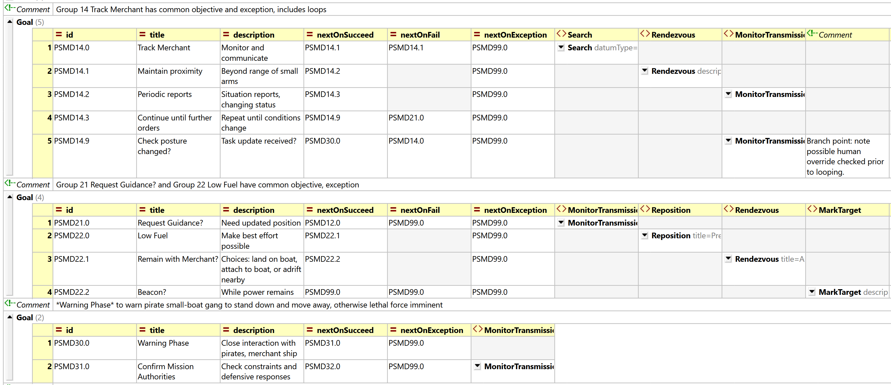
PiratesSeizingMerchantDefense.xml AVCL 2 Track Merchant

Slide 87
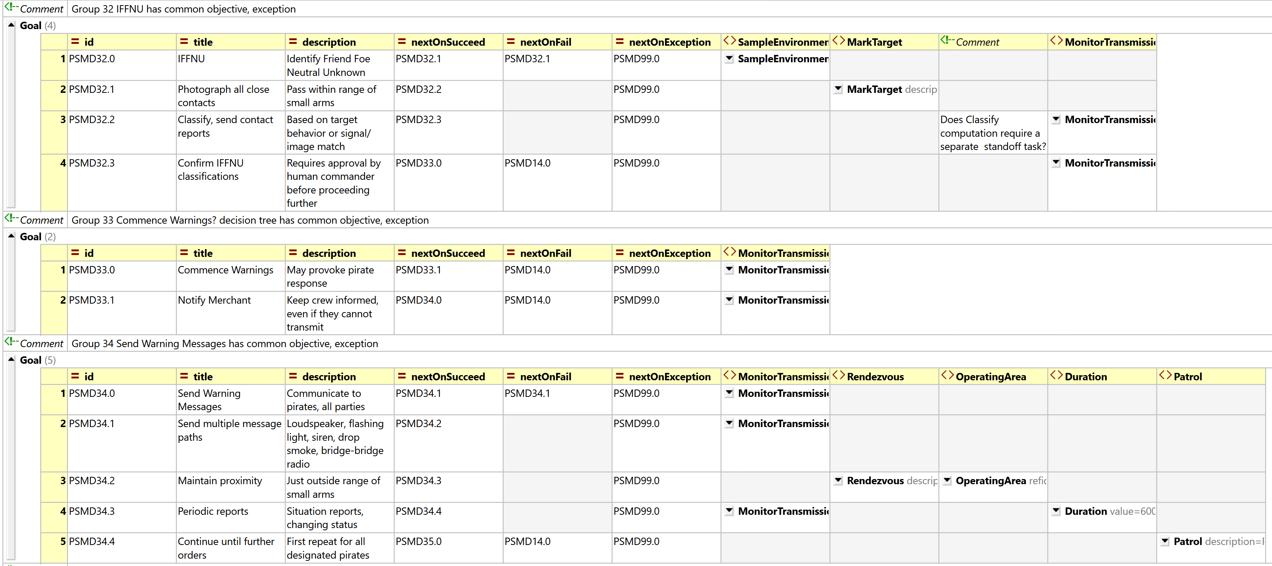
PiratesSeizingMerchantDefense.xml AVCL 3 Warning Phase initiation

Slide 88
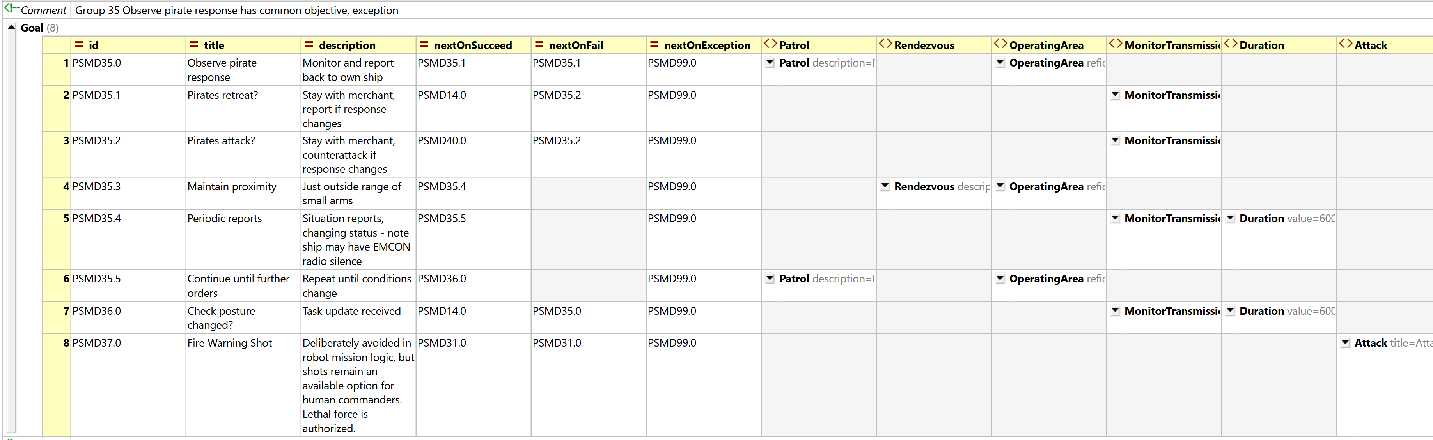
PiratesSeizingMerchantDefense.xml AVCL 4 Observe Pirate Response to warnings

Slide 89
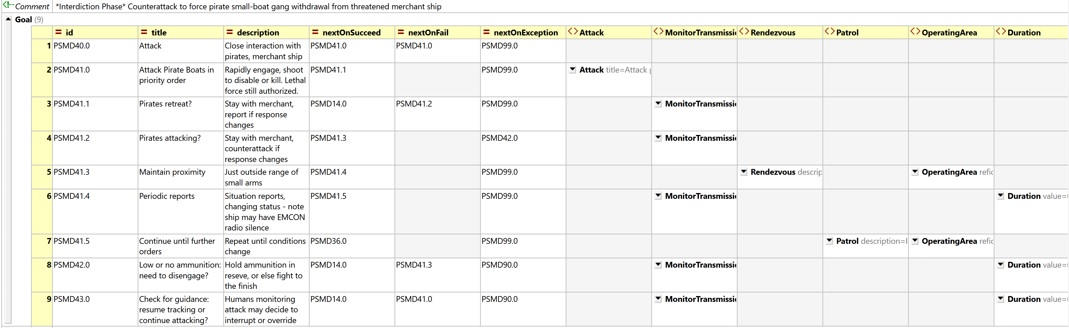
PiratesSeizingMerchantDefense.xml AVCL 5 Interdiction Phase

Slide 90
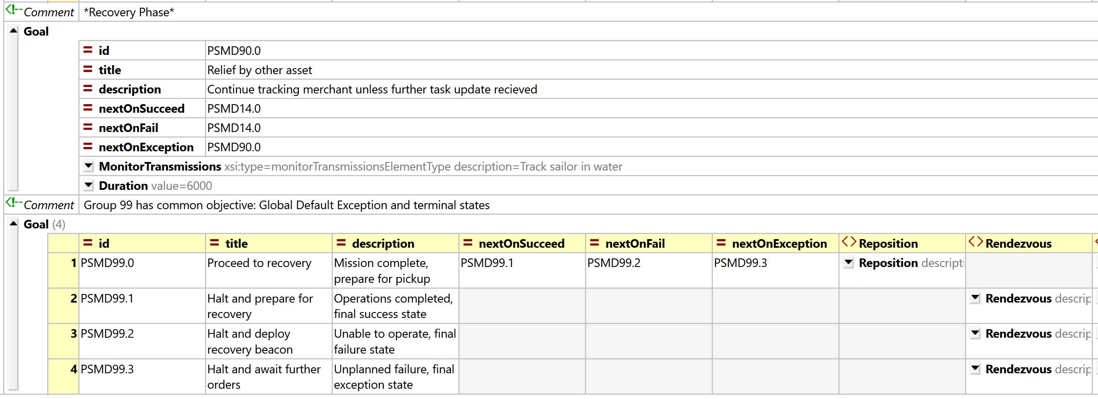
PiratesSeizingMerchantDefense.xml AVCL 6 Recovery Phase

Slide 91
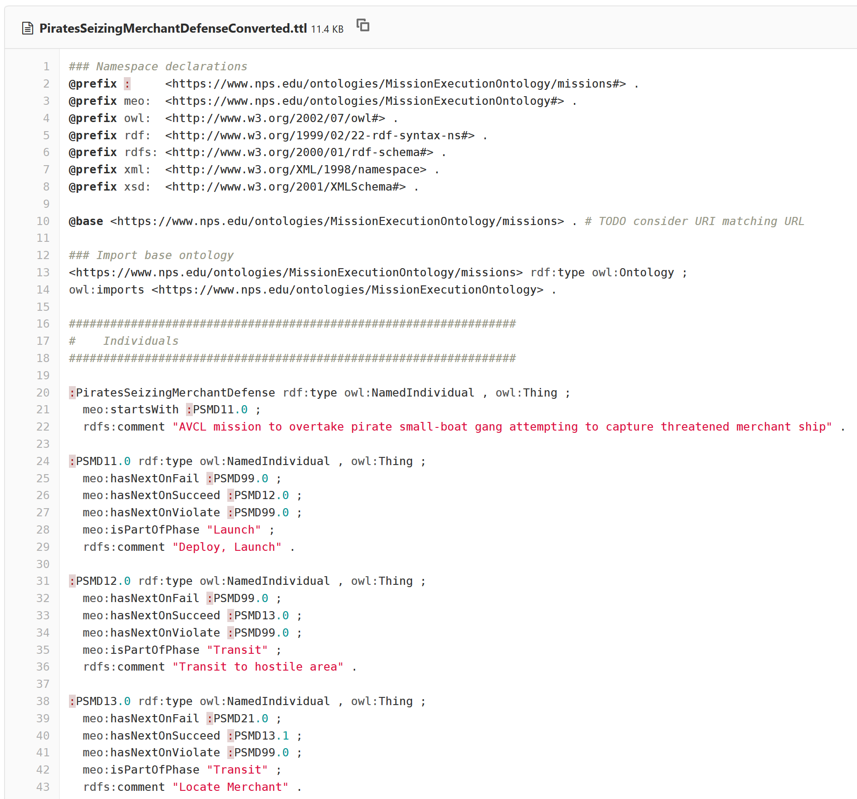
PiratesSeizingMerchantDefenseConverted.ttl Turtle excerpt autogenerated in gitlab.nps.edu version control

Slide 92
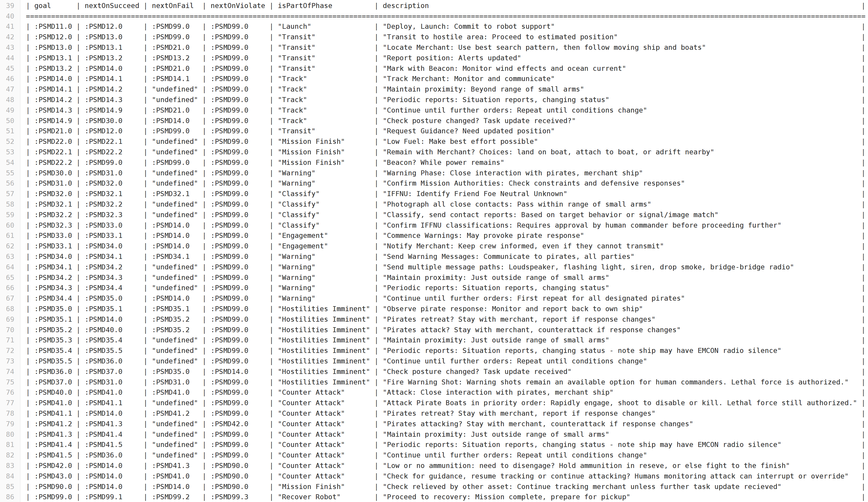
SPARQL query response PiratesSeizingMerchantDefenseConverted.MissionGoalsQuery_01_GoalBranches.rq.txt

Slide 93
Hospital Ship EM Decoy Scenario: Design
Motivations
Simplistic sense-decide-act responses easily exploitable by adversary.
Failure to operate with ethical control results in blue-on-blue damage, self-inflicted war crime, likely stand down of all unmanned systems.
Compare/contrast mission operations with/without ethical control.
Lessons learned
Historical context: False flag scenario where opponent appears friendly.
Comparison with OODA loop principles ensures that human-robot teamed operations are well understood and tactically effective.

Slide 94
Hospital Ship EM Decoy Missions: Description
Purpose: Comparison
Immediate reaction by robot swarm using only Sense-Decide-Act cycle results in unintended blue-on-blue war crime.
Ethical Control constraints (identity, OODA orientation to confirm) prevent automatic counterattack, accelerates defense.
Phases
Set response thresholds, detect threat, counterattack ship or threat.
Human Supervisory Role
Confirm IFFNU classification, must permit lethal force prior to use.

Slide 95
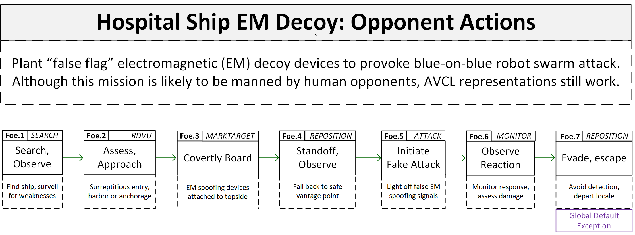
Hospital ship EM Decoy: Opponent Actions
Simple yet effective

Slide 96
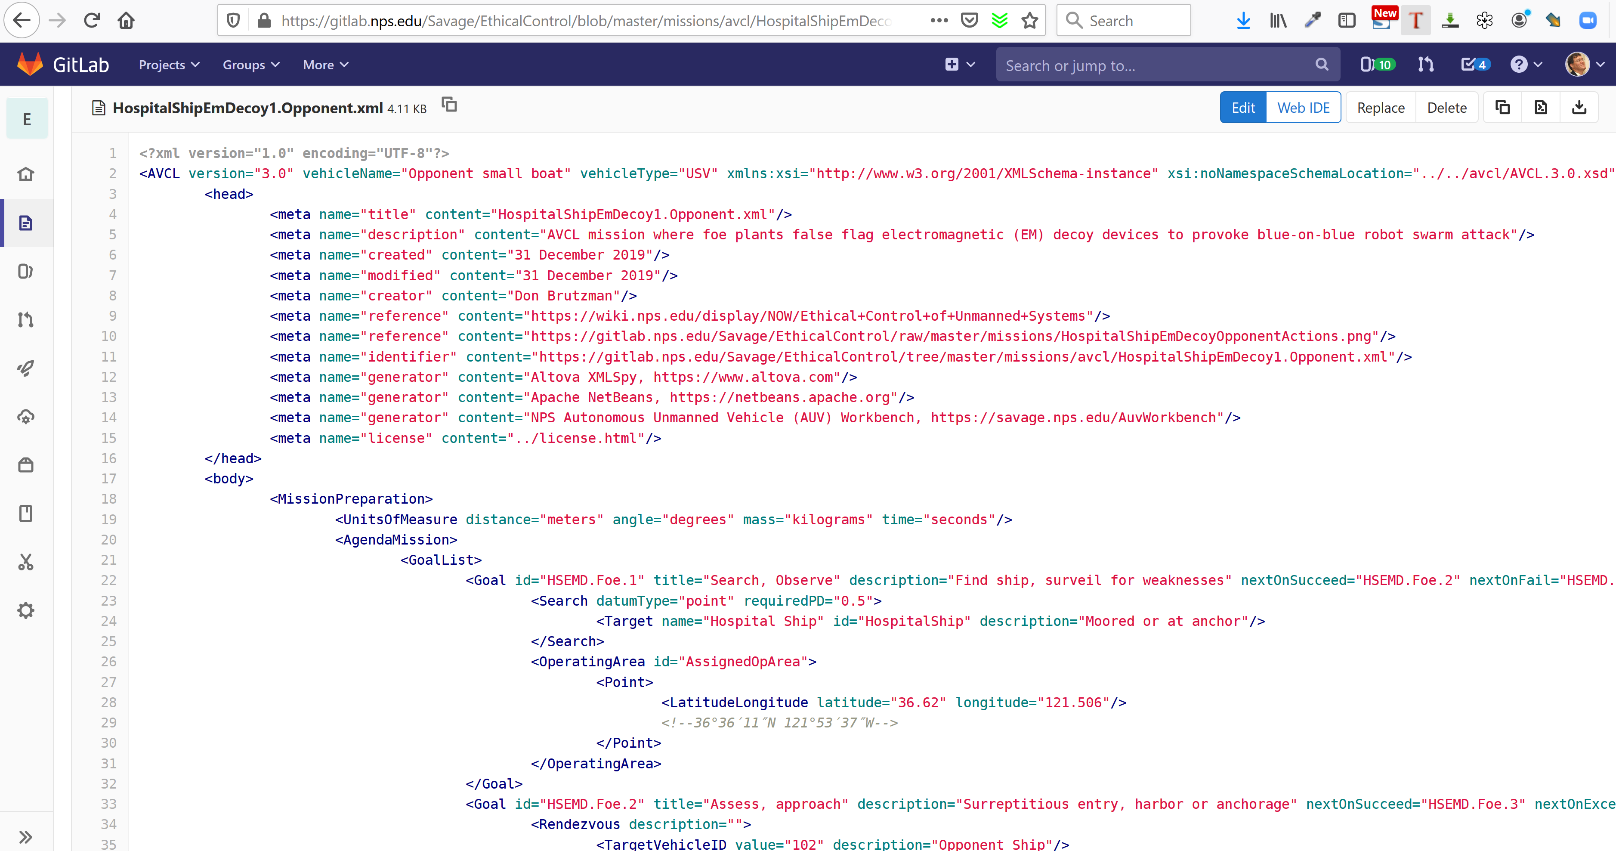
HospitalShipEmDecoy1.Opponent.xml in gitlab.nps.edu version control

Slide 97
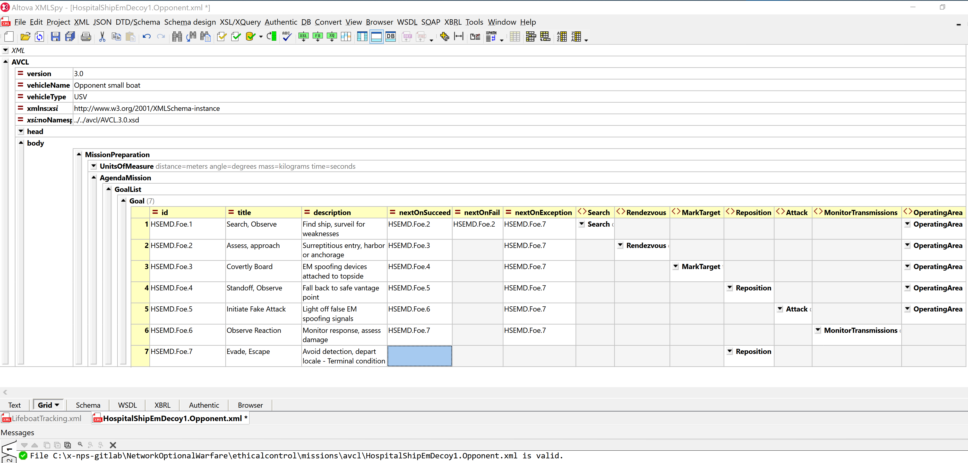
HospitalShipEmDecoy1.Opponent.xml AVCL

Slide 98
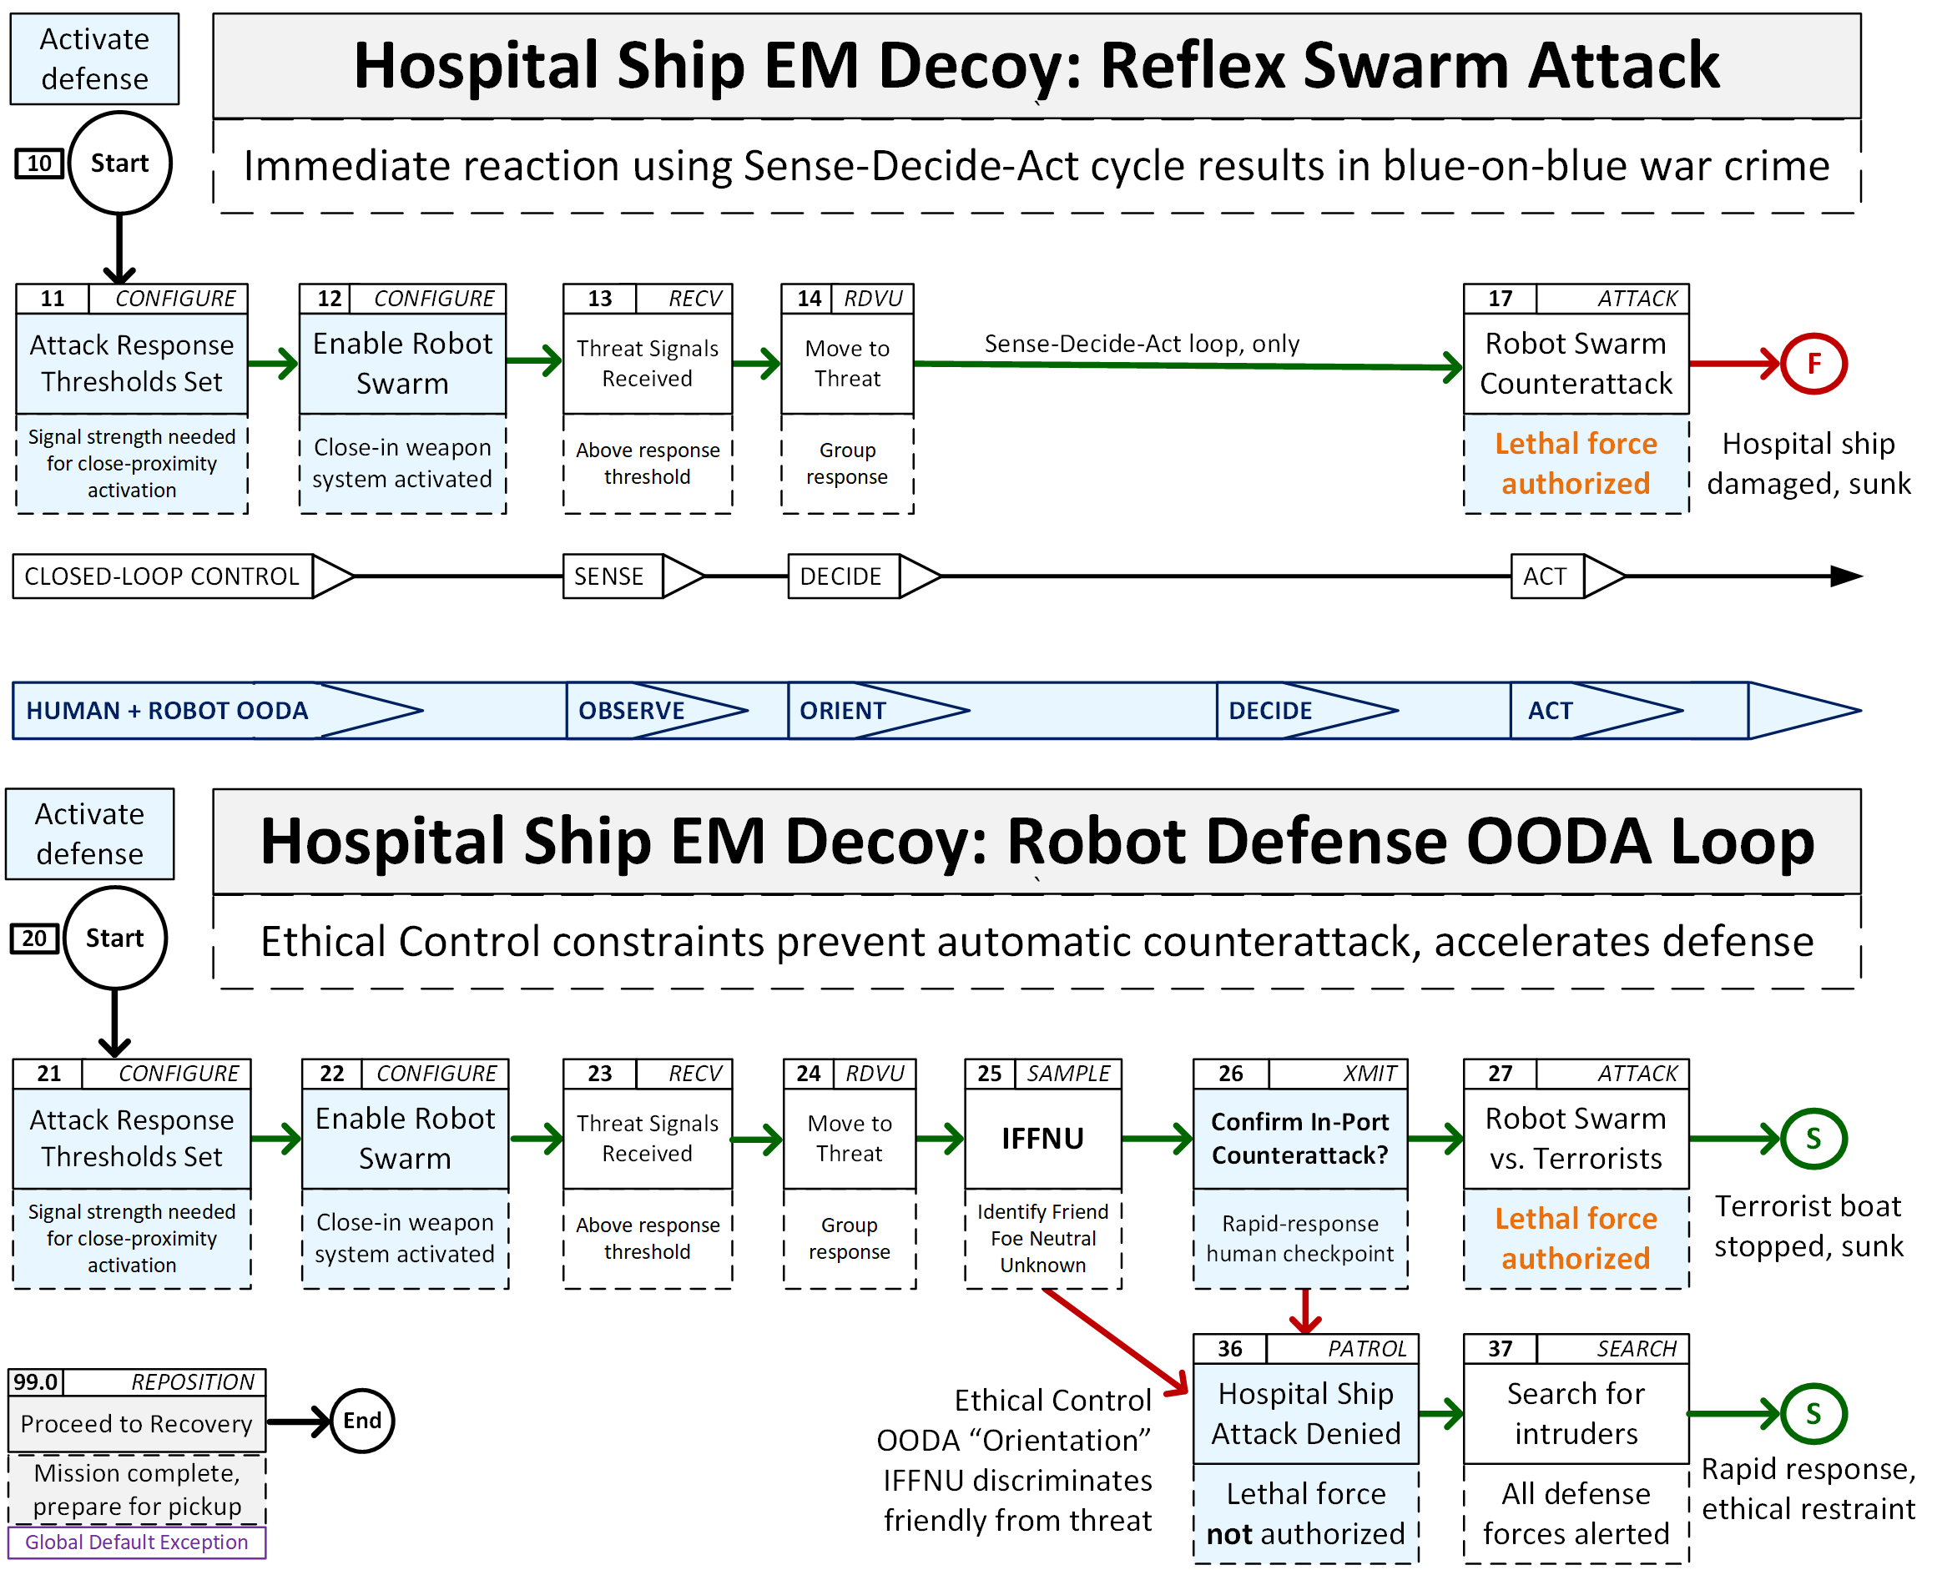
Hospital ship EM Decoy: Robot Responses

Slide 99
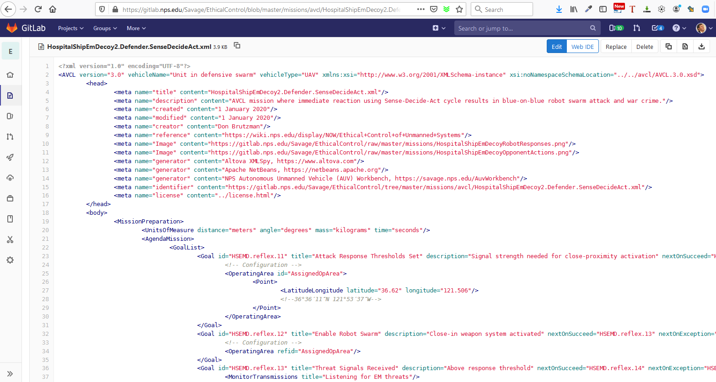
HospitalShipEmDecoy2.Defender.SenseDecideAct.xml in gitlab.nps.edu version control

Slide 100

HospitalShipEmDecoy2.Defender.SenseDecideAct.xml AVCL

Slide 101

HospitalShipEmDecoy3.Defender.EthicalControlOODA.xml in gitlab.nps.edu version control

Slide 102

HospitalShipEmDecoy1.Opponent.xml AVCL

Slide 103

HospitalShipEmDecoy2.Defender. SenseDecideActConverted.ttl Turtle excerpt autogenerated in gitlab.nps.edu version control

Slide 104

HospitalShipEmDecoy2.Defender. EthicalControlOODAConverted.ttl Turtle excerpt autogenerated in gitlab.nps.edu version control

Slide 105



SPARQL query response resultsHospitalShipEmDecoy1.OpponentConverted.MissionGoalsQuery_01_GoalBranches.rq.txt
SPARQL query response HospitalShipEmDecoy2.Defender.SenseDecideActConverted.MissionGoalsQuery_01_GoalBranches.rq.txt
SPARQL query response HospitalShipEmDecoy3.Defender.EthicalControlOODAConverted.MissionGoalsQuery_01_GoalBranches.rq.txt

Slide 106
Several new AVCL mission goal types needed
Current mission-goal vocabulary seems sufficient for most tasks considered.
Prior work consolidated 12 goal types from multiple data models.
SampleEnvironment awkwardly phrased when scanning for vessels…
MonitorTransmissions needs to distinguish transmit and/or receive…
Additional goal categories can help establish good design patterns for tasks.
Configuration: apply settings, make preparations (stationary Patrol?)
Checkpoint: clarify decision branching, including via external communication. If loop branching is enabled, termination conditions must be provided in order to avoid infinite loop or deadlock conditions.
Current AVCL3 mission designs descriptively apply existing goal types and is confirming that these further types are indeed necessary.

Slide 107
Current work in progress
Demonstrations for all missions
Semantic Web ethical validation: proven capability, adding depth/breadth.
AUV Workbench simulation confirmation: advancing steadily.
With those additions
we will have simulated evidence of correctness for all exemplar missions,
Project Conclusions and Recommendations are grounded at a higher TRL.

Slide 108
AVCL Missions in Multiple Programming Languages
We are demonstrating AVCL mission parsers using multiple programming languages, in order to demonstrate that Ethical Control can be supported by any unmanned system.
Notes:
Multiple Programming Languages

Slide 109
Tech Memo: Rational Behavior Model (RBM) for Exhaustive Testing of Mission Software
“Rational Behavior Model (RBM): Achieving Fail-Safe and Ethically Constrained Missions by Human/Robot Teams Using Exhaustively Testable Self-Monitoring Software” by Robert McGhee, Don Brutzman, and Curtis Blais, Technical Memo, NPS, November 2019.
Examines Mission Execution Automata (MEA) example Java mission presented in IEEE Journal of Ocean Engineering (JOE) 2018 paper.
Demonstrate algorithm for searching all possible decision points.
Test cases in both Lisp and Prolog programming languages.
Future work: codify test sequences of interest with expected outcomes as integral part of validated missions to support ongoing regression testing within each programming language of interest.

Slide 110
Multiple Programming Languages
Implementing AVCL mission parsers in multiple programming languages encourages potential deployment of Ethical Control across many robots.
Java using AUV Workbench is the initial implementation.
XSLT for mission conversion via multiple “AvclToLanguage” stylesheets.
Lisp is a functional programming language for AI research.
Prolog is a logic programming language associated with AI research and computational linguistics.
“Your Programming Language Here” ecosystem of rigorous parsers.
Future Work: qualification of robot abilities to follow AVCL missions.

Slide 111




Programming environments in use
Java
OpenJDK 13 and Oracle JDK 13
Apache Ant, Netbeans 11.2
Lisp
Franz Allegro Common Lisp (ACL) 10.1
Armed Bear Common Lisp (ABCL)
Prolog
Franz Allegro Prolog (bundled with ACL)
TODO: GNU Prolog
NPS Savage
Developers Guide
includes tool links

Slide 112

Java: Autonomous Underwater Vehicle (AUV) Workbench
The NPS Autonomous Unmanned Vehicle Workbench (AUVW) is experimental open-source software that supports physics-based mission rehearsal, real-time task-level control of robot missions, and replay of recorded results in support of autonomous unmanned underwater, surface and air vehicles.
AUV Workbench encompasses multiple Java-based simulation programs that can parse and execute AVCL missions with controllers getting feedback from a high-fidelity 6 degree of freedom (6-DOF) hydrodynamics model.
Java custom library parses AVCL XML directly without requiring any further conversion, also validates mission correctness.
Future work: extract a simple standalone AVCL parser for general Java use.

Slide 113

XSLT Extensible Stylesheet Language for Transformations
Mission Converter
XSLT is an XML-based language used for transforming XML documents into other forms
For example, AVCL XML into a variety of alternatives.
Does not change original document while producing a new one.
Takes advantage of strictly-defined vocabularies and well-validated structure.
Open standard, World Wide Web Consortium (W3C)
Well suited for diverse conversion tasks.
Program Source Code

Slide 114
Lisp Programming for AVCL Mission Logic
Common Lisp is a functional programming language for AI research.
https://gitlab.nps.edu/Savage/EthicalControl/tree/master/missions/lisp holds automatic conversions of all project AVCL missions.
AvclToLisp.xslt stylesheet reads AVCL XML to produce Lisp source code
Initial section is Mission Execution Engine (MEE) goal-traversal algorithm.
Next section defines, allows operator testing of mission-goal decision tree logic.
Sailor Overboard mission includes example operator test sequences.
Simple test routine shows how to run all possible choice sequences.
Future work: automate exhaustive testing of all choices in all missions as initial exemplar for exhaustive verification of mission logic.

Slide 115


Sailor Overboard mission in Lisp, excerpted

Slide 116


Sailor overboard example operator test sequences in Lisp

Slide 117


Simple Lisp test routine of Sailor Overboard mission logic

Slide 118

Running all possible choice sequences of Sailor Overboard mission logic

Slide 119

Autogenerated mission excerpt: LifeboatTracking in Lisp All existing AVCL missions are converted to Lisp and tested successfully

Slide 120
Prolog Programming for AVCL Mission Logic
ANSI Prolog is a logic programming language associated with AI research and computational linguistics.
https://gitlab.nps.edu/Savage/EthicalControl/tree/master/missions/prolog holds automatic conversions of all project AVCL missions.
AvclToProlog.xslt stylesheet reads AVCL XML to produce Prolog source code.
Initial section is Mission Execution Engine (MEE) goal-traversal algorithm.
Next section defines, allows operator testing of mission-goal decision tree logic.
Mission Execution Engine holds common code for Sailor Overboard mission accompanied by console log of example operator test sequences.
Future work: test routine showing how to build all possible choice sequences.
Future work: automate exhaustive testing of all choices in all missions as initial exemplar for exhaustive verification of mission logic.

Slide 121

Mission Execution Engine in Prolog, excerpted

Slide 122

Sailor Overboard mission in Prolog, excerpted

Slide 123

Sailor overboard example operator test sequences in Prolog

Slide 124

“Your Programming Language Here” example
Robot software tends to be highly specialized, idiosyncratic, evolving.
Despite rapid change, programmers want library reuse + flexible repeatability.
Robot Operating System (ROS) is steadily gaining usage
with hardened ROS-Military (ROS-M) version available.
Creating a family of AVCL parsers that can read XML-based missions opens the door to interoperability and shared support.
Automating the production of these parsers from the AVCL schema ensures that all systems can have rigorous and consistent support.
Individual robot logic may vary widely in implementation details, but core semantics of AVCL goals and nomenclature remain well defined.
Future work: establishing qualification testing for software or hardware running “in the loop” can confirm that individual robots operate safely.

Slide 125
Simulation and Visualization
Rehearsal, real-time runs and replay are possible using AVCL constructs across multiple representations and programming languages.

Slide 126
Path towards achieving interoperability
Robotic systems tend to be complex codebases with implementations that require strict, idiosyncratic, language-specific programming logic.
In general, system designers can say “here are the requirements”
In general, programmers can say “here’s how we wrote that code”
… but these are not the same, often not even sharing same terms of reference!
Traceable predictability of software logic is difficult, not portable across systems.
… but confirming code capabilities is testable and repeatable across systems.
Key point: strict validation of mission syntax, semantics are both possible!
Patterns of implementation then become demonstrable in different systems,
Human confirmation of mission definitions remains central throughout.

Slide 127
Multiple implementations for scalability
Given the broad diversity of robotic software and hardware systems under development, no single reference codebase is either possible or desirable.
Nevertheless systems can easily parse and utilize well-defined data (orders).
Focusing on formal mission definition for both humans and systems provides a testable middle ground that each can use effectively.
Implementing and evaluating using multiple software implementations also provides strong evidence that design capabilities all work as planned.
… in turn producing corresponding work lists of needed improvements, to help both mission-design clarity and software-implementation correctness.
This project multiple programming paths in tandem, in order to demonstrate that multiple kinds of unmanned systems can adopt it on their own terms.

Slide 128
Data representation languages of interest
Extensible Markup Language (XML) provides declarative basis for customized, strictly defined data definitions of interest.
Autonomous Vehicle Command Language (AVCL) is defined using XML schema for strict validation of syntax, particularly hierarchical data modeling relationships, strictly defined enumerations and legal values for numerical values.
Semantic Web languages add ability to perform queries and reasoning.
Turtle (Terse Triple Language) deconstructs AVCL into primitives.
RDF/OWL expresses logical conditions and constraints of Mission Execution Ontology (MEO) corresponding to AVCL.
SPARQL query language enables further inspection and verification of logical relationships.
Not used in this work: JavaScript Object Notation (JSON) syntax is also available.
Common use, potential to match XML expressiveness, lesser validation maturity.

Slide 129
Programming languages of interest
Java is primary language used for exemplar robot controllers.
Implemented in AUV Workbench and various build processes.
Not currently used but similar expressiveness: C++ and C# (C sharp).
Lisp and Prolog are also used for testing AVCL mission-tasking logic.
Both are well suited for AI application design.
Earlier thesis work similarly applied CLIPS expert-system rule bases.
Of note: AVCL missions can be used to autogenerate exemplar source code in various alternative languages by creating XLST conversion stylesheets.
Thus showing interoperability path to all manner of robotic systems.

Slide 130
Presentation languages of interest
HTML5 for mission reports as portable, archival Web pages
Also Cascading Style Sheets (CSS) for consistency, quality
KML for annotated, animated placemarks on maps and globes
OpenStreetMap/OpenSeaMap, Google maps, etc.
Extensible 3D (X3D) Graphics for 3D visualization and animation
Future publication expected in SPIDERS3D virtual environments (VE)

Slide 131

AUV Workbench
Example
open-source
implementation
Autonomous Unmanned Vehicle (AUV) Workbench supports underwater, surface and air vehicles
Rehearsal of physics-based mission response
Real-time task-level control of robot missions, and
Replay of recorded results
Industry-friendly open-source license, Sourceforge
Basis: RBM 3-level architecture, AVCL commands
Used to rehearse strategic-level agenda missions
https://savage.nps.edu/AuvWorkbench

Slide 132

4 earlier example missions, UUV and USV

Slide 133
AVCL version 3 improvements planned
Coder speak!
Refactoring of agenda mission definitions is being closely considered.
Overly complex, multiple data-model simplifications in progress.
Consolidating distinctions between UAVs, USVs, UUVs, UGVs.
Ensuring convertibility AVCL3 to AVCL2 for backwards compatibility.
Refactoring corresponding software implementation in Java:
Prior AVCL2 implementation uses Java Advanced XML Binding (JAXB) which is exceedingly complex and difficult to maintain.
Planning to create Plain Old Java Object (POJO) mapping for AVCL3, will be much easier to maintain and utilize programmatically.
Review, confirm mappings for mission scripts and telemetry logs are OK.

Slide 134
AUV Workbench improvements planned
Coder speak!
TODO
Upgrade legacy codebase and libraries to latest versions of Java
Upgrade AUV Workbench to support for AVCL version 3 missions
Near term will be quite simple, AVCL3 -> AVCL2 conversion
Display conduct of canonical missions developed in this project
Manually record videos of mission demonstrations and playbacks
Update mission production of HTML reports, KML maps, X3D graphics
Support project report and multiple peer-review presentations

Slide 135
AUV Workbench Demo Mode 1
How can we rapidly test missions and visualize their progress?
Demo mode resets each goal's Search type to EXPANDINGSQUARE
with slight change in criteria: reaching the center of the goal is sufficient to declare goal success, skipping the actual search.
Demo mode thus lets a mission proceed as written in rapid fashion to illustrate decision-tree logic checking.
Demo: 2D map display on next slide shows
Green arrows are nextOnSuccess,
Orange arrows are nextOnFailure,
Bolded arrows indicate which of choices was taken during mission conduct.
_S_uccess _F_ailure letters (upper-left panel) also report results of each Goal's conduct.

Slide 136

AUV Workbench Demo Mode 2
Example simulation using AUV Workbench

Slide 137
AUV Workbench Demo Mode 3
Repeatable Ethical Mission Testing
Goal-by-goal narrative of completed mission conduct [0] Launch from launch position. [6] Avoid first obstacle, next proceed to goalA boundary and then center. [2] Once at center: success goalA (Search), next proceed to goalB boundary and then center. [3] Once at center: success goalB (Sample Environment), next proceed to goalC boundary and then center. [4] Once at center: failure goalC (Search), next proceed to goalD boundary and then center. [5] Immediate failure without transit to goalD (Rendezvous) since capability is declared as not supported by robot controller. [1] Proceed directly to nextOnSuccess Recovery Position, once there finished in terminal state.
Methodology summary
Read an AVCL mission document
Test decision logic using a virtual Software In The Loop (SITL) robot controller,
Run within an evaluation virtual environment (AUV Workbench).
Human evaluators then evaluate proper execution of the AVCL ethical mission, specifically assessing that robot-controller SITL within the AUV Workbench virtual environment.

Slide 138
Qualification of unmanned systems: extend Verification Validation Accreditation (V V&A)
Proposed Future Work
SISO V V&A Study Group
How to test and certify robots will follow both orders and constraints? Humans confirm understanding and trust through qualification processes.
Design, construct “qualification card” for testing unmanned systems…
Comprehensive virtual environment, hardware/software in the loop.
Carefully crafted scenario testing of key requirements and capabilities.
Anti-pattern tests to provoke and confirm constraints are not violated.
Record all unit-test decision trees, decision-branching traces, and results as a certification record for each hardware/software version of robots.
Visualize realistic rehearsal, real-time and replay of robot operations repeatably using shared Web-based SPIDERS3D virtual environment.
Humans assess mission logs and scenario outcomes for after-action analysis, lessons learned, and continuous improvement via suite of unit tests.

Slide 139
Python Mission Evaluation, Exhaustive Test Analysis and Connecting to AI-based Opponent Systems
Implementation Demonstration Video, Jon Cefalu, neurobinder.com 16 December 2020 (59:41)
( (6:00) Jon shows new capabilities include a Python implementation for exercising decision logic in Autonomous Vehicle Command Language (AVCL) mission. Additional features include the ability to exhaustively test mission variations, checking functional mission correctness and detecting decision loops.
(20:00) Mission testing considerations appear to provide an initial basis for evaluating human-machine mission logic and code coverage, building stepping stones towards model-based testing as well as verification and validation,
(27:30) Jon also demonstrated cross-connecting the Pirate mission to AI Dungeon (Wikipedia), a text-based adventure game engine based on the Generative Pre-trained Transformer 3 (GPT-3) language-prediction model by OpenAI that uses deep learning to produce human-like text responses. Despite only superficial configuration, scenario exploration became possible using interesting (and occasionally outlandish) text responses from the tool.
(48:30) Group discussion on future design considerations for connecting human-machine teaming systems with realistic wargaming systems for sensitivity analysis, massively repeatable testing, and analysis of alternatives.

Slide 140


Python mission testing vieo
Notes:
https://savage.nps.edu/EthicalControl/#PythonMissionEvaluationVideo

Slide 141
Data-Centric Security and Trust
Compression, authentication, encryption, composability, blockchain ledger, and asymmetric advantages enable group communication of secure mission orders and responses. This is a Chain of Trust for distributed Command Authority.

Slide 142
XML Security for Data: Structure 1
Extensible Markup Language (XML) provides formal structure for data models and information exchange.
“XML is a markup language that defines a set of rules for encoding documents in a format that is both human-readable and machine-readable.” – Wikipedia
Declarative and self-describing data structures, not program source code.
Data validation through XML Schema includes strong typing of values and correct parent-child hierarchical relationships.
Avoids Garbage In Garbage Out (GIGO) pathologies when communicating between multiple systems and across related protocols.
Similarly applicable using JavaScript Object Notation (JSON) and other formats.
Offers complete precision of expressive power when defining human orders and system responses, e.g. via Autonomous Vehicle Command Language (AVCL).

Slide 143
XML Security for Data: EXI Compression 2
Efficient XML Interchange (EXI) provides best-possible compression of XML documents, reducing size and speeding up decompression.
Years of work by exceptionally competent working group, proven results.
EXI Recommendations by World Wide Web Consortium (W3C).
Multiple open-source and commercial implementations in Java, C++
Preserves sufficient structure for lossless composition of compressed XML.
Thus even signed and encrypted data documents shown in this work can get best-proven compression for use on limited, disadvantaged and challenged communications links facing deployed Naval forces.

Slide 144
Network Optional Warfare (NOW): Efficient Messaging
Navy networks afloat are very different than networks ashore. Bandwidth is a precious and finite resource, latency can be huge, connectivity can be intermittent, environmental effects dominate, channels are limited in varying ways, and mobile relays are rare. Manned and unmanned naval systems need efficient messaging for networks afloat - but rarely have it. Failing to properly utilize communications capacity directly limits tactical effectiveness.
Efficient messaging is needed to take maximum advantage of severely constrained data links. The key to our strategies for achieving efficient messaging is first to use of Extensible Markup Language (XML) for structured data languages, and then use EXI for compressing XML. Since XML provides a flexible and validatable way to define regular data structures for any language, it provides a practical opportunity to compatibly capture and convert all manner of diverse data formats used for military messaging. The economics of Web technologies are undeniable and usually provide industry-wide best practices as well. As a result, this use of open standards is scalable and repeatable, avoiding the "stove pipes" which commonly prevent system-wide interoperability between Navy platforms and coalition partners.
"Efficiency" means both size and speed. EXI has demonstrated compaction that always meets or beats the most commonly used compression techniques (zip and gzip). Additionally, because EXI decompression goes straight into memory rather than string characters, which then require significant additional parsing, decoding EXI is many times faster than other techniques. This approach also reduces memory requirements and power consumption on small devices. Because Navy tactical traffic is usually highly structured and highly numeric, EXI provides major advantages that might well impact all afloat Navy communications. Alternative bit-centric compression schemes cannot take full advantage of those characteristics.
"Efficiency" is compatible with Data-Centric Security. Demonstrated thesis work has shown that digital signature (for authentication) and XML Encryption (privacy and access control) can coexist with efficient compression, when applied in the correct order. Such interoperability for Information Assurance (IA) Is necessary when working with coalition partners, and also for safeguarding data within deployed unmanned systems that are beyond the reach of network-centric security.

Slide 145
XML Security for Data: Digital Signature 3
XML Digital Signature (DS) defines XML syntax for digital signatures.
W3C Recommendation, stable since 2013, international adoption.
https://www.w3.org/TR/xmldsig-core1
Public-private key pairs for signature/authentication, key distribution is separate.
Applicable to entire documents or to fragments (subsections).
Requires XML Canonicalization of input documents to regularize formatting so that identical documents are uniquely expressed.
Can sign any data resource for identity verification, non-repudiability, confirmation that original information has not been tampered with, etc.
Completely compatible for data handling within trusted networks.
2019 NPS has adapted open-source Java version of Apache Santuario as utility classes and test suite for further use. Prior examples from years ago still work.
https://sourceforge.net/p/x3d/code/HEAD/tree/www.web3d.org/x3d/tools/security/ XmlSecurityApacheSantuario

Slide 146
XML Security for Data: Encryption 4
XML Encryption (XML-Enc) defines how to encrypt XML data.
W3C Recommendation, stable since 2013, international adoption.
https://www.w3.org/TR/xmlenc-core1
Public-private (i.e. shared-secret) key pairs, key distribution is separate.
Applicable to entire documents or to fragments (subsections).
Different from Transport Layer Security (TLS) used by http/https for sending encrypted traffic over the Internet.
Some vulnerabilities were reported publicly, but each was performed via exhaustive attacks against server, incrementally analyzing error responses. Not likely or practical mode of attack against unmanned systems.
Completely compatible for data handling within already-trusted networks.

Slide 147

XML Security Suite: unit tests sat

Slide 148
XML Security: Composition 5
EXI Compression, XML Digital Signature and XML Encryption can be composed for applying to data in single files/documents/messages.
Each technology works on data formatted as valid XML.
Multiple NPS theses have examined EXI characteristics in combination with XML Security.
Such composition is partially demonstrated, appears completely feasible.
Williams, Jeffrey S., Document-based message-centric security using XML authentication and encryption for coalition and interagency operations, Masters Thesis, Naval Postgraduate School, Monterey, California, 2009.
Each is usable in concert for data-centric security, compatibly within any secure network or within fixed/mobile data storage of unmanned systems.

Slide 149
Williams Thesis: Composition of EXI Compression, XML Authentication, and XML Signature

Slide 150

Security Assertion Markup Language (SAML)
Security Assertion Markup Language (SAML) is an open standard for exchanging authentication and authorization data between parties, in particular, between an identity provider and a service provider.
SAML is an XML-based markup language for security assertions (statements that service providers use to make access-control decisions).
With some adaptation work, SAML might be used to formally describe policies and requirements for data-centric security of mission orders.
References
RDML Danelle Barrett USN, “The data-driven Department of the Navy,” CHIPS, January-March 2018
Latest version is SAML 2.0 standardized by OASIS

Slide 151
Blockchain distributed ledger characteristics
“A distributed ledger is a consensus of replicated, shared, and synchronized digital data geographically spread across multiple sites, countries, or institutions. There is no central administrator or centralized data storage.” – Wikipedia
Design characteristics can be tuned to match system needs and include strict sequencing of ledger entries, nonrepudiability of message indexes, consensus algorithm (proof of work or stake), etc.
Implementation is often accomplished via a blockchain system.
Future work: ships, aircraft and ground systems might maintain a strong distributed ledger of all messages sent and received, reducing risk of spoofing or counterfeit messages compromising unmanned systems.

Slide 152
Significant protections from hostile takeover… is possible for deployed friendly-force robots
Accountability for actions requires a traceable, provable decision tree.
The following vulnerability "anti-pattern" provides an interesting use case, whereby non-repudiability of mission orders can prevent an opponent from falsely claiming a "rogue robot" or "rogue commander" scenario:
Opponent captures control of a friendly unmanned system (physically or through cyber attack).
Opponent has no key, unable to decrypt previously recorded sensor data.
Opponent disables onboard security interlocks, directs unmanned system to execute hostile act (e.g. attack on friendly or neutral force).
Post-incident investigation reveals and proves that mission orders were not authenticated or authorized by original friendly commander.
Block-chain ledger of all issued authenticated orders reveals that no gaps occurred in shipboard records of approved missions.

Slide 153
Data-Centric Security and Command Authority
Data-centric security that includes authentication of ordered missions for unmanned systems provides a military, legal, ethical and moral basis for non-repudiability and accountability of human commanders.
Authorized humans remain in charge, accountable for robot actions.
Collected robot data is encrypted in asymmetric manner, greatly reducing vulnerabilities following any robot capture or compromise.
Data-centric security can coexist within all levels of network security.
Such reliability provide excellent rationale to link data-centric security to design considerations for Ethical Control, compatibly across all networks.
Once again, Ethical Control leads to more-effective warfighting.

Slide 154
Trust
Trusted Mission Orders
Trusted Mission Execution
Formal shared meaning between robots and human commanders
Controlled vocabulary of terms with well-defined conditions, outcomes
Syntax validation, well-formed data
Numerical validation, in bounds
Semantic confirmation of tactical prerequisites, coordination steps
No logical contradictions present
Portable tasking across diverse unmanned systems, C4I networks
Data-centric encryption for transmission across any network
Digital-signature authentication that confirms command identity
Blockchain ledger authoritatively confirms completeness, no gaps
Testable in simulation, eventually formalized as robot qualification

Slide 155
Blockchain ledger for distributed accountability
Given a trusted chain of message exchange among participating human commands and distributed systems, there are additional vulnerabilities that still need to be considered. Blockchain technology is relevant.
Obvious tactical accountability issue is missing gaps or jammed messages
Failure to receive even one message (perhaps requiring human permissions) can invalidate any subsequent actions, thereby losing control of lethal force.
Extrapolating further needs: after-action analysis, investigation, improvement.
Having a ledger of all received/sent messages can provide accountability and verifiable chain of trust for authoritative reconstruction and progress.
Important future work: custom blockchain providing assurances that scale among diverse participants and over time, without needing a central hub.

Slide 156
Related work: Zero Trust Architecture (ZTA)
Zero Trust Architecture, Scott Rose (NIST), Oliver Borchert (NIST), Stu Mitchell (Stu2Labs), Sean Connelly (DHS), 2nd Draft, NIST SP 800-207, February 2020. zerotrust-arch@nist.gov
“Zero trust refers to an evolving set of network security paradigms that narrows defenses from wide network perimeters to individual resources. Its focus on protecting resources rather than network segments is a response to enterprise trends that include remote users and cloud-based assets that are not located within an enterprise-owned network boundary.”
https://csrc.nist.gov/publications/detail/sp/800-207/draft
Data-centric security seems like logical conclusion of such an approach.

Slide 157
Next steps: implement, evaluate, deploy tests
Data-centric security can provide guarantees of command authority over the application of lethal lifesaving force by unmanned systems.
Open standards and implementations exist for each component: compression, signature, encryption, assertion metadata, etc.
Alternative technologies are also available.
Composition testing with robots during field experimentation (FX) can extend laboratory results with real-world experience, risk analysis and red-team testing.
Further work recommended.

Slide 158
Related Ethical Activities
Ethics of lethality and unmanned systems is an active area of work. The following synopses are distilled from each respective resource.

Slide 159

Campaign to Stop Killer Robots
Fully autonomous weapons are fundamental change to nature of war.
Problem aspects include: lethal force without human intervention, destabilizing robotics arms race, lower threshold to decide on war, lack of human judgement for proportionality, lack of accountability or culpability, further use against populations by oppressive regimes.
Their proposed solution: development, production and use of fully autonomous weapons must be banned. Retain meaningful human control through laws and treaty, international commitment to ban by countries, pledge by technology companies/organizations/individuals to never contribute to development of fully autonomous weapons.
https://www.stopkillerrobots.org includes notable endorsements.

Slide 160

Convention on Certain Conventional Weapons (CCW)
Sometimes referred to as the Inhumane Weapons Convention. Some parties argue that any unmanned systems with lethal force ought to restricted in a similar fashion.
“Seeking to restrict or outlaw specific types of weapons used in armed conflict, 51 states negotiated the Convention on Certain Conventional Weapons (CCW) in 1980. The agreement is formally known as the Convention on Prohibitions or Restrictions on the Use of Certain Conventional Weapons Which May Be Deemed to Be Excessively Injurious or to Have Indiscriminate Effects. It is also sometimes referred to as the Inhumane Weapons Convention. The convention aims to protect military troops from inhumane injuries and prevent noncombatants from accidentally being wounded or killed by certain types of arms. When it entered into force in December 1983, the treaty applied to incendiary weapons, mines and booby-traps, and weapons designed to injure through very small fragments. Since then, treaty states-parties—numbering 120 total as of August 2017—have added provisions to ban blinding laser weapons and address lingering dangers posed by unexploded munitions leftover after combat ends.”
https://www.un.org/disarmament/publications/more/ccw
https://www.armscontrol.org/factsheets/CCW
https://en.wikipedia.org/wiki/Convention_on_Certain_Conventional_Weapons

Slide 161

IEEE Global Initiative on Ethics of Autonomous and Intelligent Systems (A/IS)
Ethically Aligned Design: A Vision for Prioritizing Human Well-being with Autonomous and Intelligent Systems, First Edition (EAD1e)
“The most comprehensive, crowd-sourced global treatise regarding the Ethics of Autonomous and Intelligent Systems available today.”
“It is time to move “From Principles to Practice” in society regarding the governance of emerging autonomous and intelligent systems. The implementation of ethical principles must be validated by dependable applications of A/IS in practice.
https://ethicsinaction.ieee.org

Slide 162

IEEE P7000-series Standards Projects https://ethicsinaction.ieee.org
P7000 Model Process for Addressing Ethical Concerns during System Design
P7001 Transparency of Autonomous Systems
P7002 Data Privacy Process
P7003 Algorithmic Bias Considerations
P7004 Standard on Child and Student Data Governance
P7005 Standard on Employee Data Governance
P7006 Standard on Personal Data AI Agent Working Group
P7007 Ontological Standard for Ethically driven Robotics and Automation Systems
P7008 Standard for Ethically Driven Nudging for Robotic, Intelligent and Autonomous Systems
P7009 Standard for Fail-Safe Design of Autonomous, Semi-Autonomous Systems
P7010 Well-being metrics Standard for Ethical Artificial Intelligence and Autonomous Systems
P7011 Stadard for the Porcess of Identifying and Rating the Trustworthiness of News Sources
P7012 Standard for Machine Readable Personal Privacy Terms
P7014 Standard for Ethical Considerations in Emulated Empathy in Autonomous and Intelligent Systems

Slide 163

IEEE Standards Project P7007 for Ontological Standard for Ethically driven Robotics and Automation Systems
IEEE Global Initiative on Ethics of Autonomous and Intelligent Systems.
https://ethicsinaction.ieee.org includes large document providing broad rationale.
Includes 15 separate working groups in IEEE Standards Association (IEEE-SA).
Relevant group: P7007, Ethically driven Robotics and Automation Systems.
“IEEE P7007 Standards Project for Ontological Standard for Ethically driven Robotics and Automation Systems establishes a set of ontologies with different abstraction levels that contain concepts, definitions and axioms that are necessary to establish ethically driven methodologies for the design of Robots and Automation Systems.”
http://standards.ieee.org/develop/project/7007.html
Must be IEEE member, observe patent-policy requirements to participate in working group.
“Not the intent to specify required ethical behaviors, but rather to formalize a vocabulary of terms, concepts, and relationships that can be used to enable unambiguous discussion among […] communities regarding what it means for autonomous systems to exhibit ethical behaviors.”
Excellent forum with rich references, worth observation and participation.
Active work: align several Ethical Control terms, concepts, use cases with P7007.

Slide 164
Unmanned Maritime Autonomy Architecture (UMAA)
Richard R. Burgess, “Navy Requests Information for Unmanned Maritime Autonomy Architecture,” SEA POWER, 20 FEB 19
“The intent of UMAA is to provide overarching standards that various UUVs and USVs can be built to in order to avoid creating multiple conflicting systems in the future”
“The UMAA is being established to enable autonomy commonality and reduce acquisition costs across both surface and undersea unmanned vehicles.”
Topics of interest include Situational Awareness, Sensor and Effector Management, Processing Management, Communications Management, Vehicle Maneuver Management, Vehicle Engineering Management, Vehicle Computing Management, Support Operations
Multiple public NAVSEA documents refer to autonomy efforts and UMAA.
NAVSEA PMS 406 is Program Office for Unmanned Maritime Systems
NAVSEA Fact Sheet: Unmanned Maritime Systems Program Office (PMS 406) https://www.navsea.navy.mil/Portals/103/Documents/Exhibits/SNA2019/UnmannedMaritimeSys-Small.pdf
Automated Management of Maritime Navigation Safety Navy SBIR 2020.1 - Topic N201-059, https://www.navysbir.com/n20_1/N201-059.htm
Proposed Critical Path Forward

Slide 165
Related resources of interest
This project draws on multiple relevant activities and capabilities. The following synopses are distilled from each respective resource.

Slide 166

DoD Directive: Autonomy in Weapon Systems
CONTROLLING REFERENCE OVERALL
DoD Directive 3000.09, 21 NOV 2012 with change 1, 8 May 2017
Original and update signed by DEPSECDEF Ashton Carter
1. PURPOSE
a. Establishes DoD policy and assigns responsibilities for the development and use of autonomous and semi-autonomous functions in weapon systems, including manned and unmanned platforms.
b. Establishes guidelines designed to minimize the probability and consequences of failures in autonomous and semi-autonomous weapon systems that could lead to unintended engagements.
4. POLICY (excerpted)
a. Autonomous and semi-autonomous weapon systems shall be designed to allow commanders and operators to exercise appropriate levels of human judgment over the use of force.
b. Persons who authorize the use of, direct the use of, or operate autonomous and semi-autonomous weapon systems must do so with appropriate care and in accordance with the law of war, applicable treaties, weapon system safety rules, and applicable rules of engagement (ROE). […]
6. RELEASABILITY. Cleared for public release. […]

Slide 167


John Boyd and OODA Loop
Wikipedia: John Boyd (military strategist) and Observe Orient Decide Act (OODA) Loop
“… the key to victory is to be able to create situations wherein one can make appropriate decisions more quickly than one's opponent.”
Robert Coram, BOYD: The Fighter Pilot Who Changed the Art of War, 2004.
“John Boyd may be the most remarkable unsung hero in all of American military history. Some remember him as the greatest U.S. fighter pilot ever - the man who, in simulated air-to-air combat, defeated every challenger in less than forty seconds. Some recall him as the father of our country's most legendary fighter aircraft - the F-15 and F-16. Still others think of Boyd as the most influential military theorist since Sun Tzu. They know only half the story.”
“Boyd, more than any other person, saved fighter aviation from the predations of the Strategic Air Command. His manual of fighter tactics changed the way every air force in the world flies and fights. He discovered a physical theory that forever altered the way fighter planes were designed. Later in life, he developed a theory of military strategy that has been adopted throughout the world and even applied to business models for maximizing efficiency. And in one of the stories of modern military history, the Air Force fighter pilot taught the U.S. Marine Corps how to fight war on the ground. His ideas led to America's swift and decisive victory in the Gulf War and foretold the terrorist attacks of September 11, 2001.”

Slide 168


Fleet Tactics and Naval Operations
Wayne P. Hughes, Jr. and Robert P. Girrier, Fleet Tactics and Naval Operations, Third Edition, Naval Institute Press, Annapolis Maryland, June 2018.
https://www.usni.org/press/books/fleet-tactics-and-naval-operations-third-edition
From newly added Chapter 12, A Twenty-First-Century Revolution:
“At the most fundamental level, [Information Warfare] IW is about how to employ and protect the ability to sense, assimilate, decide, communicate, and act – while confounding those same processes that support the adversary.”
“Information Warfare broadly conceived is orthogonal to naval tactics. As a consequence, IW is having major effects on all six processes of naval tactics used in fleet combat – scouting and antiscouting, command-and-control, C2 countermeasures, delivery of fire, and confounding enemy fire.”
“Indeed there is a mounting wave of concern about how far automation will expand and what its impact will be on the continuum of cognition from data to information to knowledge. […] Navies are facing similar uncertainties.”
Wayne Hughes coined the term “Network Optional Warfare” after many discussion sessions, directly contrasting it to Network Centric Warfare. Thank you sir.

Slide 169

Network Optional Warfare (NOW)
Overall Concept
Naval forces do not have to be engaged in constant centralized communication. Deployed Navy vessels have demonstrated independence of action in stealthy coordinated operations for hundreds of years.
Littoral operations, deployable unmanned systems, and a refactored force mix for surface ships pose a growing set of naval challenges and opportunities. Network-optional warfare (NOW) precepts include Efficient Messaging, Optical Signaling, Semantic Coherence and Ethical Human Supervision of Autonomy for deliberate, stealthy, minimalist tactical communications.
https://wiki.nps.edu/display/NOW/Network+Optional+Warfare

Slide 170
Rich Semantic Track (RST)
Track models commonly describe the same things in slightly different ways.
Military decision-makers inundated with massive amounts of data is insufficient… without proper analytic tools, leads to information overload.
Rich Semantic Track (RST) research examined dozens of track data models to identify common information content, to good effect.
Formalized a semantic model of track data using Web Ontology Language (OWL) for standards-based reasoning by higher-level Artificial Intelligence (AI).
Common characteristics across civil/military C2, robotic systems, and corresponding modeling & simulation (M&S) efforts.
Semantic Coherence example for Network Optional Warfare

Slide 171

Rich Semantic Track (RST)
Related Work
Curt Blais Dissertation
DoD mandates data sharing practices, but practices have been mixed and uneven, resulting in perpetuation of system-centric data practices.
Sharing and collective understanding of track data - collections of time-stamped perceptions of the state of objects of interest — are critical to warfighting systems.
Shared understanding requires common semantics.
The Rich Semantic Track (RST) ontology provides a foundation for shared understanding of track data.
It is time to change the way DoD manages data and engineers systems, starting with adoption of the RST ontology and moving toward the vision of a Web of linked track data.
Network Optional Warfare (NOW) Semantic Coherence
Rich Semantic Track (RST)

Slide 172

Rich Semantic Track (RST) Ontology

Slide 173

George Lucas, Military Ethics
George Lucas, Military Ethics: What Everyone Needs to Know, Oxford University Press, 2016
An approachable, case-driven account of global military ethics
Raises and responds to some of the most important and provocative questions about the proper role and conduct of military organizations and their members
Links sweeping, centuries-old political issues regarding war and the use of force in international relations to the day-to-day responsibilities of the individual members of the profession
Notes:
Description
What significance does "ethics" have for the men and women serving in the military forces of nations around the world? What core values and moral principles collectively guide the members of this "military profession?" This book explains these essential moral foundations, along with "just war theory," international relations, and international law. The ethical foundations that define the "Profession of Arms" have developed over millennia from the shared moral values, unique role responsibilities, and occasional reflection by individual members the profession on their own practices - eventually coming to serve as the basis for the "Law of Armed Conflict" itself. This book focuses upon the ordinary men and women around the world who wear a military uniform and are committed to the defense of their countries and their fellow citizens. It is about what they do, how they do it, what they think about it, how they behave when carrying out their activities, and how they are expected to behave, both on and off the battlefield (whether in, or out of, uniform) - and what everyone (and not just military personnel themselves) needs to know about this. The book also examines how military personnel are treated and regarded by those whom they have sworn to defend and protect, as well as how they treat and regard one another within their respective services and organizational settings. Finally, the book discusses the transformations in military professionalism occasioned by new developments in armed conflict, ranging counterinsurgency warfare and humanitarian military intervention, to cyber conflict, military robotics, and private military contracting. From China to Russia, author George Lucas effectively sheds light on today's military ethics in existence throughout the world.

Slide 174

George Lucas, Ethics and Cyber Warfare
George Lucas, Ethics and Cyber Warfare: The Quest for Responsible Security in the Age of Digital Warfare, Oxford University Press,
Outlines a new code of ethics for today's "cyber warriors"
Presents controversial new thesis that "state sponsored hacktivism" is a form of warfare
Explores the ethical and legal dimensions of cyber warfare, grounding the discussion in a broad revisionist approach to military ethics and just war theory
Offers a thorough and authoritative critique of international law and the Tallinn Manual
Notes:
Description
From North Korea's recent attacks on Sony to perpetual news reports of successful hackings and criminal theft, cyber conflict has emerged as a major topic of public concern. Yet even as attacks on military, civilian, and commercial targets have escalated, there is not yet a clear set of ethical guidelines that apply to cyber warfare. Indeed, like terrorism, cyber warfare is commonly believed to be a war without rules. Given the prevalence cyber warfare, developing a practical moral code for this new form of conflict is more important than ever. In Ethics and Cyber Warfare, internationally-respected ethicist George Lucas delves into the confounding realm of cyber conflict. Comparing "state-sponsored hacktivism" to the transformative impact of "irregular warfare" in conventional armed conflict, Lucas offers a critique of legal approaches to governance, and outlines a new approach to ethics and "just war" reasoning. Lucas draws upon the political philosophies of Alasdair MacIntyre, John Rawls, and Jürgen Habermas to provide a framework for understanding these newly-emerging standards for cyber conflict, and ultimately presents a professional code of ethics for a new generation of "cyber warriors." Lucas concludes with a discussion of whether preemptive self-defense efforts - such as the massive government surveillance programs revealed by Edward Snowden - can ever be justified, addressing controversial topics such as privacy, anonymity, and public trust. Well-reasoned and timely, Ethics and Cyber Warfare is a must-read for anyone with an interest in philosophy, ethics, or cybercrime.

Slide 175

Killing by Remote Control: the Ethics of an Unmanned Military
Bradley Jay Strawser editor, Killing by Remote Control: The Ethics of an Unmanned Military, Oxford University Press, 2012
Addresses topic of contemporary debate: whether use of an unmanned military is ethical.
The increased military employment of remotely operated aerial vehicles, also known as drones, has raised a wide variety of important ethical questions, concerns, and challenges. Many of these have not yet received the serious scholarly examination such worries rightly demand. This volume attempts to fill that gap through sustained analysis of a wide range of specific moral issues that arise from this new form of killing by remote control. Many, for example, are troubled by the impact that killing through the mediated mechanisms of a drone half a world away has on the pilots who fly them. What happens to concepts such as bravery and courage when a war-fighter controlling a drone is never exposed to any physical danger? This dramatic shift in risk also creates conditions of extreme asymmetry between those who wage war and those they fight. What are the moral implications of such asymmetry on the military that employs such drones and the broader questions for war and a hope for peace in the world going forward? How does this technology impact the likely successes of counter-insurgency operations or humanitarian interventions? Does not such weaponry run the risk of making war too easy to wage and tempt policy makers into killing when other more difficult means should be undertaken?
Notes:
Killing By Remote Control directly engages all of these issues. Some essays discuss the just war tradition and explore whether the rise of drones necessitates a shift in the ways we think about the ethics of war in the broadest sense. Others scrutinize more specific uses of drones, such as their present use in what are known as "targeted killing" by the United States. The book similarly tackles the looming prospect of autonomous drones and the many serious moral misgivings such a future portends.
"A path-breaking volume! BJ Strawser, an internationally known analyst of drone ethics, has assembled a broad spectrum of civilian and military experts to create the first book devoted to this hot-button issue. This important work represents vanguard thinking on weapon systems that make headlines nearly every day. It will catalyze debates policy-makers and military leaders must have in order to preserve peace and protect the innocent. - James Cook, Department Chair/Head of Philosophy, US Air Force Academy "The use of 'drones' (remotely piloted air vehicles) in war has grown exponentially in recent years. Clearly, this evolution presages an enormous explosion of robotic vehicles in war - in the air, on the ground, and on and under the sea. This collection of essays provides an invaluable contribution to what promises to be one of the most fundamental challenges to our assumptions about ethics and warfare in at least the last century. The authors in this anthology approach the ethical challenges posed by these rapidly advancing technologies from a wide range of perspectives. Cumulatively, they represent an essential overview of the fundamental ethical issues involved in their development. This collection makes a key contribution to an urgently needed dialogue about the moral questions involved." - Martin L. Cook, Adm. James B. Stockdale Professor of Professional Military Ethics, Professor Leadership & Ethics, College of Operational & Strategic Leadership, U.S. Naval War College

Slide 176

Who Should Die? The Ethics of Killing in War
Bradley Jay Strawser editor, Who Should Die? The Ethics of Killing in War, Oxford University Press, 2017
Who Should Die? Editors' Introduction
Chapter 1. Liability to Deadly Force in War Leonard Kahn
Chapter 2. Jus in Bello: Actual vs. Hypothetical Contract Yitzhak Benbaji
Chapter 3. Do Some Soldiers Deserve to Die More Than Others? David Whetham
Chapter 4. Defensive Liability: Four Common Mistakes Kai Draper
Chapter 5. Fighting for One's Self Michael Robillard
Chapter 6. An Axiomatic Theory of Just War: Forfeiture Theory Stephen Kershnar
Chapter 7. Dignity, Self-Respect, and Bloodless Invasions Saba Bazargan
Chapter 8. What is the Moral Problem with Killer Robots? Susanne Burri
Chapter 9. Distributing the Cost of Rescue Lars Christie
Chapter 10. Legality, Justice, and the War on Terrorism Lionel K. McPherson
Notes:
Description
War remains a grim fixture of the human landscape, and because of its tremendous and ongoing impact on the lives of millions of people, has always attracted the attention of careful, rigorous, and empathetic moral philosophers. And while war is synonymous with death and ruin, very few people are willing to surrender to moral nihilism about war--the view that all really is fair. At the center of debates about war remains the most important question that faces us during battle: whom are we allowed to kill? This volume collects in one place the most influential and groundbreaking philosophical work being done on the question of killing in war, offering a "who's who" of contemporary scholars debating the foundational ethical questions surrounding liability to harm. In ten essays, it expands upon and provides new and updated analyses that have yet to be captured in a single work. Essays explore questions such as: Are some soldiers more deserving of death than others? Should states allow soldiers to conscientiously object (to opt out of war) on a case-by-case basis? Can a theory of rights best explain when it is permissible to kill in war? When are we allowed to violently resist oppression that is itself nonviolent? Is there anything wrong with targeting people with autonomous weapons? As a convenient and authoritative collection of such discussions, this volume is uniquely suited for university-level teaching and as a reference for ethicists, policymakers, stakeholders, and any student of the morality of killing in war.

Slide 177

Military Ethics and Emerging Technologies
Military Ethics and Emerging Technologies, edited by Timothy J. Demy, George R. Lucas Jr., and Bradley J. Strawser, Routledge, 2014.
This volume looks at current and emerging technologies of war and some of the ethical issues surrounding their use. Although the nature and politics of war never change, the weapons and technologies used in war do change and are always undergoing development. Because of that, the arsenal of weapons for twenty-first century conflict is different from previous centuries. Weapons in today’s world include an array of instruments of war that include, robotics, cyber war capabilities, human performance enhancement for warriors, and the proliferation of an entire spectrum of unmanned weapons systems and platforms. Tactical weapons now have the potential of strategic results and have changed the understanding of the battle space creating ethical, legal, and political issues unknown in the pre-9/11 world. What do these technologies mean for things such as contemporary international relations, the just-war tradition, and civil-military relations?
This book was originally published in various issues and volumes of the Journal of Military Ethics.
Notes:
Directed at readers in the academic, scientific, military, and public policy communities, this volume offers current thought on ethics and emerging technologies from internationally-recognized scholars addressing the full spectrum of issues in present warfare technology. It includes current and ongoing topics of multi-discipline and international interest, such as ethics, law, international relations, war studies, public policy, science and technology.

Slide 178

International Society for Military Ethics
The International Society for Military Ethics (ISME) is an organization of military professionals, academics, and others formed to discuss ethical issues relevant to the military. The Society’s meetings have been held each year since 1979.
The chapter in North America is the founding chapter, formerly known as the "Joint Services Conference on Professional Ethics" (JSCOPE). Affiliate chapters have been established in Europe (Euro-ISME), and are in the process of formation in Latin America, Africa, and the Pacific Rim.
https://www.internationalsocietyformilitaryethics.org

Slide 179

Stockdale Center for Ethical Leadership
Stockdale Center for Ethical Leadership, U.S. Naval Academy (USNA)
Authorized by the Secretary of the Navy in 1998, the Center for the Study of Professional Military Ethics (CSPME) undertook an ambitious mission – to promote and enhance the ethical development of current and future military leaders. In February 2006, the Superintendent of the Naval Academy directed the expansion of the Center, and the Center was renamed the Vice Admiral James B. Stockdale Center for Ethical Leadership.
The Center could not have a finer model as its namesake than this most distinguished graduate of the United States Naval Academy. Admiral Stockdale was a man of unsurpassed courage and integrity who clearly understood the gravity of a leader’s moment of ethical decision.

Slide 180

Alan Schuller, Crossroads of Control: AI in Autonomous Weapons and International Humanitarian Law
Network Optional Warfare (NOW) Blog, December 2018
Alan L. Schuller, "At the Crossroads of Control: The Intersection of Artificial Intelligence in Autonomous Weapon Systems with International Humanitarian Law," Harvard National Security Journal, vol. 8 no. 2, 30 May 2017, pp. 379-425. (online, pdf)
Alan L. Schuller, "Inimical Inceptions of Imminence: A New Approach to Anticipatory Self-Defense Under the Law of Armed Conflict," UCLA Journal of International Law and Foreign Affairs, vol. 18, no. 2, 2014, pp. 161-206. (online, pdf)
Growing controversy surrounds the rapid development of artificial intelligence (AI) in weapon systems, with little consideration of intent or the variety of potential risks involved. The following papers provide significant detail and insight regarding actual legal aspects with respect to International Humanitarian Law (IHL). Key insights include recognition of the temporal aspect associated with naval missions. Long time intervals may occur between direction and execution, without frequent communication, but the need for human control remains essential throughout.

Slide 181

College of Leadership and Ethics
College of Leadership and Ethics, U.S. Naval War College, Newport RI
The College of Leadership and Ethics (CLE) works through three lines of effort: education, research and outreach. The leadership and ethics area of study in the electives program and core curriculum is the key focus of CLE education. CLE’s leadership research, assessment, and analysis helps develop various leader development course curricula. CLE outreach includes support for leader development in various Navy communities.
The College of Leadership & Ethics (CLE) is composed of a group of teaching scholars and practitioners who support Navy leader development initiatives and conduct research on leadership effectiveness. CLE provides an opportunity for students to engage in studies that broaden their educational experience by focusing on leadership and ethics. We develop stronger leaders by preparing them to fulfill their expanding and ever-widening roles as global leaders.

Slide 182

Marine Corps University (MCU) School of Advanced Warfighting
Mission Statement. The School of Advanced Warfighting (SAW) develops lead planners and future commanders with the will and intellect to solve complex problems, employ operational art, and design/execute campaigns in order to enhance the Marine Corps’ ability to prepare for and fight wars.
Formulate solutions to complex problems and apply operational art in an uncertain geostrategic security environment.
Employ knowledge of the operational level of war, the art of command, and ethical behavior in warfighting.
Quickly and critically assess a situation, determine the essence of a problem, fashion a suitable response, and concisely communicate the conclusion in oral and written forms.
Demonstrate the competence, confidence, character, and creativity required to plan, lead, and command at high level service, joint, and combined headquarters.
Design and plan adaptive concepts to meet current and future challenges.

Slide 183

Naval Leadership and Ethics Center
Naval Leadership and Ethics Center, U.S. Naval War College, Newport RI
The Naval Leadership and Ethics Center (NLEC) is headquartered in beautiful Newport, Rhode Island, with locations in Dam Neck, Virginia and San Diego, California. Each year, the NLEC prepares more than 400 prospective commanding officers and their support teams for leadership success.
Committed to Ethical Leadership
NLEC develops ethical, responsible, and accountable command leaders through interactive coursework. In addition to programs specifically designed for the command triad, NLEC offers a command spouse leadership course and general professional development for all levels of fleet leadership.

Slide 184

Redefining Human Control: Lessons from the Battlefield for Autonomous Weapons
Larry Lewis, Redefining Human Control: Lessons from the Battlefield for Autonomous Weapons, CNA, March 2018.
“This report examines the issue of human control with regard to lethal autonomy, an issue of significant interest in United Nations discussions in the Convention on Certain Conventional Weapons (CCW) forum. We analyze this issue in light of lessons and best practices from recent U.S. operations. Based on this analysis, we make the case for a wider framework for the application of human control over the use of force. This report recommends that CCW discussions currently focusing on process considerations, such as human control, should instead focus on outcome—namely, mitigation of inadvertent engagements. This allows consideration of a more complete set of benefits and risks of lethal autonomy and better management of risks. The report also describes best practices that can collectively serve as a safety net for the use of lethal autonomous weapons. It concludes with concrete recommendations for how the international community can more effectively address the risk of inadvertent engagements from lethal autonomy.”
Press release, more at www.cna.org/CAAI
CNA is a nonprofit research and analysis organization located in Arlington, VA.

Slide 185

Army of None: Autonomous Weapons and the Future of War
Paul Scharre, Army of None: Autonomous Weapons and the Future of War, W.W. Norton, New York 2018. www.paulscharre.com/army-of-none
“What happens when a Predator drone has as much autonomy as a Google car? Or when a weapon that can hunt its own targets is hacked? Although it sounds like science fiction, the technology already exists to create weapons that can attack targets without human input.”
“Army of None engages military history, global policy, and cutting-edge science to argue that we must embrace technology where it can make war more precise and humane, but without surrendering human judgment. When the choice is life or death, there is no replacement for the human heart.”
Interestingly anticipates many of the approaches taken in this project.

Slide 186

Autonomous Weapons and Human Control
Paul Scharre and Kelley Sayler, Autonomous Weapons and Human Control, Center for a New American Security (CNAS), April 2016.
“Nations from around the world met at the United Nations in Geneva, Switzerland to discuss autonomous weapons, potential future weapons that would select and engage targets on their own. Ensuring “meaningful human control” over future weapons has been a topic of much debate, with some human rights activists advocating for a preemptive ban. Increasing autonomy in weapons raises the question of how much human involvement is required in lethal attacks.”
“In this brief, Scharre and Sayler explain how autonomy is already used in many weapons today and how future fully autonomous weapons would be different. Autonomous weapons would be programmed by humans and launched by a human. Once launched, however, the weapon would have the freedom to select its own targets over a wide area according to preprogramed parameters, raising new legal, ethical, and safety questions.”
Additional reports at CNAS Task Force on Artificial Intelligence and National Security

Slide 187




NY Times: video, selected articles
Jonah M. Kessel, Killer Robots Aren’t Regulated. Yet. NY Times, 13 DEC 2019. “Killing in the Age of Algorithms” is a New York Times documentary examining future of AI and warfare.
Carol Giacomo, Are You Ready for Weapons That Call Their Own Shots? NY Times, 26 JUN 2019. The speed with which the military is developing artificial intelligence raises fears of an autonomous weapons race.
Kelsey D. Atherton, Are Killer Robots the Future of War? Parsing the Facts on Autonomous Weapons, NY Times, 15 NOV 2018. Under what circumstances should militaries delegate the decision to take a human life? It is a moral leap that the international community is grappling with.
John Markoff, Fearing Bombs That Can Pick Whom to Kill, NY Times, 11 NOV 2014. Weapons that rely on artificial intelligence to decide what to target could become increasingly difficult to control, critics warn.

Slide 188



USA is not a signatory to, or fully compliant with, multiple international conventions of importance
United Nations Convention on Law of the Sea (UNCLOS)
(United Nations) (Wikipedia) (NOAA)
UN Convention on Prohibition of Use, Stockpiling, Production and Transfer of Anti-Personnel Mines and on Their Destruction
(United Nations) (Wikipedia) aka “Ottawa Treaty”
International Court of Justice (ICJ)
(United Nations) (Wikipedia)

Slide 189

Trusting Software and Trusting Data
Network Optional Warfare (NOW) Blog, January 2016
In 1983, Dennis Ritchie and Ken Thompson jointly received the Turing Award for their development of generic operating systems theory, and specifically for the implementation of the UNIX operating system.
Ken Thompson’s lecture was Reflections on Trusting Trust, with the subtitle “To what extent should one trust a statement that a program is free of Trojan horses? Perhaps it is more important to trust the people who wrote the software.” This talk can still surprise: he describes source code that looks like it does one thing, but actually performs things that are quite different.
So in effect, Ken Thompson chose his Turing Award moment to reveal to the world that he had superuser and user access for every Unix system and server on the planet. Further he revealed that, even with a great many people scrutinizing and rebuilding the source code, and even despite users banging on Unix daily everywhere, anyone else might use a super password for each and every account. Meanwhile no one else knew that the super password existed, much less that it quietly insisted on re-propagating itself in each fresh new copy of Unix. No kidding.
How does the Navy get beyond software barriers to reach the next level of capability:
trust for shared data?

Slide 190

DoD Digital Modernization Strategy
DoD CIO Digital Modernization Strategy provides Information Resource Management Strategic Plan FY 19-23, guiding IT transformation (interview)
Advancement of digital environment to ultimately ensure competitive advantage for warfighters. Addresses Cybersecurity, AI, Cloud,C3.
Four initiatives: Innovation, Optimization, Cybersecurity, Talent.
Relevant sections include: Establish JAIC, Enterprise Cloud, Modernize C4, Treat Data as Strategic Asset, International Collaboration Partnerships and Allied Interoperability, Protect Positioning Navigation & Timing (PNT), End-To-End Airborne ISR Data Transport, Info Sharing to Mobile Users, Drive Standards into IT Systems, Transform Cybersecurity Architecture, End-To-End Identity Credential Asset Management, Risk Management

Slide 191


Autonomy Recommendation for ACM Code of Ethics and Professional Conduct
Network Optional Warfare (NOW) Blog, February 2018
As noted in Richard W. Hamming’s Turing Award Lecture of fifty years ago: ethics, professional behavior, and social responsibility cannot be separated from the diverse fields in which computer science is applied [2].
Recommendation: "Recognize potential risks associated with autonomy.
Systems operating remotely or with minimal human supervision (for example, drones or driverless vehicles) may have the capacity for inflicting unintended lethal force. Safeguards, legal requirements, moral imperatives, and means for asserting direct human control must be considered, in order to avoid the potential for unintended injury or loss of life due to emergent behavior by robotic systems."
Comments acknowledged and considered, not accepted.
ACM Code of Ethics and Professional Conduct,
adopted 22 JUN 2018.

Slide 192

Modeling Manned and Unmanned Systems
Curtis L. Blais and Don McGregor, NPS Technical Report NPS-MV-16-002, September 2016
https://calhoun.nps.edu/handle/10945/50678
Abstract (excerpt). “Unmanned systems are being introduced rapidly into operational forces. However, there is little capability in modeling the performance of manned systems and unmanned systems to distinguish the two, making it impossible, currently, to use simulation for analysis of future manned/unmanned system force mixes and most effective levels of autonomy for unmanned systems.”
“We contend that is it not enough to simply insert additional ‘human-like’ entities into the simulations and call them ‘unmanned systems’ possessing nearly the same behaviors implemented in nearly the same ways. Something more needs to be represented…” p. 18
“We have come to a point in combat modeling where we can no longer be satisfied with simplistic models of human performance. We must be able to investigate the complex interplay that will occur among humans and unmanned systems. Suffice to say, we are in the early stages of a fascinating era of research and development that will bring about greater precision in our concepts and terminology relating to unmanned systems, while likely redefining our notions of manned systems as well.” pp. 42-43

Slide 193





Recommended Reading: Semantic Web, X3D
Dean Allemang and Jim Hendler, Semantic Web for the Working Ontologist: Effective Modeling in RDFS and OWL, second edition, 2012.
Don Brutzman and Leonard Daly, X3D for Web Authors, Morgan, 2007.
Bob DuCharme, Learning SPARQL, second edition, 2013.
Leslie F. Sikos, Mastering Structured Data on the Semantic Web: from HTML5 Microdata to Linked Open Data, 2015.
Wikibooks SPARQL edition covers both language and also Web-based GUI: Wikidata Query Service SPARQL endpoint.

Slide 194
X3D Ontology for 3D Graphics
Related Work
Of direct interest to this project:
X3D Ontology for Semantic Web has details, source for semantic query of X3D models
Template for next stages of work in this project found in X3D Ontology presentation
Semantic Web Pro Workshop, 3 DEC 2019, Paris France
“Semantic Web techniques and standards have emerged in many fields. By facilitating interoperability across the Web, they are giving new impetus to the integration of heterogeneous data and the construction of knowledge graphs that provide a foundation for dynamic business ecosystems.” – from presentation announcement
"The Semantic Web3D: towards comprehensive representation of 3D content on the Semantic Web" by Christophe Mouton, Jakub Flotyński, Athanasios Malamos, Don Brutzman, John Carlson, Marc Petit, Nicholas Polys, and Leslie Sikos.

Slide 195

https://www.web3d.org/x3d/content/semantics/semantics.html

Slide 196

Collaborative X3D Visualization
Collaborative 3D Visualization for Ashore, Afloat and Expeditionary Readiness Workshop, Web3D Consortium and NAVFAC, 6 DEC 2019, Arlington VA
One-day workshop to provide Naval enterprise leaders presentations on the use of collaborative Web-based X3D visualization techniques by Government, Academia and Industry practitioners.
Sixteen presentations, two videos, real-time building scans
SPIDERS3D Collaborative Visualization for Navy and US Coast Guard Risk Assessment Support describes deployment planning for XLUUV at Port Hueneme CA in support of COMOPTEVFOR, NAVSEA PMS 406
Related Work

Slide 197

IEEE Distributed Interactive Simulation (DIS)
I/ITSEC Interservice Industry Training Simulation Education Conference, Distributed Interactive Simulation (DIS) 101 Tutorial, 2 DEC 2019, Orlando FL
“The Distributed Interactive Simulation (DIS) protocol is a well-established IEEE standard for packet-level exchange of state information between entities in military simulations. DIS facilitates simulation interoperability through a consistent over-the-wire format for information, widely agreed upon constant enumeration values, and community-consensus semantics.” – from presentation announcement
Distributed Interactive Simulation 101 Tutorial: The Basics tutorial by Don Brutzman
Github Open-DIS Software Archive
Repeatable Unit Testing of Distributed Interactive Simulation (DIS) Protocol Behavior Streams using Web Standards by NPS thesis student Tobias Brennenstuhl (potential NATO connection)
Of direct interest to this project:
AUV Workbench outputs simulation results using DIS protocol, making it feasible to someday export and include Ethical Control testing in other Live Virtual Constructive (LVC) scenarios.
Related Work

Slide 198

Simulation Interoperability Standards Organization (SISO)
Simulation Interoperability Standards Organization (SISO) is an international organization dedicated to the promotion of modeling and simulation interoperability and reuse for the benefit of a broad range of M&S communities.
SISO slogan: “Simulation Interoperability and Reuse through Standards”
Several SISO working groups are relevant to Ethical Control future plans establishing virtual environments for unmanned-systems qualification.
C2SIM: C2 - Simulation Systems Interoperation uses ontology-governed compatible message interchange, especially focused on NATO forces.
DIS/RPR FOM: Distributed Interactive Simulation / HLA Real-time Platform Reference Federation Object Model for distributed simulation networks.
VV&A: Verification Validation & Accreditation/Acceptance emphasizes requirements and metrics within larger Systems Engineering spirals.

Slide 199

Creating Virtual Environments for Evaluating Human-Machine Teaming
Creating Virtual Environments for Evaluating Human-Machine Teaming
Donald P. Brutzman and Christian R. Fitzpatrick, Naval Research Program (NRP) Project NPS-19-M285-A, January 2020.
Abstract. With the emergence of robots on the battlefield, it is critical for the Marine Corps to tactically integrate existing unmanned assets with manned systems during Marine Air Ground Task Force (MAGTF) operations. In parallel, the Marine Corps must also look forward to identify capability gaps that future unmanned systems might address. To do both requires extensive field testing, which is often unfeasible and always costly. This effort proposes the use of virtual environments (VE), virtual reality (VR) and agent-based modeling to conduct scenario-based assessments of Manned-Unmanned Teaming (MUM-T) during combat operations.
To pursue such goals, the project examined a variety of relevant tactical scenarios where Marines and robots act in concert to achieve specific mission objectives. Such tactical scenarios are further assessed using deterministic combat simulations to create a valid methodology for behavior creation and assessment within each scenario-specific problem space. Support for a complete range of combat simulations was determined as a necessary part of VE design explorations since specific MUM-T tactics, techniques and procedures (TTPs) are expected to co-evolve constantly as sensor, communication and vehicle capabilities continue to improve. Such diversity was supported through establishment of the MOVES Live Virtual Constructive (LVC) Laboratory for diverse simulation tools. Additionally two general approaches for the coordination of Manned-Unmanned Teaming (MUM-T) behaviors were considered, each beginning with a high-level description of expected behaviors. Completion of the goal tasks indicates that combined human-robot teams have achieved a desired world state.
This research surveyed a large variety of combat models and visualization tools to create the best and broadest possible environment for Marine Corps decision-makers to understand the complexity and warfighting value of the MUM-T battlespace. Shared VEs can potentially be used during the Marine Corps Force Development System (MCFDS) annually to plan for the integration of MUM-T into combat units. As the DoD is generally unfamiliar with such operations but is eagerly anticipating their development, it is quite clear that the use of live, virtual, constructive (LVC) simulations to wargame these capabilities becomes fundamental for all progress. Ultimately such MUM-T co-development is the critical path needed to expand MAGTF capabilities and avoid MAGTF vulnerabilities.

Slide 200
Coactive Design and Interdependency Analysis
Matthew Johnson and Alonso Vera, “No AI is an Island: The Case for Teaming Intelligence”, AI Magazine, vol. 40 no.1, Spring 2019
Abstract. “The purpose of this article is to draw attention to an aspect of intelligence that has not yet received significant attention from the AI community, but that plays a crucial role in a technology’s effectiveness in the world, namely teaming intelligence. We propose that Al will reach its full potential only if, as part of its intelligence, it also has enough teaming intelligence to work well with people. Although seemingly counterintuitive, the more intelligent the technological system, the greater the need for collaborative skills. This paper will argue why teaming intelligence is important to AI, provide a general structure for AI researchers to use in developing intelligent systems that team well, assess the current state of the art and, in doing so, suggest a path forward for future AI systems. This is not a call to develop a new capability, but rather, an approach to what AI capabilities should be built, and how, so as to imbue intelligent systems with teaming competence.”
Strong resonances exist with Ethical Control that deserve further exploration.

Slide 201

Naval Research Advisory Committee (NRAC)
“Autonomous and Unmanned Systems in Department of Navy”
Technical Report, September 2017
Chair: Dr. James Bellingham, Director of Center for Marine Robotics, Woods Hole Oceanographic Institute (WHOI). Former Chief Technologist at Monterey Bay Aquarium Research Inst. (MBARI)
https://www.nrac.navy.mil/docs/2017_rpt_Autonomous_Unmanned_Systems_Don-SEP2017.pdf
Recommendation #1: create comprehensive data plan to field autonomy.
“DoN must urgently develop an organizational data plan.”
“In the future, data will win wars.”
“Data is ultimate ‘component’ for AI systems and must be controlled.”

Slide 202

Naval Applications of Machine Learning Workshop SSC Pacific, 13-15 FEB 2018
Broad interest: 40 presentations and 50 posters!
Broad range of topic categories:
Naval Research and Development,
Computer Vision,
Autonomy and Cognitive Electronic Warfare,
Cybersecurity, Algorithms, and Theory
https://sites.google.com/go.spawar.navy.mil/naml2018/agenda
Plenary roundtable discussion recognized value and need to establish a machine learning (ML) data strategy, for both inputs and outputs
Report and article online. Also notification about NAML 2020.

Slide 203

DoD Artificial Intelligence (AI) Strategy February 2019
https://media.defense.gov/2019/Feb/12/2002088963/-1/-1/1/SUMMARY-OF-DOD-AI-STRATEGY.PDF
“Leading in military ethics and AI safety. The Department will articulate its vision and guiding principles for using AI in a lawful and ethical manner to promote our values. We will consult with leaders from across academia, private industry, and the international community to advance AI ethics and safety in the military context. We will invest in the research and development of AI systems that are resilient, robust, reliable, and secure; we will continue to fund research into techniques that produce more explainable AI; and we will pioneer approaches for AI test, evaluation, verification, and validation. We will also seek opportunities to use AI to reduce unintentional harm and collateral damage via increased situational awareness and enhanced decision support. As we improve the technology and our use of it, we will continue to share our aims, ethical guidelines, and safety procedures to encourage responsible AI development and use by other nations.”
Terri Moon Cronk, “DOD Unveils Its Artificial Intelligence Strategy”, Defense.gov
Execution:

Slide 204

Defense Innovation Board (DIB) AI Principles Project
https://innovation.defense.gov/ai (Primary Document) (Supporting Document)
“We have witnessed how deeply committed the women and men who work in the Department are to ethics: avoiding civilian casualties, adhering to international humanitarian law, and collaborating with allies in international fora to advance international law and norms. Additionally, the Department extensively tests all its systems, especially weapons systems, and systems employing AI will likely be subjected to more scrutiny than ever before.”
“The DIB noted that -- as with all new technologies -- rigorous work is needed to ensure new tools are used responsibly and ethically. The stakes are high in fields such as medicine or banking, but nowhere are they higher than in national security.”
Approved by DIB on 31 OCT 2019

Slide 205

Joint Artificial Intelligence Center (JAIC) https://www.ai.mil
DoD CIO Joint Artificial Intelligence Center (JAIC) tasked to execute DoD AI Strategy.
JAIC’s Guiding Tenets:
AI is critical to the future of United States’ national security, and the JAIC is the focal point for the execution of the DoD AI Strategy.
We exist to create and enable impact for the Armed Services and DoD Components across the full range of their missions – from back office to front lines of the battlefield.
Leadership in ethics and values is core to everything we do at the JAIC.
The JAIC attracts the best and brightest people from across DoD, commercial industry, and academia. When they get here, they are empowered to bring their expertise to the Department’s transformation.
Ethical Principles for AI: Responsible, Equitable, Traceable, Reliable, Governable.

Slide 206
DoD Prototyping Guidebook, Emerging Capability and Prototyping
DoD Prototyping Guidebook, OUSD R+E
Issued by the Office of the Under Secretary of Defense for Research and Engineering's Prototypes and Experiments office.
This guidebook attempts to capture and consolidate the approaches, best practices, and recommendations that Department of Defense (DoD) Components have used for decades to plan and execute prototyping projects for the DoD. This guidebook is an introductory and reference document that can be used by DoD research and acquisition professionals conducting prototyping projects and staff officers seeking to increase their knowledge of prototyping.

Slide 207


CTF 151: Counter-Piracy
Combined Task Force 151 (CTF 151) is one of three task forces operated by Combined Maritime Forces (CMF).
In accordance with United Nations Security Council Resolutions, and in cooperation with CMF coastal states, CTF 151’s mission is to deter and disrupt piracy and armed robbery at sea and to engage with regional and other partners to build capacity and improve relevant capabilities in order to protect global maritime commerce and secure freedom of navigation.
CTF 151 was established in January 2009 with a specific piracy mission-based mandate, currently endorsed under UNSCR 2316. This has now been expanded to include conducting wider maritime security operations in support of CMF.

Slide 208


Feedback by “Doc” Will Bundy Ph.D., CAPT USN (Ret.) Naval War College, 1946-2019
UUVs will need to operate by mission command, like submarines, given broad missions and the UUV will decide what targets need to be engaged
To follow this ethical argument, must build Mission Command capabilities into your intelligent agent controller
High-confidence Automated Target recognition will be required.
We need to let machines kill things.
Relevant: unrestricted submarine warfare in WWII. Recommended reading: ‘Execute Against Japan – The US Decision To Conduct Unrestricted Submarine Warfare’ by Joel Holwitt
Noted “collaborative mission autonomy“ as important concept / capability
Recommendation: need to engage LTG Shanahan of Joint AI Command.
Notes:
CAPT USN (Ret.) 1946-2019

Slide 209

Execute Against Japan – The US Decision To Conduct Unrestricted Submarine Warfare
Joel Ira Holwitt, Texas A+M University Press
“ . . . until now how the Navy managed to instantaneously move from the overt legal restrictions of the naval arms treaties that bound submarines to the cruiser rules of the eighteenth century to a declaration of unrestricted submarine warfare against Japan immediately after the attack on Pearl Harbor has never been explained. Lieutenant Holwitt has dissected this process and has created a compelling story of who did what, when, and to whom.”—The Submarine Review
“Execute against Japan should be required reading for naval officers (especially in submarine wardrooms), as well as for anyone interested in history, policy, or international law.” — Adm. James P. Wisecup, President, US Naval War College (for Naval War College Review)
“Although the policy of unrestricted air and submarine warfare proved critical to the Pacific war’s course, this splendid work is the first comprehensive account of its origins—illustrating that historians have by no means exhausted questions about this conflict.”—World War II Magazine
“US Navy submarine officer Joel Ira Holwitt has performed an impressive feat with this book. . . Holwitt is to be commended for not shying away from moral judgments . . . This is a superb book that fully explains how the United States came to adopt a strategy regarded by many as illegal and tantamount to ‘terror’.”—Military Review

Slide 210

Taking Back the Seas: Transforming the U.S. Surface Fleet for Decision-Centric Warfare
Center for Strategic and Budgetary Assessments (CSBA), 31 December 2019
“The U.S. Navy’s surface fleet is at a crossroads. Today’s force lacks the size, resilience, and offensive capacity to contribute effectively to degrading, delaying, or denying aggression. These shortfalls are especially problematic in light of the fact that the surface fleet will play an increasingly important role in the U.S. Navy’s ability to counter enemy attacks. The current fleet is also fiscally unsustainable due to growing operations and support costs for today’s highly integrated and manpower-intensive surface combatants. New technologies for unmanned systems, sensors, weapons, C3, and countermeasures could allow significant improvements in the surface fleet’s ability to create complexity for an adversary and harden surface forces from attack while improving surface force’s capacity for maritime or land strike.”
Bryan Clark and Timothy A. Walton
Notes:
[Emphasis added] Force structure debates typically occur each spring. CSBA is a key contributor and influencer. Website includes full publication, event photographs and videos (including Acting SECNAV Modly).

Slide 211

Navy Force Structure and Shipbuilding Plans: Background and Issues for Congress
Congressional Research Service, 4 February 2020
INFSA = Integrated Naval Force Structure Assessment
(excerpted from abstract) “DON officials suggest that the INFSA could shift the fleet to a more distributed architecture that includes a reduced proportion of larger ships, an increased proportion of smaller ships, and a newly created category of large unmanned surface vehicles (USVs) and large unmanned underwater vehicles (UUVs) . Such a change in fleet architecture could alter, perhaps substantially, the mix of ships to be procured for the Navy and the distribution of Navy shipbuilding work among the nation’s shipyards.”
Ronald O’Rourke, Specialist in Naval Affairs
Notes:
[Emphasis added]
Force structure debates typically occur each spring. Ronald O’Rourke is the preeminent Naval analyst in the U.S. government.

Slide 212

Acting SECNAV Modly: unmanned, data, wargame, iterate
SECNAV Modly: Path to 355 Ships Will Rely on New Classes of Warships
USNI News, Megan Eckstein, 3 February 2020
“You look at the frigate program: we think, because of the way we’ve approached that program, we’ve probably taken three years off the product development lifecycle for that. So we have to start doing the same type of thing: looking at proven hulls, things that can be adaptable for different areas. I understand the Hill’s concerns about unmanned, and we get that. … We have to convince them with data: we have to wargame this, we have to iterate it over and over again.”
Honorable Thomas Modly, Acting SECNAV
Notes:
[Emphasis added]. Force structure debates typically occur each spring.

Slide 213

OSD Digital Engineering Strategy
Digital Engineering Strategy, Washington DC, June 2018
Department of Defense Announces its Digital Engineering Strategy
Under Secretary of Defense for Research and Engineering Michael Griffin
Formalize the development, integration, and use of models to inform enterprise and program decision making,
Provide an enduring, authoritative source of truth,
Incorporate technological innovation to improve the engineering practice,
Establish a supporting infrastructure and environment to perform activities, collaborate and communicate across stakeholders,
Transform the culture and workforce to adopt and support digital engineering across the lifecycle.

Slide 214



Greg Zacharias: Emerging Technologies, Test and Evaluation (T&E) Implications
Presentation at Institute for Defense Analyses (IDA)
https://www.youtube.com/watch?v=HtFJzua3xXM
July 2019, Alexandria Virginia
Test and evaluation (T&E) of emerging unmanned systems holds many challenges beyond current paradigms for operations, assessment and analysis.
Shared approaches are essential and trust is central for effective human-system teaming across enterprise.

Slide 215

AFCEA-GMU Critical Issues in C4I Symposium, 19-20 May 2020
https://www.afcea.org/events/virtual/gmu
CxO Roundtable: Emerging Technology and the Future of Warfare
USAF CTO, USA CTO, NATO ACT, DISA ETD executives provide “big picture” overview.
Response:
Current work on Data-Centric Security may prove helpful as a way to reliably stitch together sensor/actor endpoints over network-relay nodes in the distributed data architectures described. End-to-end data security leads to mutual trust and command authority, regardless of intervening network connections, intermittent gaps, or opponent intercept. Data-Centric Security is a combination of structured messaging, efficient EXI compression, digital signature, and document encryption, in correct order, for round-trip messaging. Addition of blockchain distributed ledger has potential to further add integrity measures for aggregated message sets, confirming receipt-response-sequencing without undetected message loss.
Chris McGuire, Director for Research and Analysis on National Security Commission on Artificial Intelligence (NSCAI) notes new pillar on AI Ethics.

Slide 216

National Security Commission on AI
Independent Commission "to consider the methods and means necessary to advance the development of artificial intelligence, machine learning, and associated technologies to comprehensively address the national security and defense needs of the United States."
https://www.nscai.gov/reports
First Quarter Recommendations Memo topics of relevant interest:
Improve AI Cooperation among Key Allies and Partners
Advance Ethical and Responsible AI

Slide 217

Underwriters Labs UL4600: Standard for Safety for the Evaluation of Autonomous Products
ANSI/UL 4600 Standard for Safety for the Evaluation of Autonomous Products encompasses fully autonomous systems that move such as self-driving cars, along with applications in mining, agriculture, maintenance, and other vehicles including lightweight unmanned aerial vehicles (UAVs). It seeks to specifically address the ability of autonomous products to perform safely and as intended - without human intervention - based on their current state and sensing of the operating environment. Reliability of hardware and software necessary for machine learning, sensing of operating environment and other safety aspects of autonomy is also addressed.
Description and Purchase ($716-$1567)
Edge Case Research on UL4600
Notes:
Thanks to Jon Cefalu for reference, originally indicated by Edge Case Research.

Slide 218
DEPARTMENT OF DEFENSE STANDARD PRACTICE: SYSTEM SAFETY (MIL-STD-882E, 11 May 2020)
This system safety standard practice is a key element of Systems Engineering (SE) that provides a standard, generic method for the identification, classification, and mitigation of hazards.
DoD is committed to protecting personnel from accidental death, injury, or occupational illness and safeguarding defense systems, infrastructure, and property from accidental destruction, or damage while executing its mission requirements of national defense.
SOFTWARE CONTROL CATEGORIES. Definition: Autonomous (AT). Software functionality that exercises autonomous control authority over potentially safety-significant hardware systems, subsystems, or components without the possibility of predetermined safe detection and intervention by a control entity to preclude the occurrence of a mishap or hazard.
Document (104 pages)
Defense Acquisition University (DAU), Environment, Safety, and Occupational Health (ESOH)
Notes:
Thanks to Jon Cefalu for reference, originally indicated by Edge Case Research.

Slide 219


China Won’t Win the Race for AI Dominance: Authoritarians Love Data, but Innovation Matters More
DATA ALONE ARE NOT ENOUGH
“China made international headlines by effectively leveraging its surveillance technology for contact tracing in response to COVID-19, the disease caused by the novel coronavirus.
And yet the country’s alleged data advantage is hugely overblown. One reason is that data are highly domain specific and don’t often solve more than the problem for which they were gathered. China’s disregard for privacy enables it to snoop on its citizens, but not much else. And an abundance of surveillance data doesn’t give China an advantage in applying artificial intelligence to such ends as drug discovery or self-driving cars, for example.”
Foreign Affairs, Carl Benedikt Frey and Michael Osborne, 19 June 2020

Slide 220

Issues in Maritime Cyber Security
Edited by Joseph DiRenzo III, Nicole K. Drumhiller, and Fred S. Roberts
Westphalia Press, Policy Studies Organization, Washington DC, 2017
https://westphaliapress.org/2017/06/26/issues-in-maritime-cyber-security
Summary. The world relies on maritime commerce to move exceptionally large portions of goods, services, and people. Collectively this effort comprises the Maritime Transportation System or MTS. A major component of this daunting multi-faceted enterprise are cyber networks, and the infrastructure they control. From the complex programs managing the loading and unloading of containers to waiting trucks, to the global navigation systems onboard vessels, to the hydraulic valves designed to protect spills into waterways that are located and controlled by cyber systems within chemical, water/wastewater, or petroleum plants, the MTS is becoming increasingly automated.
The impact of the cyber element on the international MTS is significant. Yet, with the clear advantages this brings, come vulnerabilities and challenges. Researchers have demonstrated that it is possible to remotely take control of a vessel by spoofing its GPS. The news has reported attacks that shut down a boating oil rig by tilting it. The electronic positioning software systems on ships are vulnerable to attacks that could modify files and charts, causing potential for serious damage. The complexity of the problem of making our MTS safe from cyber attack is daunting, and the need for all stakeholders in both government (at all levels) and private industry to be involved in cyber security is more significant than ever as the use of the MTS continues to grow.
While there is literature about the maritime transportation system, and about cyber security, to date there is very little literature on this converging area. This pioneering book is beneficial to a variety of audiences, as a text book in courses looking at risk analysis, national security, cyber threats, or maritime policy; as a source of research problems ranging from the technical area to policy; and for practitioners in government and the private sector interested in a clear explanation of the array of cyber risks and potential cyber-defense issues impacting the maritime community.

Slide 221

Best practice: “Off road, but not offline: How simulation helps advance our Waymo Driver”
Industry is already operating at scale
Google Waymo blog, 28 April 2020
In simulation, "we drive around 20 million miles a day" and "over 15 billion miles“ total.
LIDAR laser sensors looking in all directions
Physically based modeling, simulation, reenactment
Repeatable real/virtual replay of data and logic
Large-scale regression tests
Why not Navy and USMC?
Notes:
https://blog.waymo.com/2020/04/off-road-but-not-offline--simulation27.html

Slide 222

Autonomy & Autonomous Unmanned Systems” Overview, Investment Approach, Opportunities
Jason Stack, Office of Naval Research (ONR), Autonomy Portfolio
Presentation to National Academy of Sciences (NAS) 26 NOV 2019
Comprehensive review of multiple concerns, capabilities, challenges and opportunities
Policy
The United States has policy for all weapon systems to ensure legal and ethical employment Law of Armed Conflict: Distinction, Proportionality, & Military Necessity
Decisions to use lethal force are made by humans at the appropriate level of command based on military result and risk
Weapon systems employing autonomy and automation are governed under exactly the same framework of legal and ethical concerns
Challenge
As more advanced autonomy and artificial intelligence emerges, further thought and clarification is needed to ensure the nature of the technology & usage remains legally & ethically consistent

Slide 223
Navy Large Unmanned Surface and Undersea Vehicles: Background and Issues for Congress
Congressional Research Service, 28 July 2020
(excerpted from abstract) The Navy in FY2021 and beyond wants to develop and procure three types of large unmanned vehicles (UVs). These large UVs are called Large Unmanned Surface Vehicles (LUSVs), Medium Unmanned Surface Vehicles (MUSVs), and Extra-Large Unmanned Undersea Vehicles (XLUUVs). […] The Navy’s large UV programs pose a number of oversight issues for Congress, including issues relating to the analytical basis for the more distributed fleet architecture; [… and …] potential implications for miscalculation or escalation at sea” […]
Ronald O’Rourke, Specialist in Naval Affairs

Slide 224
Conclusions and Recommendations
Much progress accomplished, and many opportunities becoming possible. Comprehensive pursuit of multiple integrated capabilities is essential.

Slide 225
Assessment of Current Thinking
Human supervision of potentially lethal autonomous systems is a matter of serious global importance.
Wide consensus is emerging on principles, aspects of the problem, elements of solutions, and need to achieve better capabilities.
Much philosophical concern but few concrete activities are evident.
Ethical Control of Unmanned Systems project appears to provide a needed path towards practice, with the historic role of warfighting professionals more central than ever as weapons autonomy grows.

Slide 226
Conclusions
Human supervision is required for any unmanned systems holding potential for lethal force.
Cannot push “big red shiny AI button” and hope for best – immoral, unlawful.
Similar imperatives exist for supervising systems holding life-saving potential.
Human control of unmanned systems is possible at long ranges of time-duration and distance through well-defined mission orders.
Readable and sharable by both humans and unmanned systems.
Validatable syntax and semantics through understandable logical constraints.
Testable and confirmable using simulation, visualization, perhaps qualification.
Coherent human-system team approach is feasible and repeatable.
Semantic Web confirmation can ensure orders are comprehensive, consistent.
Human role remains essential for life-saving and potentially lethal scenarios.

Slide 227
Recommendations for Future Work
Continued development
Diverse mission exemplars
Software implementations
2D, 3D visualization of results
Future capabilities
Automatable testing
Field experimentation (FX)
“Qualification” of unmanned systems in virtual environments
Outreach
Presentations, publication review
Engagement in key ethical forums
NPS wargame and course support
NPS thesis and dissertation work
Adoption
Support for developmental system
Influence campaign for both C4I and robotics communities of interest

Slide 228
Technical Readiness Level (TRL)
Self-assessment: have progressed from TRL 3 to TRL 4. As future work adds meaningful simulation capabilities, project begins moving into TRL 5 maturity.
https://en.wikipedia.org/wiki/Technology_readiness_level#Current_NASA_usage
The current nine-point NASA scale is:
Level 1 – Basic principles observed and reported
Level 2 – Technology concept and/or application formulated
Level 3 – Analytical and experimental critical function and/or characteristic proof-of concept
Level 4 – Component and/or breadboard validation in laboratory environment
Level 5 – Component and/or breadboard validation in relevant environment
Level 6 – System/subsystem model or prototype demonstration in a relevant environment (ground or space)
Level 7 – System prototype demonstration in a space environment
Level 8 – Actual system completed and “flight qualified” through test and demonstration (ground or space)
Level 9 – Actual system “flight proven” through successful mission operations
Now:
Next:

Slide 229
Upcoming events and next steps
Multiple conference and working group presentations
9-11 March 2020, US Semantic Technologies Symposium (US2TS), Raleigh NC
25 March 2020, Unmanned Vehicle and Autonomous Systems (UVAS) Working Group
23-25 March 2020, NDIA Undersea Warfare (USW), San Diego CA
25-27 March 2020, xSWARM 2020 workshop, NPS CRUSER, Monterey CA
TBD dates Spring 2020, ASW Community of Interest (COI)
12-14 May 2020, Submarine Technology Symposium (STS), JHU/APL, Laurel MD
Journal paper publication candidates:
IEEE Journal of Ocean Engineering (JOE)
IEEE AI Ethics journal forthcoming?
Journal of Web Semantics https://www.journals.elsevier.com/journal-of-web-semantics

Slide 230

US Semantic Technologies Symposium (US2TS) Session: Hybrid AI for Context Understanding
10-12 MAR 2020
What is nature of context that described hybrid AI system is trying to understand?
Validate human orders to remote unmanned systems with capacity for lethal/lifesaving force.
Ethics for Rules of Engagement (ROE), Laws of Armed Conflict (LOAC), operational constraints.
What specific methods and technologies does this hybrid AI system use, and how?
Validatable XML mission syntax using controlled vocabularies with corresponding ontology.
Perform SPARQL queries of RDF/OWL to check complex relationships, requirements, violations.
Conversions for declarative orders, language implementations, Turtle triples with Protégé, ARQ.
What are current limitations in presented solution, what is plan for future work?
Representative test cases are being tested in simulation to build out verification framework.
Supports maritime operations with tractable Identification Friend Foe Neutral Unknown (IFFNU).
Expand scope with larger mission sets for diverse operations by unmanned systems in real world.
Bridge command and control (C2) with modeling and simulation (M&S) virtual environments, for
Domain-expert qualification of hardware/software systems using tactical scenarios as unit tests.

Slide 231
Acknowledgements
This work builds upon 3 decades of inquiry by NPS faculty, staff and graduate/doctoral students serving on active duty.
Co-investigators Dr. Curtis Blais and Dr. Robert B. McGhee. CRADA leads RADM Jerry Ellis USN (Ret.) and Julie Leeman, Raytheon Technologies.
Research support by Raytheon Missile Systems (RMS) and Raytheon BBN Technologies (Tucson Arizona and Arlington Virginia) has been instrumental in recent progress during 2019-2020.
Significant contributions by Hsin-Fu “Sinker” Wu, Richard Markeloff and others at Raytheon, supporting current work under CRADA with NPS.
Work with Dr. Jakub Flotyński on X3D Ontology for Semantic Web was an essential prerequisite to the capabilities demonstrated here.
Collaborative design efforts with numerous skilled engineers and scientists is gratefully acknowledged. Further activity is welcome.

Slide 232
Contact
Don Brutzman
brutzman@nps.edu
http://faculty.nps.edu/brutzman
Code USW/Br, Naval Postgraduate School
Monterey California 93943-5000 USA
1.831.656.2149 work
1.831.402.4809 cell
Notes:
Questions and feedback are always welcome. Thanks for considering the possibilities.

Slide 233
Contact
Curt Blais
clblais@nps.edu
home page
Code MV/Bl, Naval Postgraduate School
Monterey California 93943-5000 USA
1.831.656.3215 work
Notes:
Questions and feedback are always welcome. Thanks for considering the possibilities.

Slide 234

Ethical Control flyer

Slide 235
Presentation abstracts
Backup slides of use in outreach sessions

Slide 236

MORS 88 Abstract … and analytic underpinnings
Ethical control of unmanned systems can be accomplished through structured mission definitions that are consistently readable, validatable and understandable by humans and robots.
Structured data models for syntactically valid, well-defined mission orders.
Semantic Web representations and queries to ascertain semantic correctness.
Modeling of scenarios and simulations that test ethical constraints can lead to visualization of outcomes.
Readable by humans, conduct probabilistic analysis, Web-based visualization.
Repeatable in any programming language or robot dialect for scalability.
We foresee analytic foresight and assessment leading to human-driven qualification of systems possessing lethal/lifesaving force.
All about the data! Can we read, repeat, replay, review, remix, understand?
Notes:
MORS Modeling & Simulation Community of Practice
Meeting 17 June 2020, MORS 88th virtual symposium
Points of Contact
CoP Lead: Curtis Blais
Description / Overview
Established: Fall 2015 Meeting Frequency: Quarterly Point of Contact: Curtis Blais, clblais@nps.edu
This CoP represents a sustained effort to continue the conversation among M&S practioners throughout the year. We will support presentations, conversations, and debate about new and emerging M&S tools, technologies, and methods especially as they support military problems. Members will help to identify common challenges in M&S in support of military analysis and how we may overcome them. Members are encouraged to share lessons learned within their organizations. We will address common issues such as scoping problems, validation and verification, credibility, and the appropriateness of M&S within the military analytic domain. We will also discuss technical issues such as model design, implementation in tool sets, statistical significance, numbers of model runs, designs of experiments, and data availability. We will discuss simulation tools in support of strategic studies, mission studies, tactical studies, tradespace analysis, acquisition, and performance modeling in order to understand common themes in simulation execution and what tools are available and appropriate for differing scopes of analysis. The MORS working group for modeling and simulation (WG28) has been very popular for some time, and this CoP is an extension of that working group and supports the working group's activities at the annual symposium.

Slide 237
Analytic questions of interest – to warfighters
Repeatability
What happened? What changed? What’s next? What will happen?
What can we learn from all data + all operations? … Will we prevail?
Understandability
Do I entrust this robot with authority for lethal or lifesaving force?
Do these combined human-machine actions make sense to team?
Trust and Verification, Validation, Accreditation (V V+A)
Is a robot system (hardware, software, sensors) qualified to deploy?
What is Modeling + Simulation basis for analysis-development loop?

Slide 238

NDIA 2020 Undersea Warfare Virtual Conference
Notes:
https://www.ndia.org/events/2020/9/22/2020-usw-virtual-conference

Slide 239
NDIA USW 2020 Conference theme: Integrating Combat Power with the Joint Force
Joint Force is increasingly interdepending on Undersea Warfare as conflict potential grows across the world
Alfred Thayer Mahan: command of the sea, even if local and temporary, naval operations in support of land forces holds decisive importance. (Wikipedia)
Command Control Communications Intelligence (C4I) working group efforts are fundamentally important.
USW forces must be capable of jointly coordinating C2 of systems holding direct potential for lethal force, despite intermittent communications, over long distances and long durations of time.

Slide 240
Where must we go next
Massive testing of unmanned hardware + software ability to follow both orders and constraints in physically realistic virtual environments
Certify capabilities via field experimentation (FX), confirmed by USW range exercises and regular force operations
Human warfighters and commanders (not just engineers) review and approve unmanned systems as… qualified
New normal will be human + machine teaming. Mainstream capabilities in all aspects of acquisition and deployment.

